Slide 1

LLSMS2903 – Digital Transformation Management
LLSMF2903 – Digital Business Systems
Digital Architecture & Platforms

Slide 2
OUTLINE
Design Principles
Architecture Design
Well Architected Framework

Slide 3
Design Principles

Slide 4
5 Design Principles
1 - Modularity – Use configuration and modularity, don’t customize – Enable ease of modification of applications and processes to allow adaptation to changes in business at low cost/complexity
2 - Scalability – Flexible design for future state and size; applications and processes are adaptable to new businesses and growths
3 - User-orientation – Focus on customer (internal / external) requirements and generate value – Ease adoption and adaptation
4 - Single source of truth – Each object is mastered in one single place - Collaborate to prevent silos. Reduce ambiguity and facilitate decision-making
5 - Sustainability – Design solutions to last – Minimize waste, environmental impact and avoid technical debt
Scalability
Sustainability
Single source of truth
User-orientation
Modularity
4

Slide 5
Cloud Architecture

Slide 6
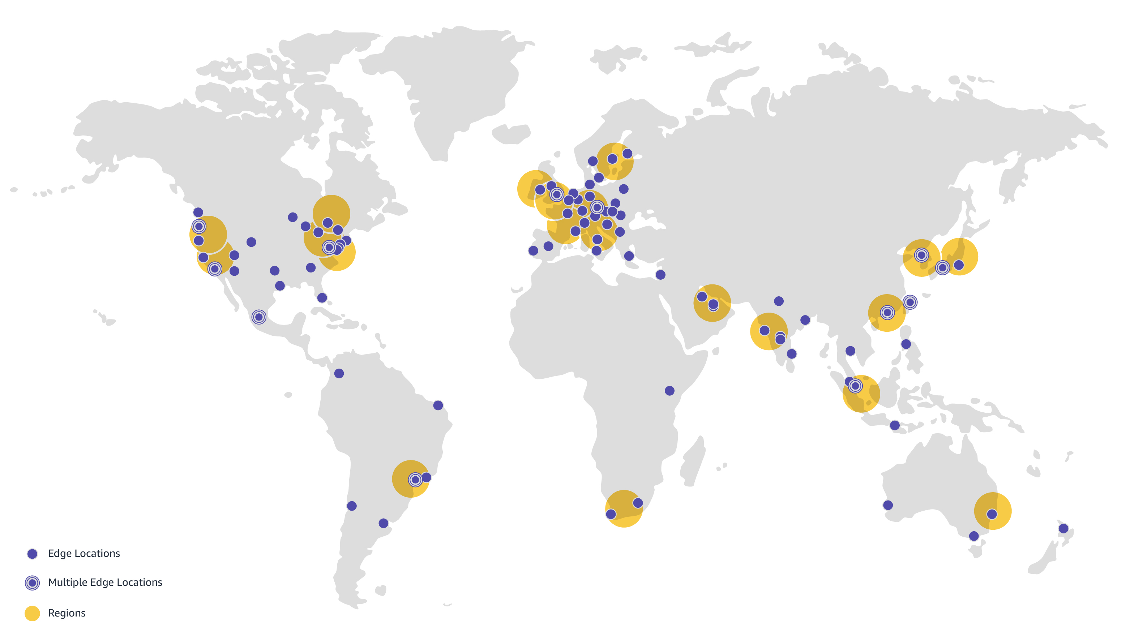
IaaS – Network & Security by Design
6

Slide 7
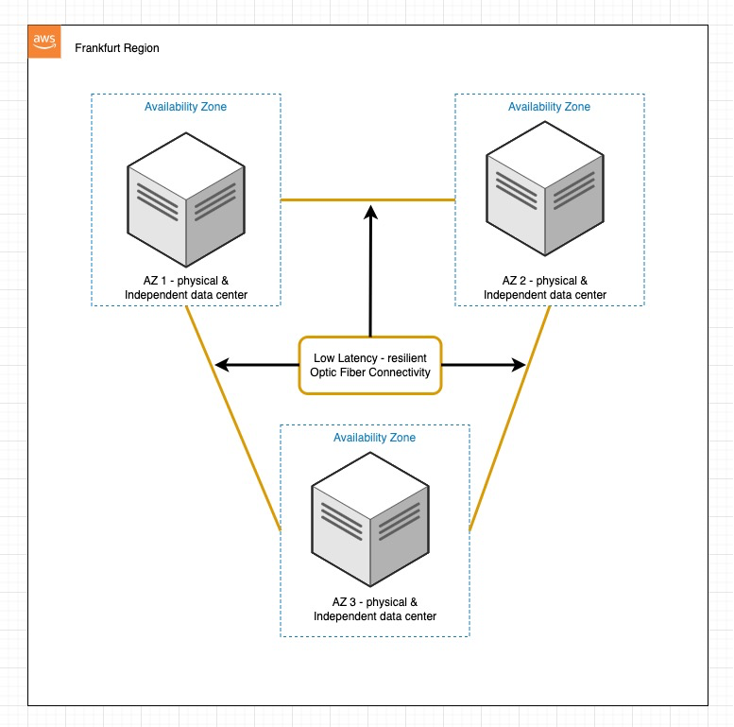
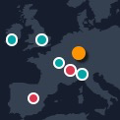
IaaS – Network & Security by Design
7

Slide 8
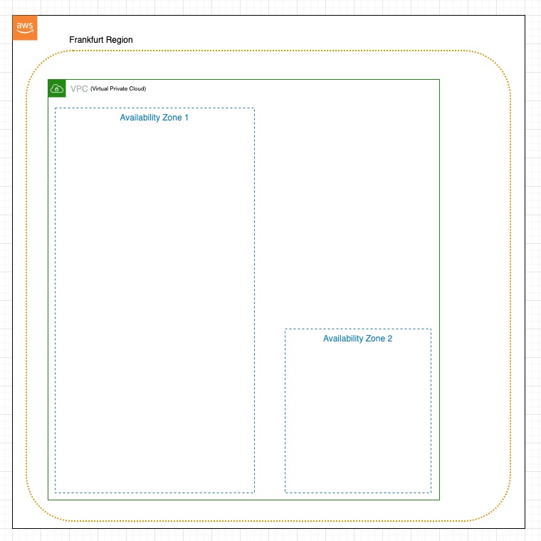
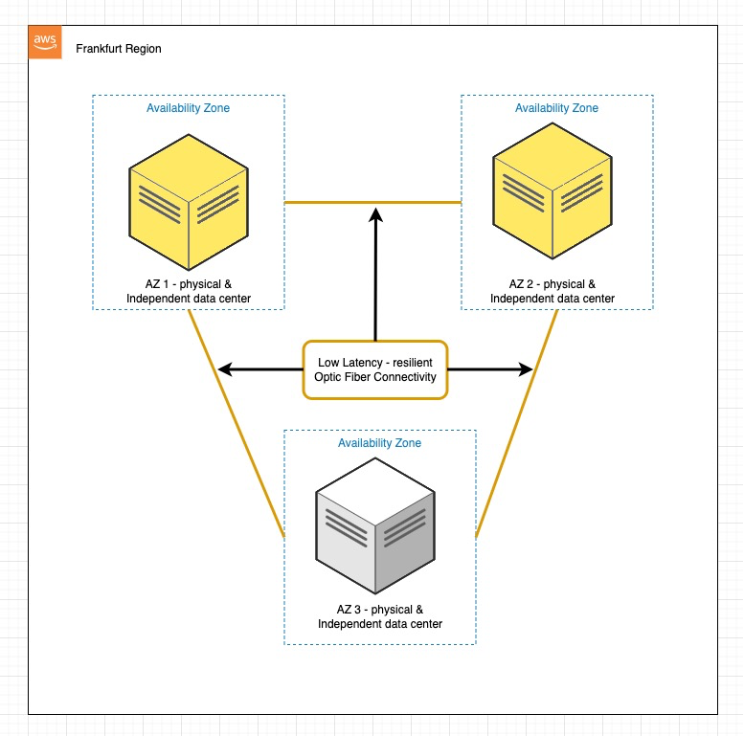
IaaS Architecture Design to Run your SaaS
A Virtual Private Cloud (VPC) is similar to a private network. It is logically isolated from other virtual networks.
You will need a VPC to add subnets, critical to deploy resources (Servers, PaaS,…).
Choose your region and setup your 1st line of defence: VPC
Your VPC will be able to cross multiple data centres in the same region
8

Slide 9
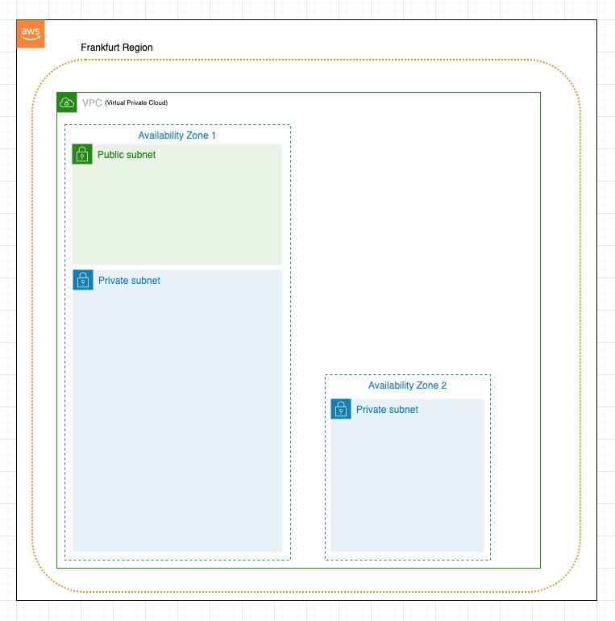
IaaS Architecture Design to Run your SaaS
A subnet allows you to launch AWS resources inside a VPC
Public Subnet
Will contain resources that users can access directly
Private Subnet
Will contain resources that users cannot access directly
Will host your most valuable workloads (applications, databases)
Setup your 2nd line of defence and what will allow you to deploy resources
9

Slide 10
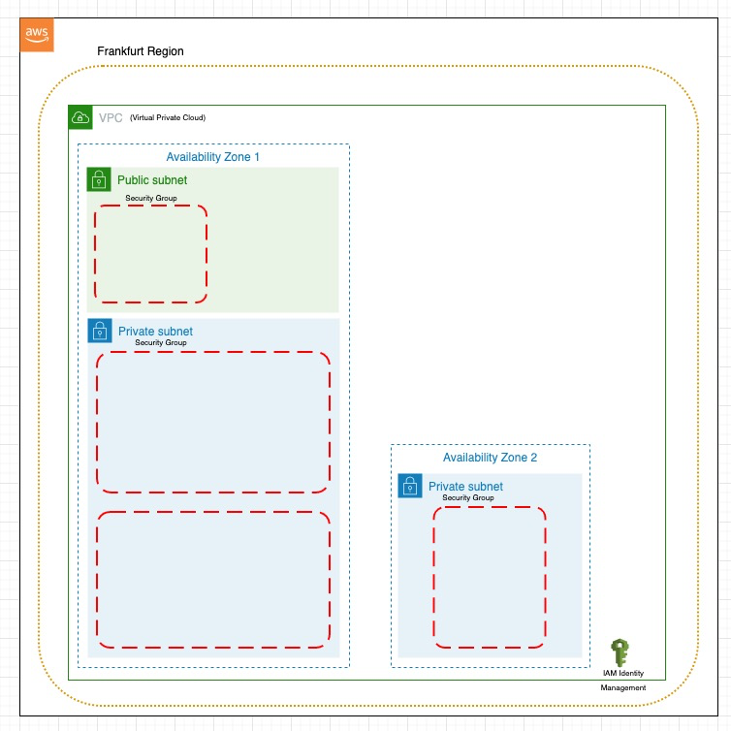
IaaS Architecture Design to Run your SaaS
A security group will allow you to set boundaries of who can access your resources
Security groups must be segregated by the resources they will welcome. This will increase the security by design of your environment
IAM – Identity Access Management
Control who can access your environment and with which privileges
Design your 3d line of defence: Security groups
10

Slide 11
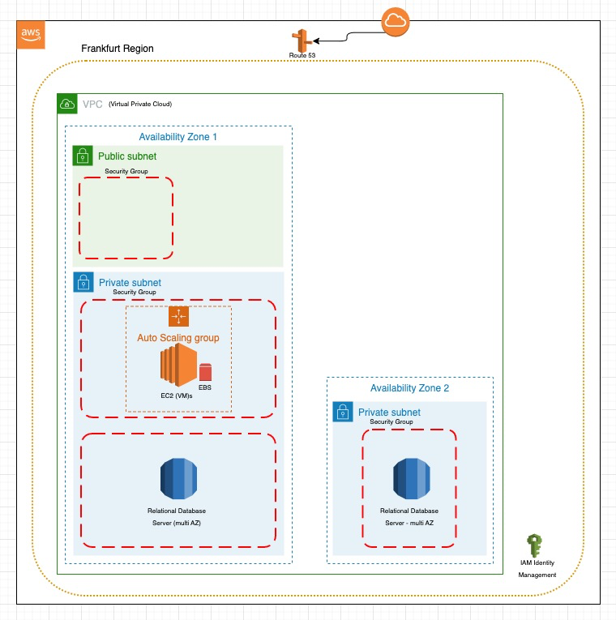
IaaS Architecture Design to Run your SaaS
Route 53 – Domain Name Server
Connect your domain name to your environment
Auto Scaling Group
Min 2, Max 4 to increase resiliency and absorb load
EC2 – Elastic Cloud Compute
Virtual Machine for your application to run
EBS - Elastic Block Storage
Persistent disk volumes, where your application will be kept (like a C: drive)
RDS - Relational DB Server
A server dedicated to your DB
Deploy your resources
Allow them to scale
Allow them to be highly available
11

Slide 12
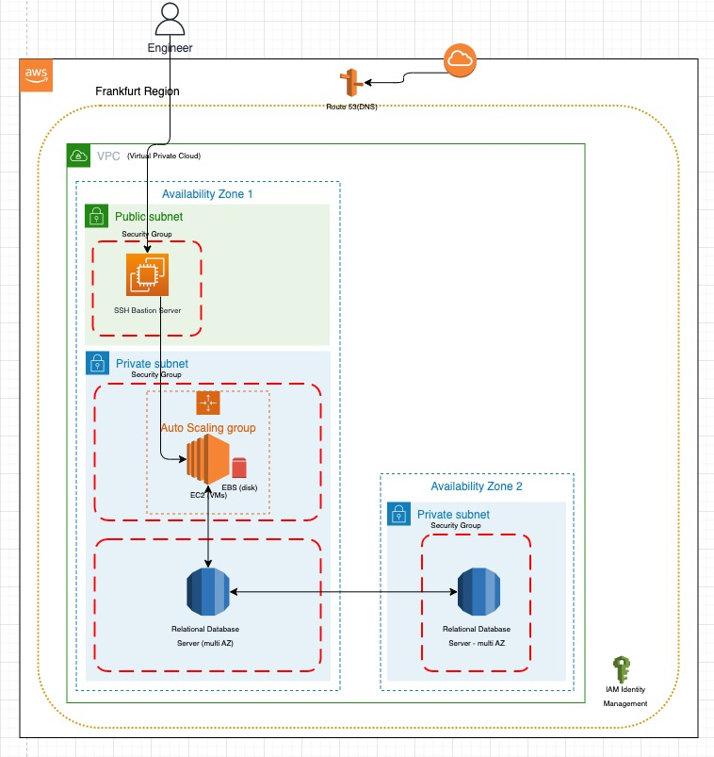
IaaS Architecture Design to Run your SaaS
Engineer Access
Bastion host to act as a gate keeper or “jump server” to enter the private subnet
Multi AZ DB setup
Your database will be automatically replicated to another DB server, this will greatly increase the reliability of your environment. In case of failure, your users will not notice anything.
Invite your team
Give access to your engineers to start working
They will have to connect to a VM in the public subnet, show clearance, to then be allowed in the Private Subnets to work on the App or DB instances
Connect your resources together
12

Slide 13
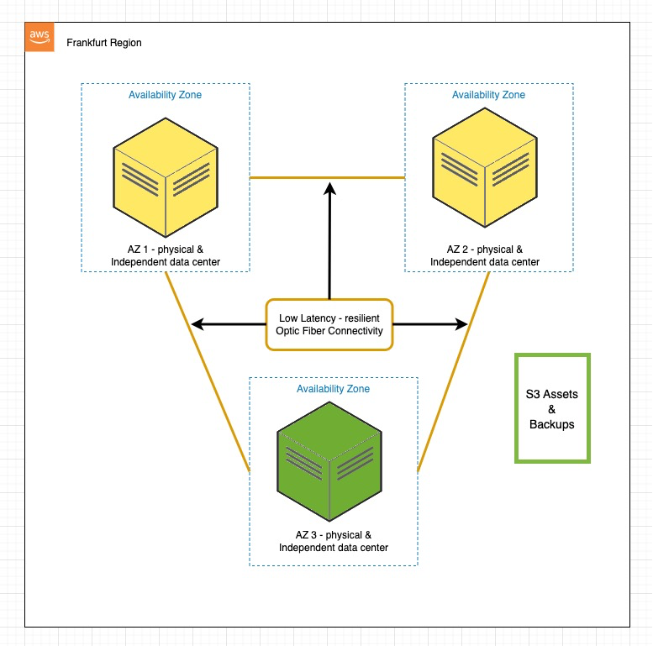
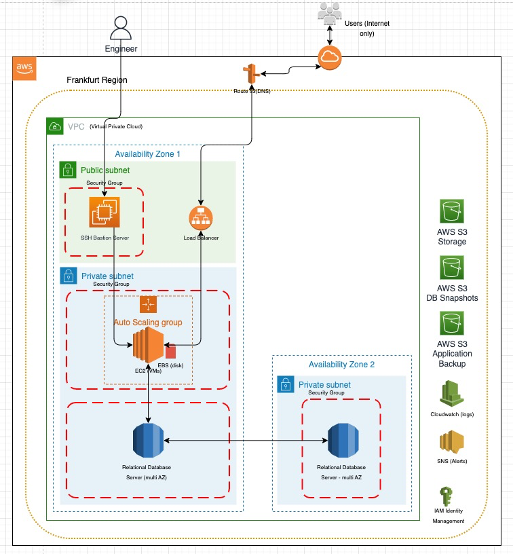
IaaS Architecture Design to Run your SaaS
S3 – Simple Storage Service
Images, back ups, log archive
S3 is resiliency is managed by AWS
Cloudwatch
Monitor all your resources
Create cron jobs to start and stop resources when required
SNS (simple notification service)
Trigger an alert whenever something does not go according to plan
Billing
Setup billing alerts
Create billing dashboards
Monitor billing
Deploy & Open your application to the world
Allow secure incoming and outgoing connectivity through an Application Load Balancer
4th level of defence
apply SSL encryption to ensure that all communication going to and out of your private subnets are encrypted
Store your web-app dynamic asset in a block storage
Cheap, reliable and convenient
Add backups for
Your machine configuration
Your application
Your database server
13

Slide 14
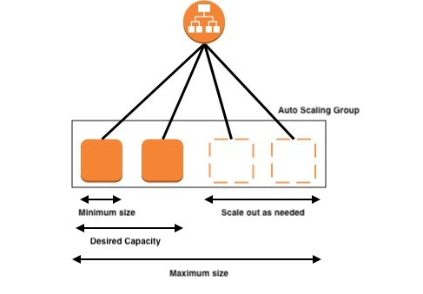
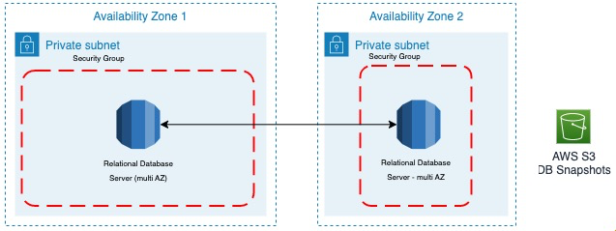
IaaS Architecture Design to Run your SaaS
Remember:
High Availability
Auto-scaling
welcome more users on the fly
If VM 1 fails, VM+1 is warm & ready
Resiliency
Cross Availability Zone replication
backup of, at least, the DB
Load Balancer
VM
VM
VM
VM
CONSTANT MONITORING
14

Slide 15
Well Architected Framework

Slide 16
Best Practices – Well Architected Framework
Operational Excellence
Support development and run workloads effectively while continuously improving processes & procedures
  Make frequent, small, reversible changes
  Refine operations procedures frequently
  Anticipate failure
  Learn from all operational failures
Remember: your application is in constant evolution, your operational team needs to be aware of the business reason of your application as well as the customers using it.
16

Slide 17
Best Practices – Well Architected Framework
Security
Protect your network, the traffic, the data, the applications, the assets
  Implement a strong identity foundation
  Enable traceability
  Apply security at all layers
  Protect data in transit and at rest
  Keep people away from data
  Prepare for security events
Remember: security starts with a posture inclined to security by design and the company culture has to be geared towards it.
17

Slide 18
Best Practices – Well Architected Framework
Reliability
Machines go down, design your environment so that it can tolerate it.
  Automatically recover from failure
  Test recovery procedures
  Scale horizontally to increase aggregate workload availability (Auto-Scaling concept)
  Stop guessing capacity
Remember: steps to implement resiliency, or the tolerance for machines to break, such as a proper disaster recovery or automated alerts are key to make your environment reliable.
18

Slide 19
Best Practices – Well Architected Framework
Performance Efficiency
Rightly size everything you need and how they will be used over time.
  Use serverless architectures
  Experiment more often
Remember: start lean, test, adapt and build on top of it when required.
Cost Optimization
Monitor your costs, fixed costs are easy to understand as they deal with a limited capacity. Variable costs are great to commercialise but are tricky to understand as they can be extremely volatile without proper preparation & control.
  Measure overall efficiency
  Analyse & attribute expenditure
Remember: know why you spend and at what pace, try & test services before validating them if possible
19

Slide 20
Best Practices – Well Architected Framework
Sustainability
This is more a discipline than a pure technical goal. Behind your VMs are a set of machines, don’t let them run for no reason.
  Use serverless architectures
  Experiment more often
Remember: select the most efficient sets of services to run your environment.
20

