Slide 1
Information Systems and IT Project Management
Manuel KOLP
manuel.kolp@uclouvain.be

Slide 2
DEVELOPMENT LIFE CYCLE

Slide 3
Systems Development Life Cycle (SDLC)
SDLC includes a systematic process of planning, designing, and creating an information system for organizations.
It is often better to have a structured methodology to avoid mishaps and coordinate the design and development tasks properly among the members of a large systems development team.
Systems Approach—Complex problems are broken up into smaller manageable problems using a systems’ hierarchy, and then developing a solution for each problem within the hierarchy.

Slide 4
Implementation Plan
Comprehensive
  Involves implementation of the full functionality of the ERP software in addition to industry-specific modules.
  Requires a high level of business process re-engineering.
Middle-of-the-Road
  Involves some changes in the core ERP modules and a significant amount of business process re-engineering.
Vanilla
  Utilizes core ERP functionality and exploits the best practice business processes built into the software.
  Business IT process (in the system) re-engineering is eliminated.
Chocolate
  Modify the system to fit the As-Is business processes

Slide 5
Implementation Methodology
An IS development life cycle provides a systematic approach to implementing the software in the changing but limited-resource organizational environment.
The traditional life cycle accomplishes one stage at a time and requires formal milestone approvals prior to moving to the next stage.
In a rapid/agile life cycle, once a company commits to the implementation, employees are empowered to make the decisions to keep the project moving forward.

Slide 6


WATERFALL vs. AGILE
WATERFALL
Waterfall is a linear approach to following the define sequence of events/ steps where each stage generally finishes before the next one can begin.
AGILE
Agile is an iterative approach where requirements and solutions evolve through the collaborative effort of self-organizing and cross-functional teams and their customer(s)/end user(s).

Slide 7
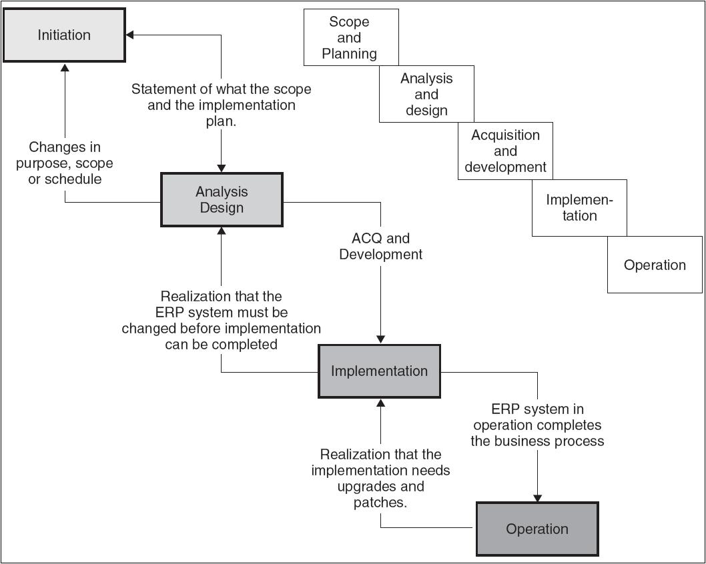
Traditional IS (ERP) Life Cycle - Waterfall

Slide 8
Traditional Life Cycle
Scope and Commitment Stage
  In addition to conducting the feasibility study, a scope of the implementation is developed within the resource and time requirement.
  Characteristics of the system implementation are defined.
  Develop a long-term vision for the new system and a short-term implementation plan and top management’s commitment.
  Vendor Selection.

Slide 9
Traditional Life Cycle (Cont’d)
Analysis and Design Stage
  A decision on the software is made and decide on consultants and SMEs.
  Analysis of user requirements.
  Map the differences between the current business process and the embedded process in the software.
  Design a change management plan, a list of embedded processes, user interface screens, and customizable reports in the software.
  Data conversion.
  System conversion.
  Training.

Slide 10
Traditional Life Cycle (Cont’d)
Acquisition & Development Stage
  Purchase the license and build the production version of the software to be made available to the end-users.
  The tasks identified in the gap analysis are executed at this stage.
  Change management team works with end-users on implementing the changes in business processes.
  Data team similarly works on migrating data from the old system to the new system.
  Finally, the system needs to be configured with proper security.

Slide 11
Traditional Life Cycle (Cont’d)
Implementation Stage
  Focus is on installing and releasing the system to the end-users and on monitoring the system release to the end-users.
  System conversion (4 Phases)
    Phased.
    Pilot.
    Parallel.
    Direct Cut or big bang.
  Feedback received from system usage needs to be funneled to the post-implementation team for ongoing system support.

Slide 12
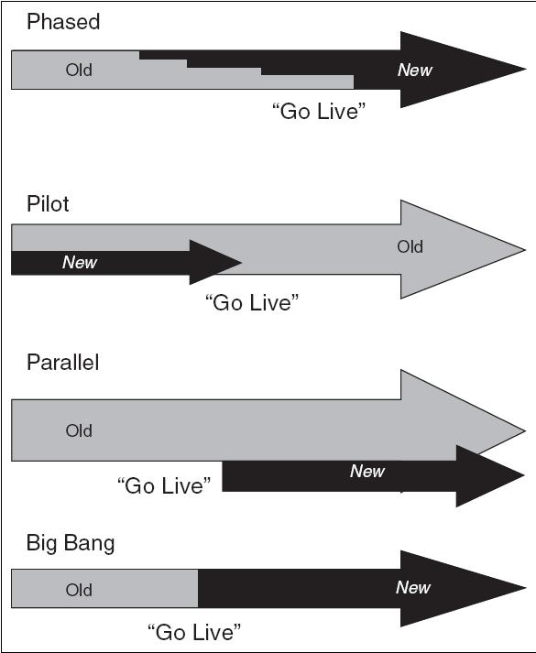
Conversion Approaches

Slide 13
Traditional Life Cycle (Cont’d)
Operation Stage
  Handover or knowledge transfer is the major activity as support for the new system is migrated to the help desk and support staff.
  Training of new users to the system as modules are released.
  Managing of new releases of the software, installation of patches and upgrades.
  Managing the software contract with the software vendor.

Slide 14
Business Process Re-engineering
A business process is defined as a set of logically related tasks performed to achieve a defined business outcome.
Re-engineering is when a business essentially dismantles existing processes into individual activities and puts them back together in a new set of business flows or sets of business flows.
Resistance to change will be high and require a significant level of change management to succeed.

Slide 15
Agile Development
Agile methodologies start with smaller sets of requirements, they start small and deliver functionality incrementally in a series of releases.
No single release covers all requirements, but every release delivers more than the previous one.
Users are able to provide feedback quickly on how the system meets their needs and also if a requirement is missing or wrong, it can be corrected quickly.
Two of the most popular implementations are:
  Scrum- Much is left up to the project team.
  Extreme programming (XP)- Stresses customer satisfaction and gives working software to the customers quickly and incorporates their feedback quickly.

Slide 16
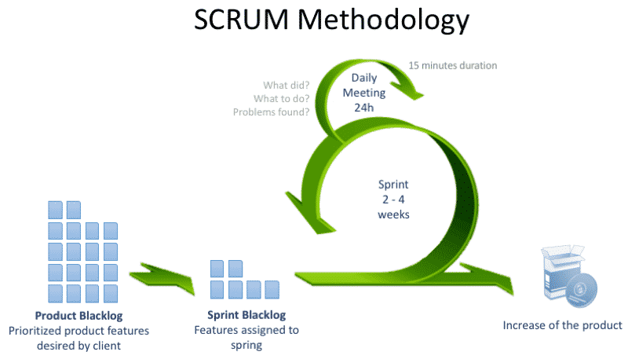
Agile Development

Slide 17
Project Management
A clear project plan and reporting structure will better ensure that the project receives the attention and accountability needed to be successful.
The project owners, a project steering committee, and project executive must develop the hierarchy and determine responsibilities.
Many businesses now have a project management organization within IT to provide the project management necessary for company projects.
The functional, technical, and change management staff for the project will likely consist of existing staff from the business, new hires, and consultants.

Slide 18
Triangle of Constraints
Quality
SCOPE
Time
Resources

Slide 19
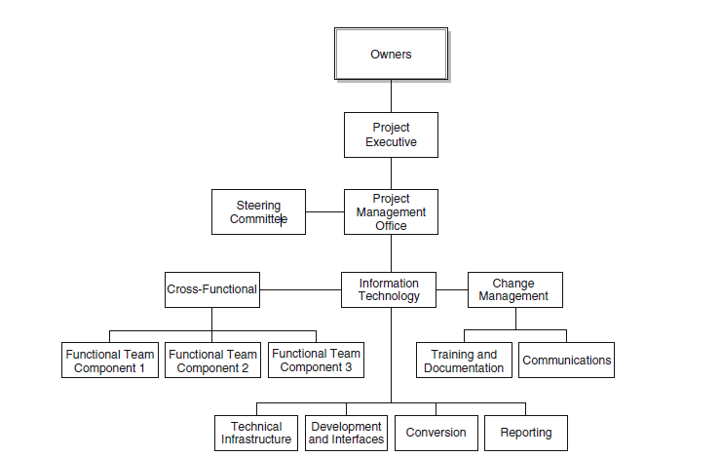
Project Organization

Slide 20
The Project Organization
Project Management Office (PMO)
Project Leads
  They provide the input to management and coordinate team activities.
Project Teams
  The Functional Team- Knowledgeable staff from each area.
  The Infrastructure Team- Implements hardware and software .
  The Development Team- Modify the software to meet the goals.
  The Conversion Team- Convert the legacy data to the new system.
  The Reporting Team- Develops a reporting framework and initial set of reports to be included in the system implementation.
  The Change Management Team- Training and communications plan for the project. Their role is to provide project implementation information to key areas within the organization.

Slide 21
Project Roles and Responsibilities
Identifying and describing roles and responsibilities for project staff is necessary to ensure there is accountability within the project.
Defining roles, often used as job descriptions on a project, will be the responsibility of the project management office.
Each member of the project team will need to know what is expected of them, who they will report to, and what they will be evaluated on.

Slide 22
Roles and Responsibilities
Owners (Consisting of Senior Management)—Determine overall policy, budget, and scope of the project.
Project Executive—Oversees project activities, provides broad project oversight, resolves policy level issues, and ensures that the project stays within scope.
Steering Committee—Oversee the project’s efforts and ensure appropriate leadership.
Application Steward—Works with the other business owners to develop an overall business direction of the system, developing consensus, and resolving functional issues raised to the steering committee.

Slide 23
Roles and Responsibilities (Cont’d)
Chairperson—Oversee the activities of the steering committee, ensuring that the committee functions in accordance with the overall project oversight. This includes budget, resources, deliverables, risk, and expectations management.
Project Management Office—Consists of the project executive, business and technical project manager(s), and the implementation partner. Manage the day-to-day aspects of the project.

Slide 24
Roles and Responsibilities (Cont’d)
Project Team Leads—Provide leadership and overall direction for the implementation, ensuring the quality of deliverables and adherence to the project plan and milestones.
  The project team leads will inform the project managers of any and all issues that are identified by their respective project team.
Cross Functional Team—The integration team will consist of the module or project team leads from the business modules and the development leads.
  This group will meet as needed to discuss and resolve cross-module issues.

Slide 25
IT Project Management Process

Slide 26
Project Characteristics
Objectives
  Clearly defined set of goals; non conflicting
Start and end points
  not a continuous activity, like operations or support
Uniqueness
  One time thing (product); not a repetitive activity
  Not production
Constraints
  Cost, schedule, quality
Source: Futrell
Notes:
A project is not like just IT support.

Slide 27
Defining IT Project Management
Software Project Management is the art of balancing competing objectives, managing risks, and overcoming constraints to successfully deliver a product which meets the needs of both customers (the payers of bills) and the users.

Slide 28
Defining Project Management
Project management is the application of knowledge, skills, tools, and techniques to project activities in order to meet or exceed stakeholder needs and expectations from a project
(Project Management Institute)

Slide 29


Management & Engineering
Planning, coordinating, leading, controlling
Focused on people, teams, products & work
Analyzing, designing, building, testing
Focused on the quality of the technical solution
Notes:
The roles of the developers and the managers are related but distinct. Often in small projects these boundaries are vague. Or a techie promoted into a manager’s position will mix things up and not do a good job at one or the other.

Slide 30
Stages in Project Control
Chaos
Controls: minimal
Mantra: Just do it!
Lifecycle: undefined
Prescriptive Control
Controls: conformance to plan
Mantra: Plan the work and work the plan
Lifecycle: Waterfall & Task-based (or WBS)
Adaptive control
Controls: conformance to acceptable results
Mantra: Embrace change
Lifecycle: iterative, feature-driven
Source: Jim Highsmith
Notes:
Our view of “control” also evolves as an organization matures. But often it get stuck in prescriptive stage, which is still the case for many large organizations

Slide 31
IT Process Basics
Lifecycle
Phases, milestone
Work products, artifacts
concrete “things” delivered or internal
Activities, task
things to do, recipes on how to do it
Workflows
meaningful sequences of activities
Roles
skills, competencies, responsibilities

Slide 32
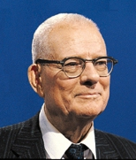
Project Management 101: PDCA
Plan
Do
Check
Act
Deming Cycle
  Deming called it Shewhart Cycle
Plan the short term objective
  Determine the time-frame
  Decide what will be needed
  Decide who is doing what
Do what the plan said
  Collect data
  Design studies or other stuff
  Train people …
W. Edward
Deming
Notes:
This was invented in the late 1930’s.

Slide 33

Project Management Body of Knowledge
PMBOK: Developed by the Project Management Institute (PMI) (USA)
Initial publication in 1987
Adopted by IEEE as IEEE 1490-1998
NOT software specific
A certification: Project Management Professional (PMP)
Source: PMI & IEEE
Notes:
This has become the main beacon, the main reference for project managers in general. It is however unfortunate that it is not quite well suited to software development, as we will see throughout the course.

Slide 34
PMBOK: Knowledge Areas
1. Project Integration management
2. Project Scope management
3. Project Time management
4. Project Cost management
5. Project Quality management
6. Project Resources management
7. Project Communication management
8. Project Risk management
9. Project Procurement management
10. Project Stakeholder management
Notes:
And we notice that MSFT did not go too far to organize the management part of MSF. The project management discipline of RUP is also heavily inspired by the PMBOK, at the outermost level.

Slide 35
Project Management Body of Knowledge
Project Integration Management
Project Scope Management
Project Time Management
Project Plan Development
Project Plan Execution
Integrated Change Control
Initiation
Scope Planning
Scope Definition
Scope Verification
Scope Change Control
Activity Definition
Activity Sequencing
Activity Duration Estimation
Schedule Development
Schedule Control
Project Cost Management
Project Quality Management
Project Human Resource Management
Resource Planning
Cost Estimating
Cost Budgeting
Quality Planning
Quality Assurance
Quality Control
Organizational Planning
Staff Acquisition
Team Development
Project Communications Management
Project Risk Management
Project Procurement Management
Communications Panning
Information Distribution
Performance Reporting
Administrative Closure
Risk Management Planning
Risk Identification
Qualitative Risk Analysis
Quantitative Risk Analysis
Risk Response Planning
Risk Monitoring & Control
Procurement Planning
Solicitation Planning
Solicitation
Source Selection
Contract Administration
Contract Closeout
Notes:
It is quite encyclopedic.

Slide 36
PMI’s PMBOK Concepts
Process Groups
Knowledge Areas
PM Processes
Plan Development
Initiating
Project Integration Management
Plan Execution
Project Scope Management
Change Control
Planning
Project Time Management
Project Cost Management
Quality Planning
Executing
Project Quality Management
Quality Assurance
Project Procurement Management
Quality Control
Controlling
Project Communications Management
Project Risk Management
Closing
Organization Planning
Project Resource Management
Staff Acquisition
Project Stakeholder Management
Team Development

Slide 37
PMI PMBOK: Focus over Time
Executing
Project Integration Mgmt
  Project Plan Execution
Project Quality Mgmt
  Quality Assurance
Level
of
Activity
Planning
Project Ressource Mgmt
  Team Development
Project Communication Mgmt
  Information Distribution
Project Procurement Mgmt
  Solicitation
  Source Selection
  Contract Admin
Initiating
Closing
Controlling
PMBOK® Guide 2000, Project Management Institute, Inc.
Phase Start
Time
Phase End

Slide 38
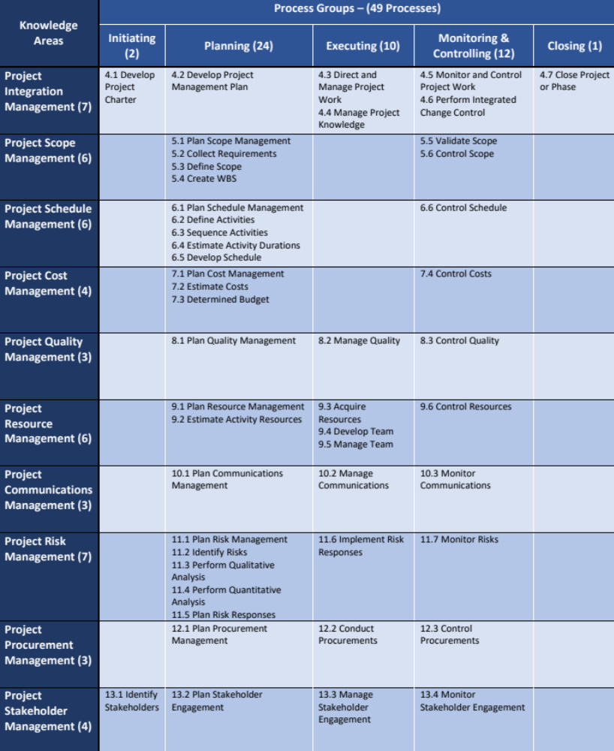
The 49 Project Management Processes as defined in the PMBOK® Guide – 6th Edition
Project Management Processes
Knowledge Areas
4. Integration
5. Scope
6. Schedule
7. Cost
8. Quality
9. Resources
10. Communication
11. Risk
12. Procurement
13. Stakeholder
Phases
Groups
Initiation
Initiating
1
1
2
Planning
Planning
1
4
5
3
1
2
1
5
1
1
24
Execution
Executing
2
1
3
1
1
1
1
10
Mon & Contr.
2
2
1
1
1
1
1
1
1
1
12
Close-out
Closing
1
1
7
6
6
4
3
6
3
7
3
4
49

Slide 39
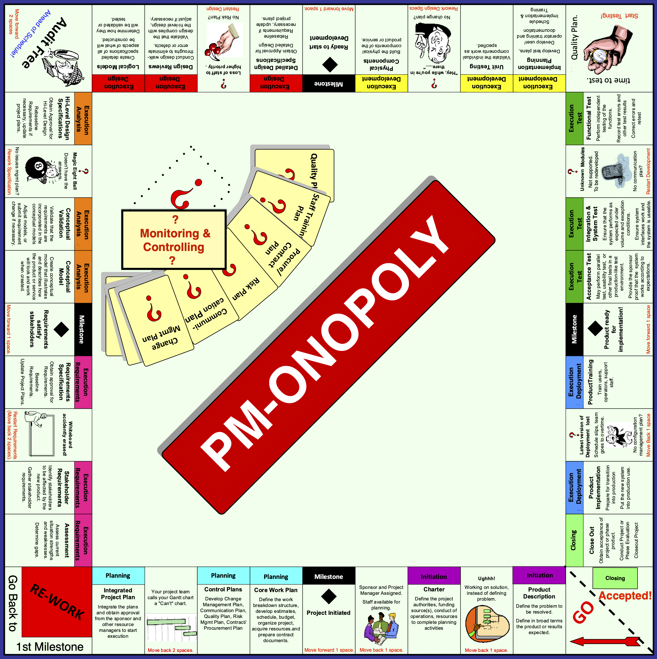
PMBOK Game
Notes:
It is quite encyclopedic.

Slide 40
Counterpoint to planning: Emergence
Agile processes:
  The requirements, the design, the process and therefore the product will gradually emerge as the project proceed.
  Very little planning, only rough sketches and envelopes at first.
  Immediate feedback allows driving the project (very short Deming cycles; few artifacts).
  Practices to support this paradigm: Test first, customer on site, Pair Programming, Scrums, Planning game, etc…
Notes:
Leading into agile processes….. from plan-driven to highly adaptive.

Slide 41
Agile Values
We have come to value:
Individuals and interactions over process and tools
Working software over comprehensive documents
Customer collaboration over contract negotiation
Responding to change over following a plan.
That is, while there is value in the items on the right, we value the items on the left more
Source: Agile Alliance
Notes:
The Agile Manifesto is quite simple, but can be interpreted way over board….

Slide 42
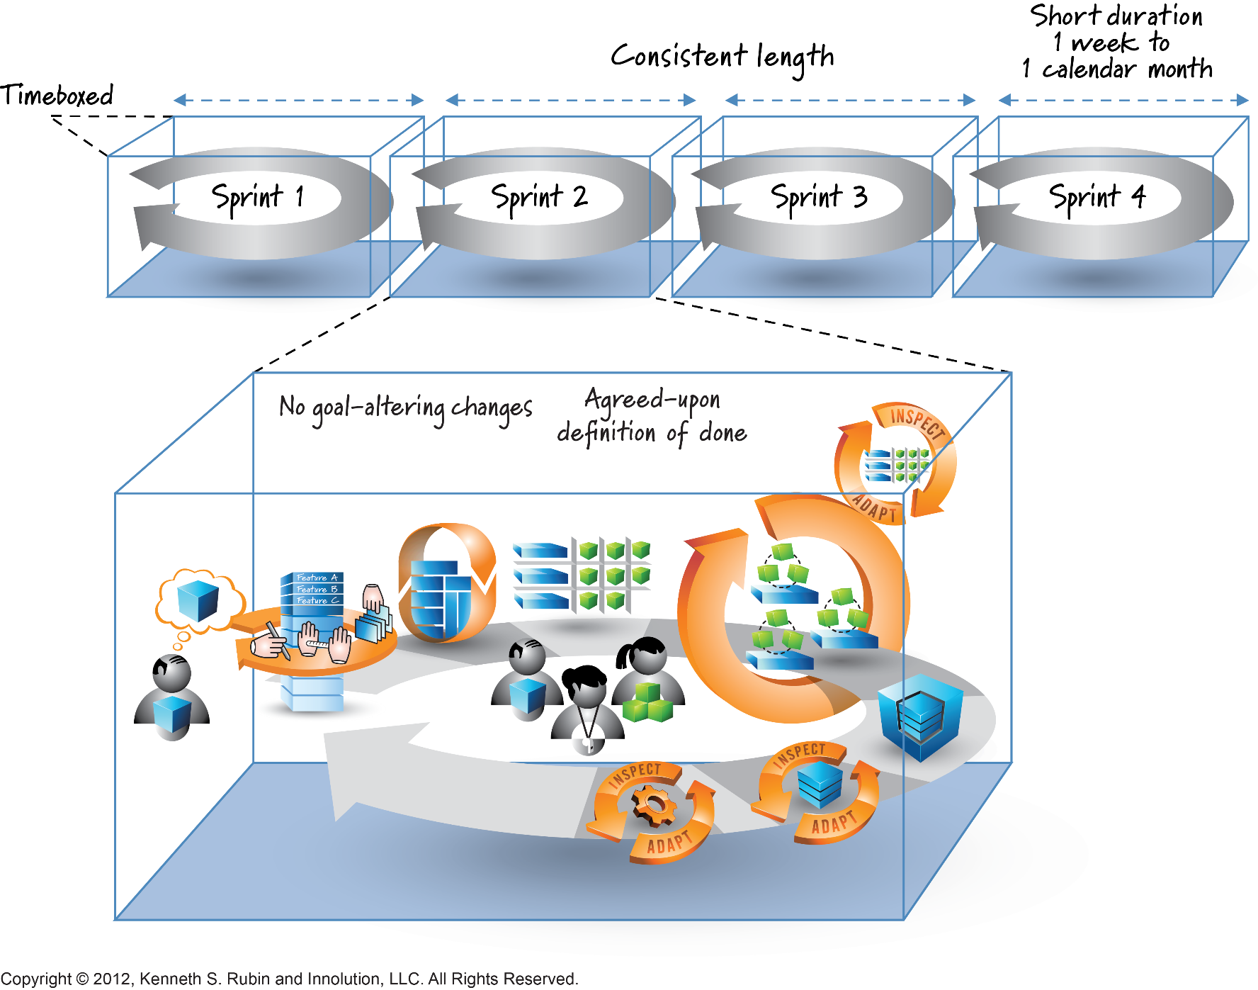
Agile Development : SCRUM

Slide 43
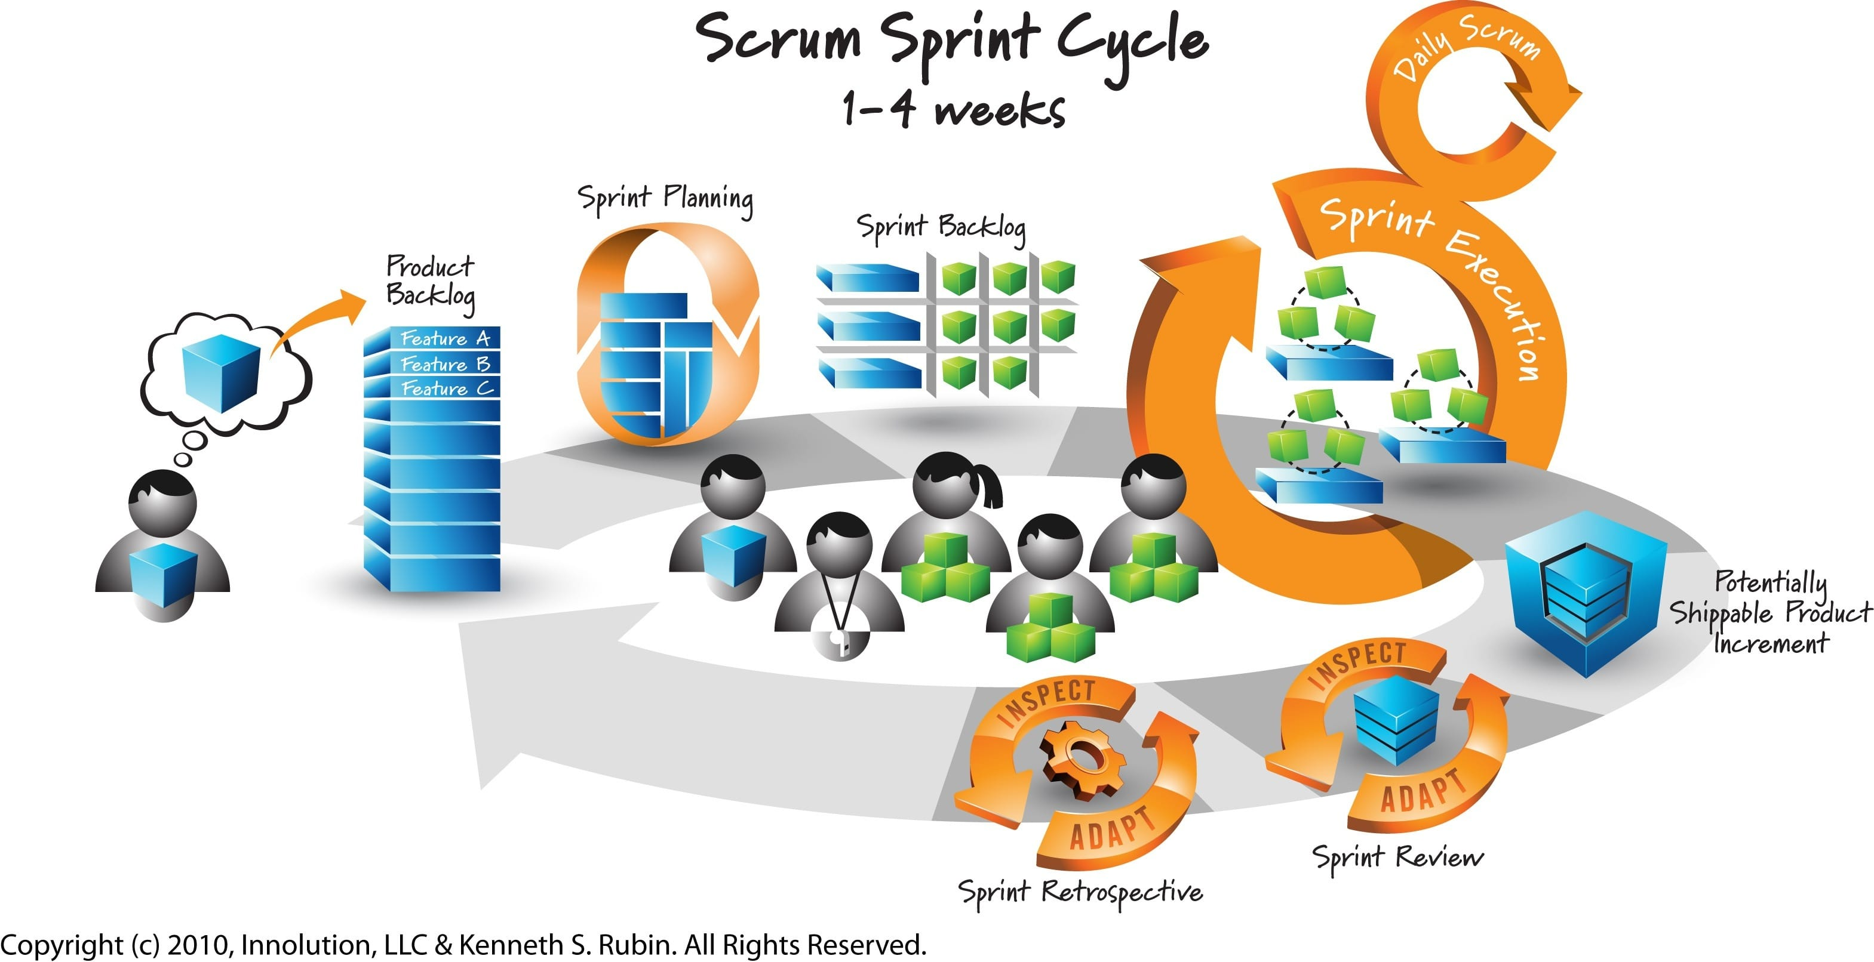
Agile with SCRUM

Slide 44
SCRUM
  Definition of Scrum
  Scrum main components
  Roles
  Artifacts
  Ceremonies
  Conclusions

Slide 45
Scrum - an agile process
SCRUM is an agile methodology, lightweight process for managing and controlling software and product development in rapidly changing environments.
  Iterative, incremental process
    Develop systems/ products rapidly and adapt to the change of the requirements
  Team-based approach
    Improve communication and maximize cooperation
  A way to maximize productivity

Slide 46
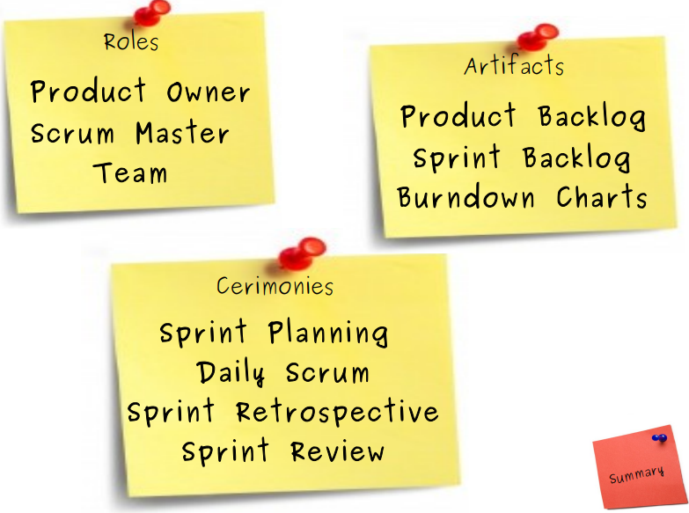
Scrum Main Components
Product Increment

Slide 47
Roles
Product owner
Scrum master
Scrum team

Slide 48
Roles: Product Owner
Knows what needs to be build and in what sequence this should be done
Writes the essential functionalities and prioritize them
Plans for the next release

Slide 49
Roles: Scrum Master
Not the same to “Project manager”
Responsible for enacting scrum values and practices
Main job is to coach the team, facilitate the process, remove impediments

Slide 50
Roles: Scrum Team
Typically 5-10 people
Cross-functional (QA, Programmers, UI Designers, etc.)
Team is self-organizing, self-motivated
Membership can change only between sprints

Slide 51
Artifacts
Product Backlog: To-do list of requirements (called user stories) i.e, everything you eventually want to build
Sprint Backlog: Smaller, specific to-do list of tasks (User Stories) the team selects from the Product Backlog to work on (analyse, design, build, test, …) during the sprint.
Product Increment: the actual, working piece of the product that is finished by the end of the sprint

Slide 52
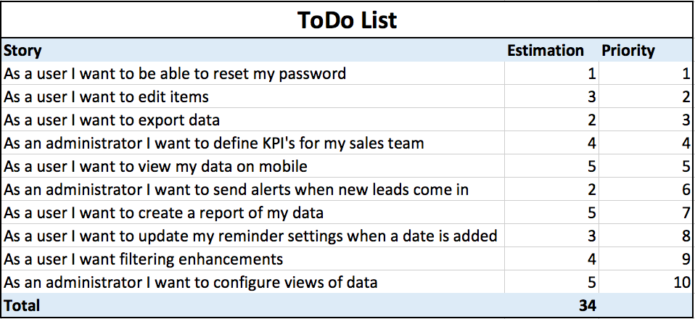
Artifacts: Product Backlog
Is a list of user stories which describe the requirements for a system
Is written and managed by the Product owner
Can be changed and re-prioritized

Slide 53
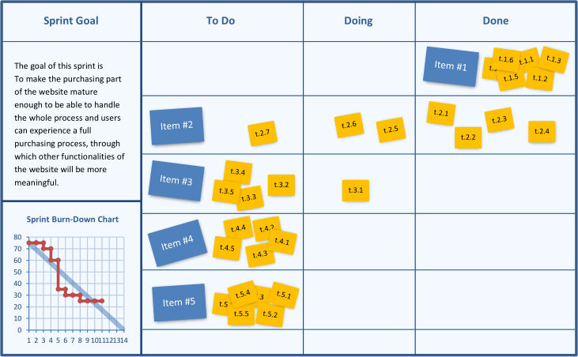
Artifacts: Sprint Backlog
Is a subset of Product Backlog to be completed within a Sprint
Is created during Sprint planning meeting
Each Item has it’s own status
Should be updated every day

Slide 54
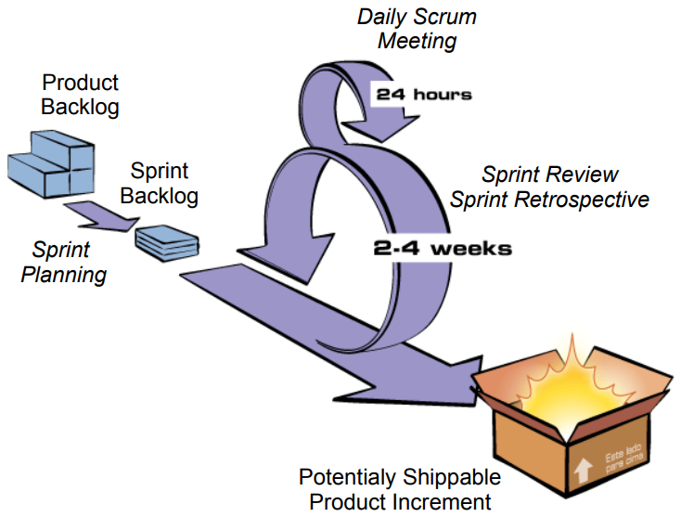
Ceremonies

Slide 55
Sprint
A 2-4 weeks-long iteration,during which specific work has to be completed and made ready for review
No outside influence can interference with the Scrum team during the Sprint
Each Sprint begins with the Sprint planning meeting

Slide 56
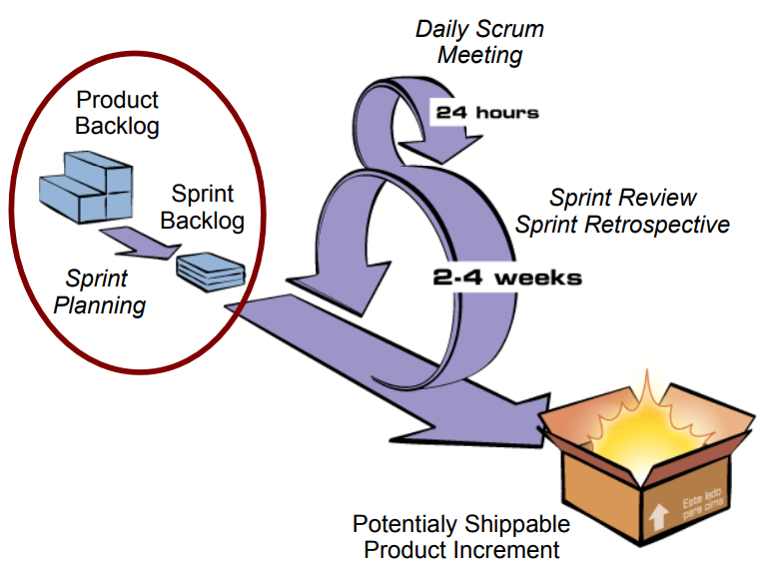
Ceremonies: Sprint Planning

Slide 57
Ceremonies: Sprint Planning Meeting
A collaborative meeting in the beginning of each Sprint between the Product Owner, the Scrum Master and the Team
Takes 8 hours and consists of 2 parts

Slide 58
Ceremonies: Sprint Planning Meeting
1st Part:
  Product owner describes what s/he wants to be built for the next sprint
  Asking and clarifying back and forth between team and product owner to drive away ambiguity
2nd Part:
  Participants: Scrum Master, Scrum Team
  Discuss how the to build the product: decomposing the product backlog items into work tasks and estimating these in hours

Slide 59
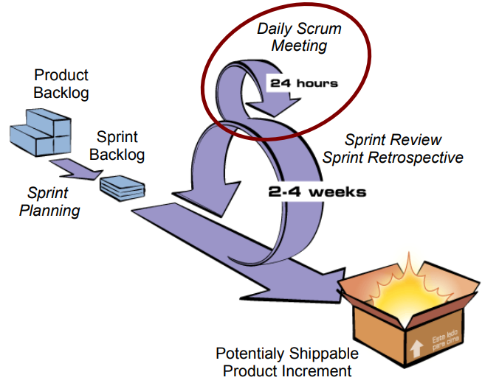
Ceremonies: Daily Scrum

Slide 60
Ceremonies: Daily Scrum Meeting
Is a short (15 minutes long) meeting, which is held every day before the Team starts working
Participants: Scrum Master (which is the organizer), Scrum Team
Every Team member should answer on 3 questions
  What did you do yesterday?
  What will you do today?
  What is blocking progress?

Slide 61
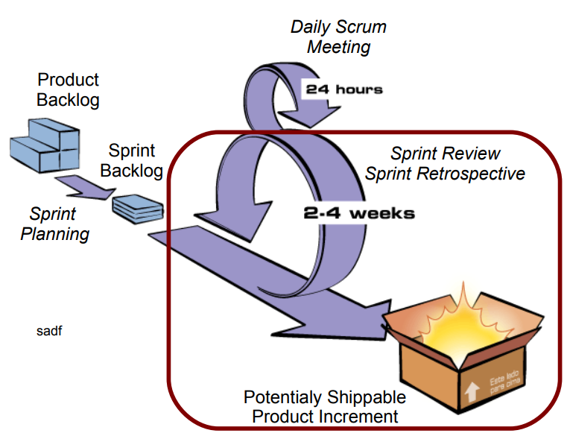
Ceremonies: Sprint Review & Sprint Retrospective

Slide 62
Ceremonies: Sprint Review Meeting
Is held at the end of each Sprint
Scrum team shows what they accomplished during the sprint to Product owner
Product Owner declares which product backlog items are done

Slide 63
Ceremonies: Sprint Retrospective Meeting
Is held at the end of each Sprint, normally after Sprint review meeting
This is the opportunity for the Scrum Team to improve by discussing on:
  What went well in the Sprint
  What could be improved
  What will we commit to improve in the next Sprint

Slide 64
Conclusion: Scrum Process in a Nutshell

