Slide 1
Information Systems and IT Project Management
Manuel KOLP
manuel.kolp@uclouvain.be

Slide 2
Enterprise Systems in Organizations
Business organizations have become very complex and their business needs can no longer be supported by one single information system.
Information Systems are a critical component of a successful organization today.
Management is generally categorized into three levels: Strategic, Mid-Management and Operational.
Information Systems provide a high level of computer automation to support business functions such as:
Accounting | Finance
Human Resource Management | Customer Service
Marketing | Operations

Slide 3
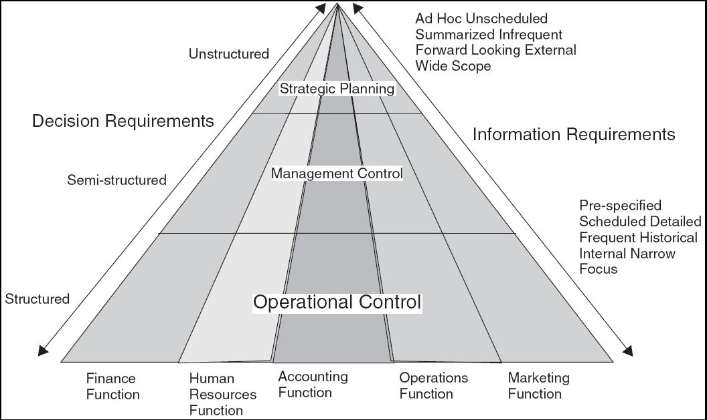
Management Pyramid with Information Requirements

Slide 4
Information Silos and Systems Integration
Over time, Information Systems create a hodgepodge of independent nonintegrated systems ultimately creating bottlenecks and interfering with productivity.
Organizations need to be agile and flexible and will require their information systems to have integrated data, applications, and resources from across the organization.
To compete effectively, organizations have to be customer focused.
  This requires cross-functional integration among the accounting, marketing and other departments of the organization.

Slide 5
Information Systems
WHAT IS AN INFORMATION SYSTEM?
Enterprise Resource Planning Systems are the first generation of enterprise systems meant to integrate data and support all the major functions of organizations.
Information systems such as ERP/E-business integrate various functional aspects of the organization as well as systems within the organization of its partners and suppliers.
The goal of an information system is to make the information flow dynamic and immediate, therefore, increasing its usefulness and value.

Slide 6
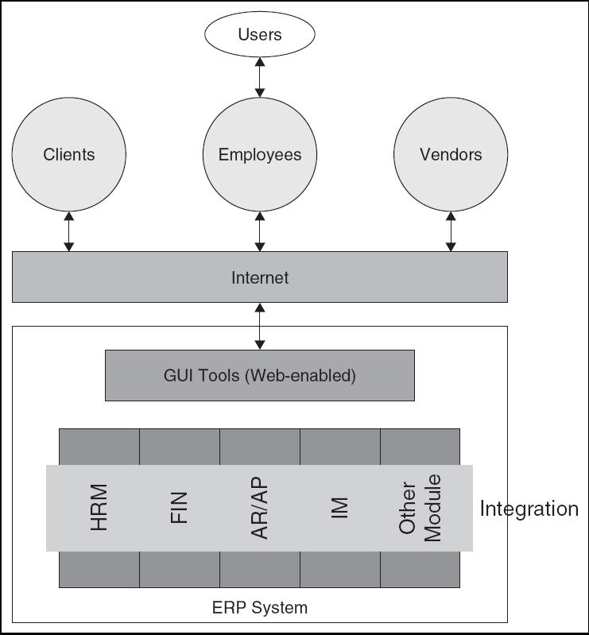
Integrated Systems

Slide 7
Business Processes and IS
A crucial role of IS in business is to better position the organization to change its business processes.
IS software have hundreds of business processes built into the logic of the system which may or may not agree with current processes of an organization.
When implementing an IS system, organizations have two choices:
  Change business processes to match the software functionality.
  Modify the IS software to match the business processes.

Slide 8
Business Processes
Examples of functional business processes
  Manufacturing and production
    Assembling the product
  Sales and marketing
    Identifying customers
  Finance and accounting
    Creating financial statements
  Human resources
    Hiring employees
Notes:
Other examples include checking the product for quality (manufacturing and production), selling the product (sales and marketing), paying creditors (finance and accounting), and evaluating job performance (human resources). You could ask students to contribute other examples of business processes and describe which of the four types they are.

Slide 9
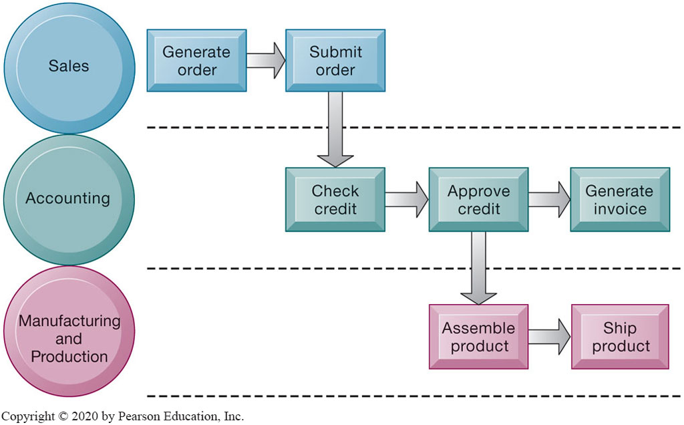
The Order Fulfillment Process
Notes:
Figure 2.1, Page 43.
Fulfilling a customer order involves a complex set of steps that requires the close coordination of the sales, accounting, and manufacturing functions.
Emphasize that each rectangle represents one part of the larger business process of order fulfillment. Notice that this business process spans several different functional areas of the business from sales (orders), to accounting, to manufacturing. Important business processes typically span several different functional areas or divisions in a business.
Full description: A diagram depicts the steps on three different levels that are involved in an order fulfillment process. The first level is labeled, Sales, and the following items are listed. Generate order, Submit order. The next level is labeled, Accounting, and the following items are listed. Check credit, Approve credit, Generate invoice. From the, Approve credit, step of, Accounting, the process also proceeds to the Manufacturing and Production level, under which the following items are listed. Assemble product, Ship product.

Slide 10
Info Systems Components
An info system consists of:
Hardware | Servers and peripherals
Software Process | Operating systems and database
Information | Organizational data from internal and external sources
Process | Business processes, procedures, and policies
People | End users and IT staff

Slide 11
Architecture
The architecture of an info system influences the cost, maintenance, and the use of the system.
A flexible architecture is best – it allows for scalability as needs change and grow.
A system’s architecture is a blueprint of the actual system and helps the implementation team build the system.
If purchased, system architecture is often driven by the vendor but other IT architectures are driven by organizational strategy and business processes.

Slide 12
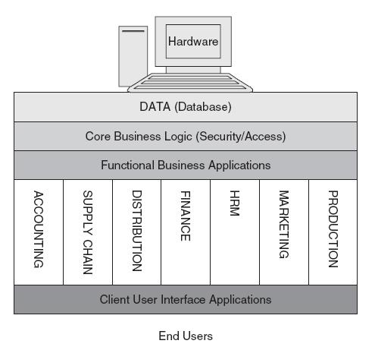
Architecture

Slide 13
Benefits of an Info System
Integration of data and applications across functional areas (i.e., data can be entered once and used by all applications; thus improving accuracy and quality of the data).
Improvements in maintenance and support as IT staff is centralized.
Consistency of the user interface across various applications means less employee training, better productivity, and cross-functional job movements.
Security of data and applications is enhanced due to better controls and centralization of hardware.

Slide 14
Limitations of an Info System
Complexity of installing, configuring, and maintaining the system increases, thus requiring specialized IT staff, hardware, and network facilities.
Consolidation of IT hardware, software, and people resources can be cumbersome and difficult to attain.
Data conversion and transformation from an old system to a new one can be a tedious and complex process.
Retraining of IT staff and end users of the new system can produce resistance and reduce productivity.

Slide 15
Intelligent Techniques
Neural networks
  Find patterns and relationships in massive amounts of data too complicated for humans to analyze
  “Learn” patterns by searching for relationships, building models, and correcting over and over again
  Humans “train” network by feeding it data inputs for which outputs are known, to help neural network learn solution by example
  Used in medicine, science, and business for problems in pattern classification, prediction, financial analysis, image/video recognition, mobility, and control and optimization , … and of course GenAI (Transformer), LLM (Large Language Models)
Notes:
This slide discusses a fourth intelligent technique, neural networks. Ask students whether neural networks could be used in medical diagnosis? How would this work? To some extent, data mining techniques have replaced neural networks in situations requiring pattern recognition. For instance, credit card companies sift through mountains of transaction data to identify which charging patterns are unlikely for each and every charge card customer.
15

Slide 16
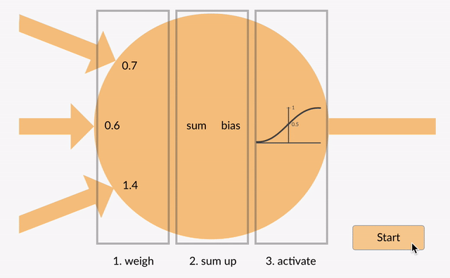
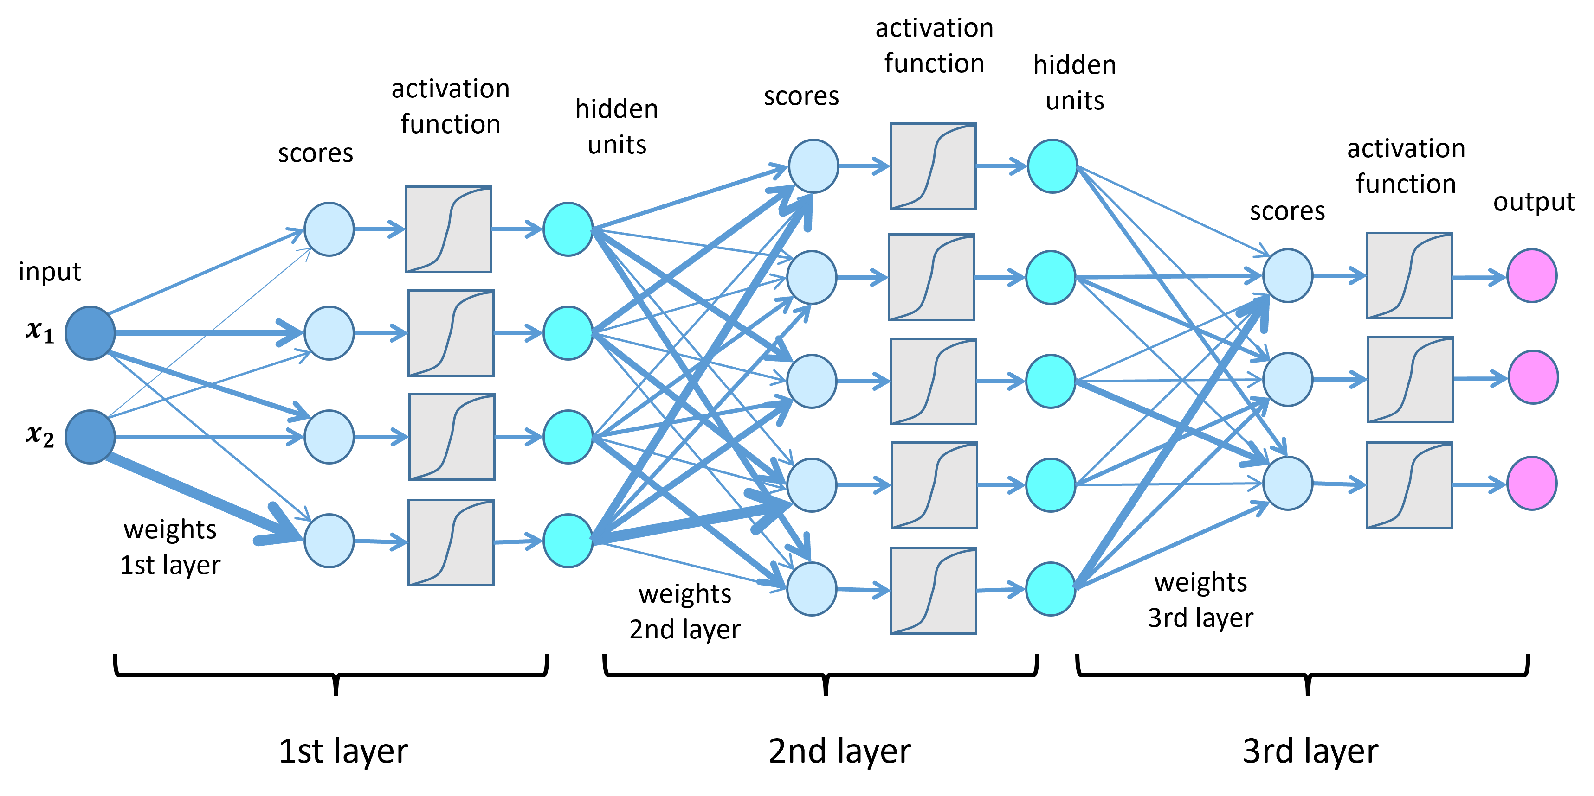
Artificial Neural Networks

Slide 17
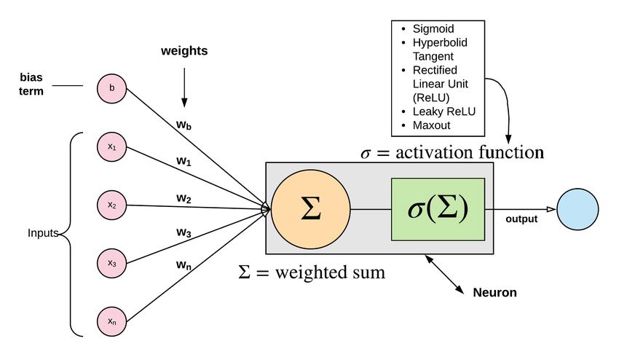
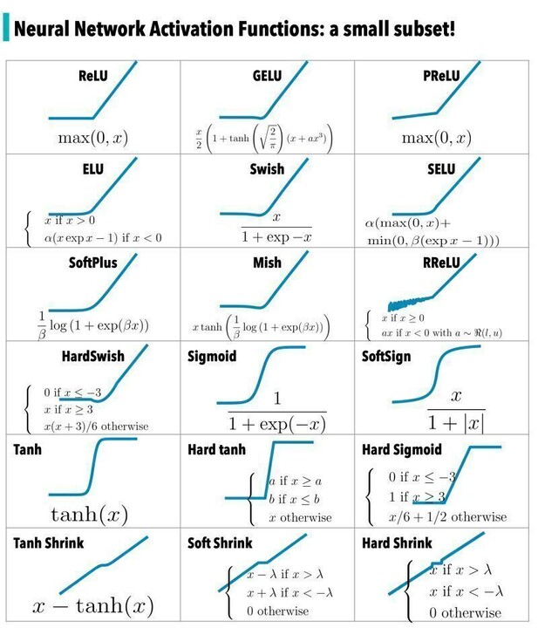
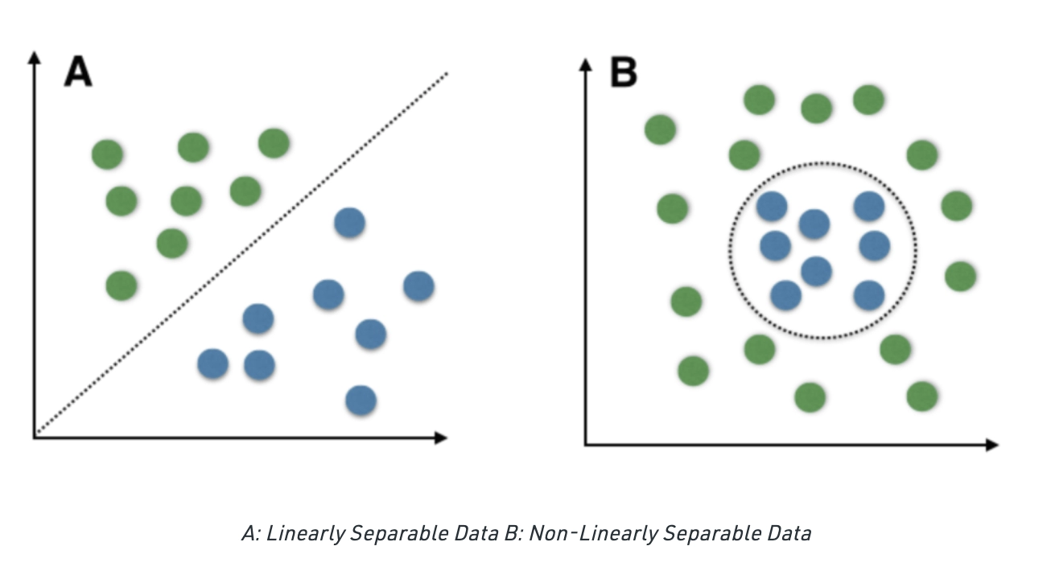
Layers and Non-Linear Activation
Why Non-Linear Activation?

Slide 18
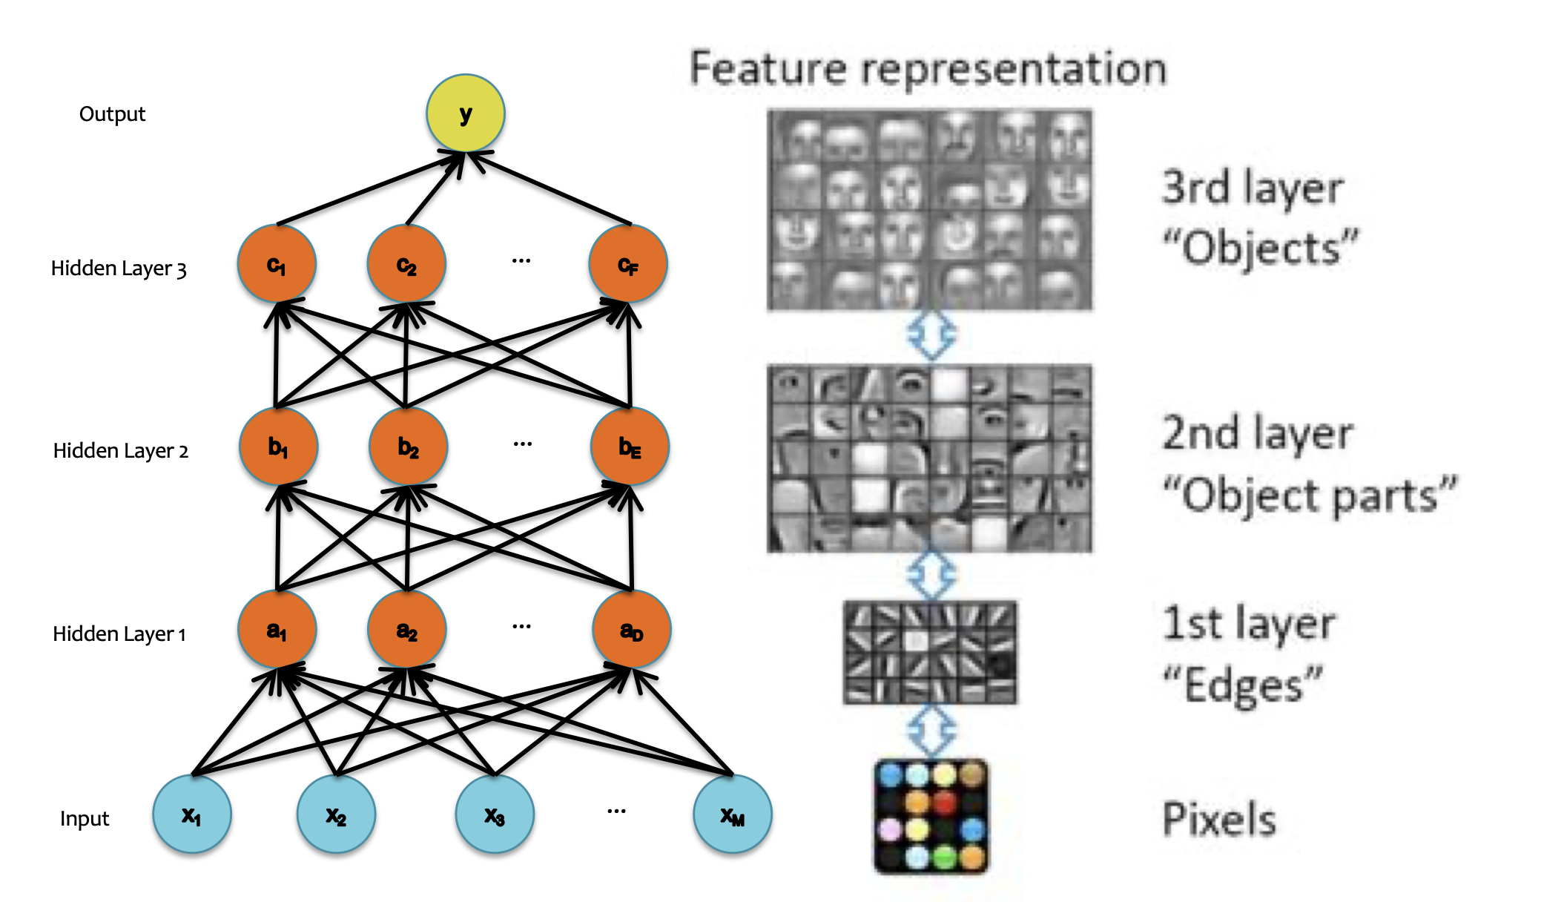
Model vs Human Interpretation

Slide 19
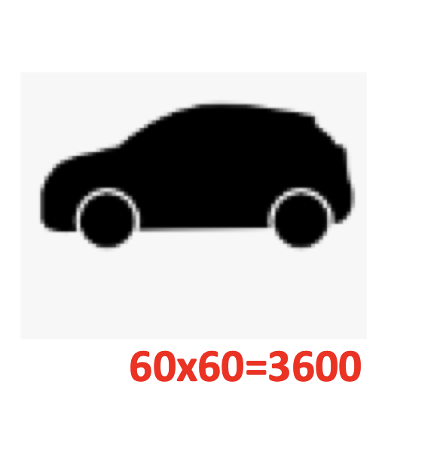
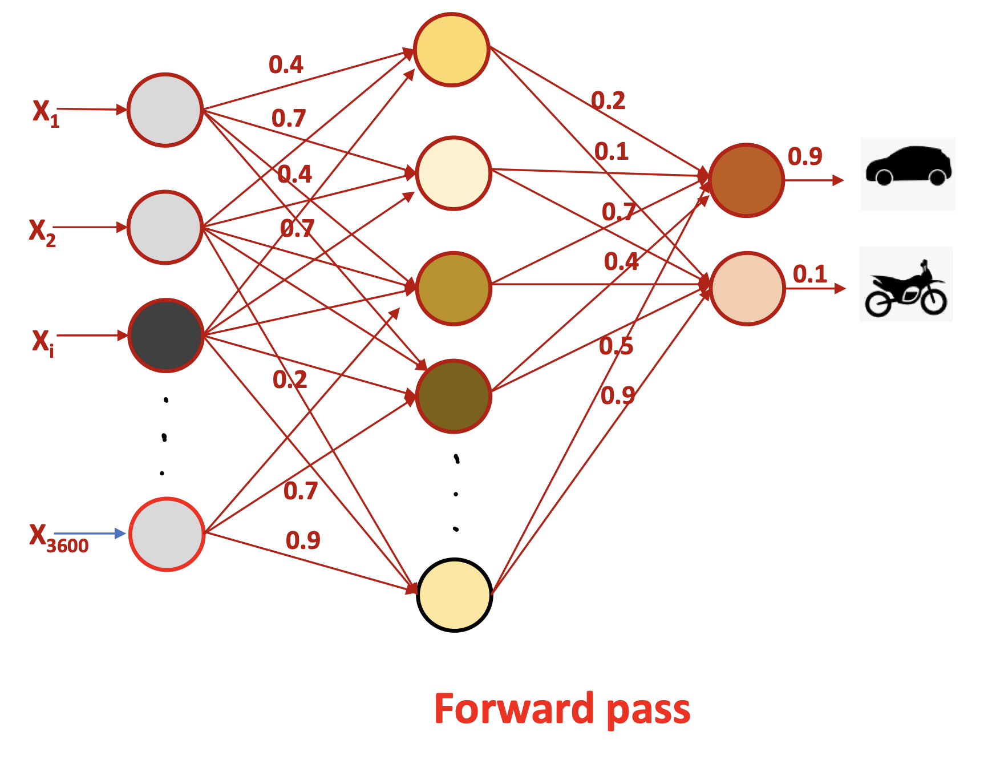
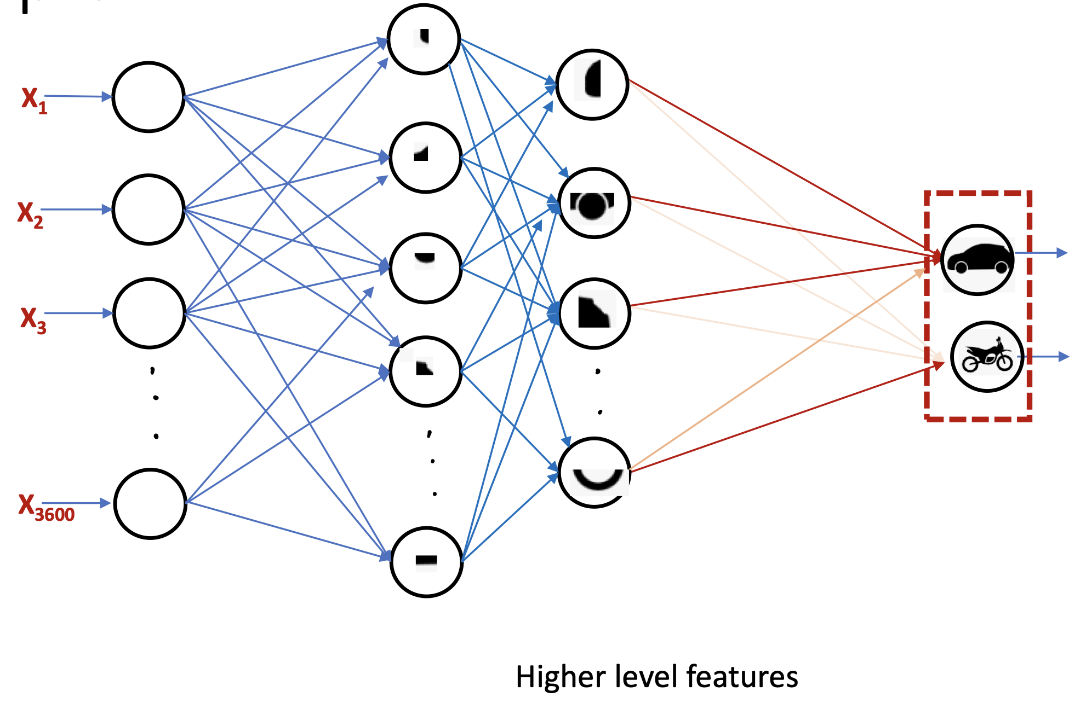
Numerical Representation vs Human Interpretation

Slide 20
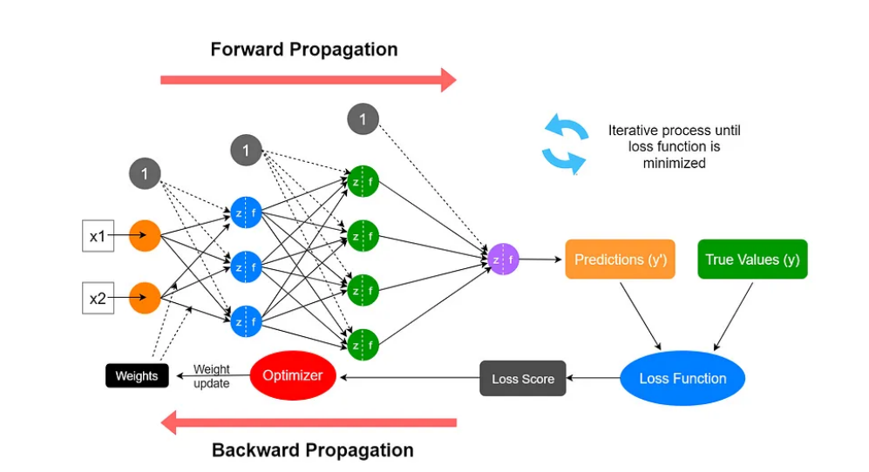
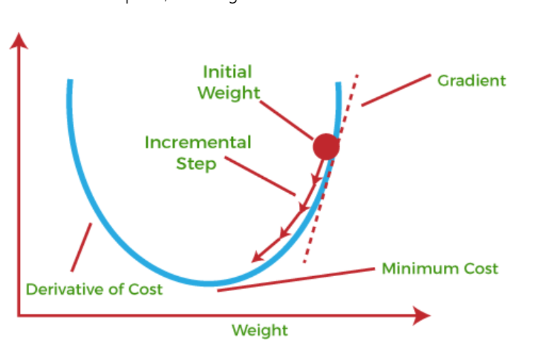
Back Propagation

Slide 21
SYSTEMS INTEGRATION

Slide 22
Components of the Enterprise Systems Architecture
Functional
  Defines the ERP modules that support the various business functions of the organization. Examples include:
    Accounting
    Human Resources
    Procurement
    Fulfillment
    Etc.
System
  Defines the architecture through the physical components of hardware, software, and networking angle.

Slide 23
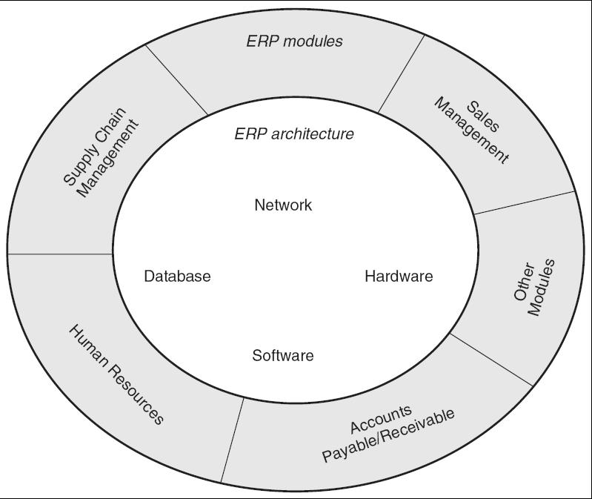
Enterprise Systems Architecture (ESA) Model

Slide 24
Functional Modules
The key role of an info system is to provide support for such business functions as accounting, sales, inventory control, and production.
Vendors, including SAP, Oracle, and Microsoft, Odoo etc. provide modules that support the major functional areas of a business.
The ERP software embeds best business practices that implement the organization’s policy and procedure via business rules.

Slide 25
Overview of Modules
Production
  Helps in the planning and optimizing of the manufacturing capacity, parts, components, and material resources using historical production data and sales forecasting.
Purchasing
  Streamlines the procurement process of required raw materials and other supplies.
Inventory Management
  Facilitates the processes of maintaining the appropriate level of stock in a warehouse.

Slide 26
Overview of Modules (Cont’d)
Sales and Marketing
  Implements functions of order placement, order scheduling, shipping, and invoicing.
Finance
  Can gather financial data from various functional departments and generate valuable financial reports.
Human Resource
  Streamlines the management of human resources and human capitals.
Miscellaneous Modules
  Nontraditional modules such as business intelligence, self-service, project management, and e-commerce.

Slide 27
IS Architecture
Ifo system architecture is organized in layers or tiers to manage system complexity in order to provide scalability and flexibility.
Web or 4-layer architecture (the most reliable, flexible, and scalable architecture) is the most prevalent today and includes:
  Clients
  Web Servers.
  Application Servers.
  Database Servers.

Slide 28
Three-Tier Architecture
Most of the current ERP implementations follow a three-tiered architecture, which consists of a Client tier, an application tier, and a data tier.
Benefits
  Scalability - Easier to add, change, and remove applications.
  Reliability - Implementing multiple levels of redundancy.
  Flexibility - Flexibility in partitioning is very simple.
  Maintainability - Support and maintenance costs are less on one server.
  Reusability - Easier to implement reusable components.
  Security - IT staff has more control system to provide higher security.
Limitations
  Can be very expensive and complex.

Slide 29
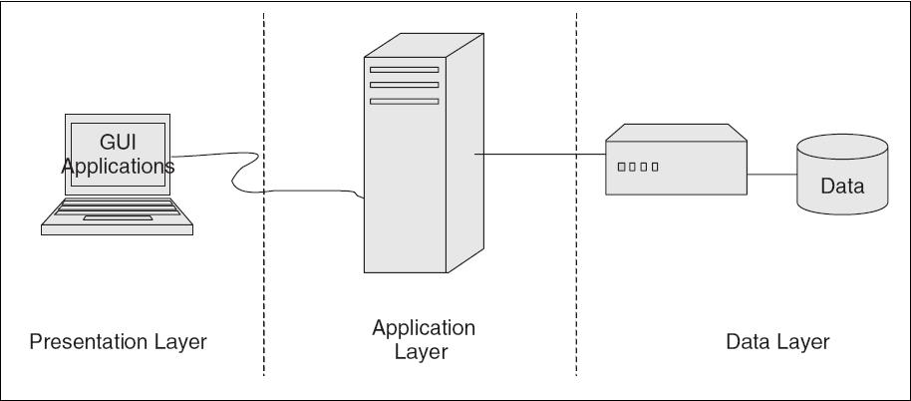
Figure 3-4 A Three-Tier ERP Architecture

Slide 30
4-Tiers = Web
Client Tier = 90% is a web browser
The Web/internet Tier
  Web-based portal allows users the ability to access and analyze information through their Web browser.
The Application Tier
  Consists of a Web Application servers and reporting tool where business processes and end-users interact with the system.
  It shields the business users from the inner workings of an ERP system, but still provides the information relevant to their job and business process.
The Data Tier
  Focus is on structure of all organizational data and its relationships with both internal and external systems.

Slide 31
Benefits and Drawbacks
Benefits
  Large numbers of end-users have access to ERP applications over the Web.
  Easily integrate ERP applications with existing systems.
  Server-centric—No complex, expensive client software installation.
  The server-centric architecture enables secure end-user access to ERP application.
  Client-centric—Architecture has better response time because user requests are mostly processed on the client’s computer.
  Web-based architectures also allow better system-to-system integration.
Drawbacks
  Client-centric architectures lack security.
  Server centric is slower.

Slide 32
Service-Oriented Architectures
Also known as object-oriented architectures for Web platforms.
Breaks the business tier into smaller, distinct units of services, collectively supporting an ERP functional module.
Allows message interaction between any service consumer and service provider.
A consumer from a device using any operating system in any language can use this service.

Slide 33
Benefits of Service-Oriented Architectures
Business-level software services across heterogeneous platforms.
Complete location independence of business logic.
Services can exist anywhere (any system, any network).
Loose coupling across application services.
Granular authentication and authorization support.
Dynamic search and connectivity to other services.
Enhances reliability of the architecture.
Reduces hardware acquisition costs.

Slide 34
Drawbacks of Service-Oriented Architectures
SOA implementations are costly and time-consuming.
Requires complex security firewalls in place to support communication between services.
Performance can be inconsistent.
Requires enterprise-level focus for implementation to be successful.
Security system needs to be sophisticated.
Costs can be high because services needs to be junked very often.

