Slide 1

Digital Transformation Management & Digital Business Systems
INTRODUCTORY LECTURE
Jérôme Coenraets

Slide 2
OUTLINE
Organization of the course
Odoo Education Program
Key Concepts in Enterprise Information Systems
Today’s Digital Landscape

Slide 3




About Me - ITC Infotech Overview…founded in 2000
13,000+ employees
60+ Fortune 500 Clients
One of the fastest growing and profitable IT Services organizations worldwide
Business outcome focused with end-to-end technology capabilities
Operations in 41 Countries
Top 10 Clients with us for 5+ years
Providing Business-led Technology Solutions to Marquee Customers across the world & across Industry clusters
Industry Cluster Focus
Geographic Focus
Manufacturing and CPG
BFS and Healthcare
Travel and Hospitality
Americas
Europe
APAC, MEA & India

Slide 4
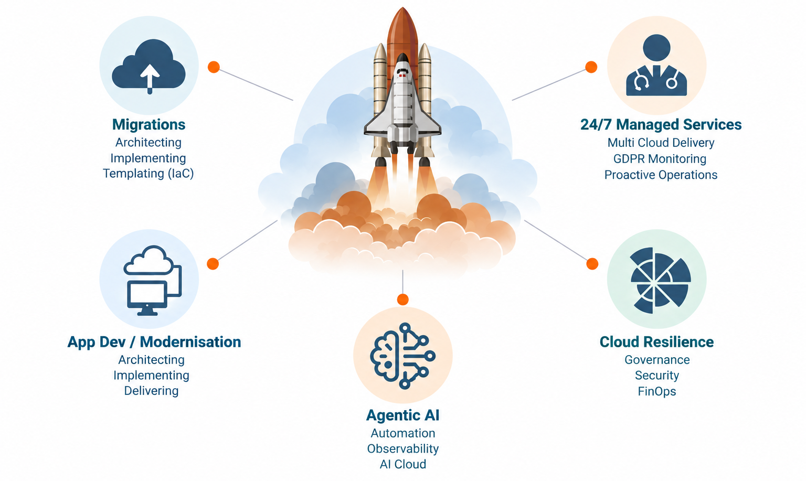
My Areas of Focus
15+ Years
Enterprise Cloud & Tech Strategy
Advisory & Digital Transformation
EXECUTIVE LEADERSHIP
Industry Track & Experience
Cloud Practice Head (EU/UK): Leading cloud consulting, architecture & enterprise delivery at ITC Infotech / Blazeclan.
Enterprise Advisory: Guiding European CXOs and global leaders on large-scale cloud migrations (7 Rs framework) & multi-cloud.
Modern Capabilities: Deep expertise in Cloud Migration, DevSecOps, Cloud Native apps, and Enterprise Data & AI strategy.
Industry Recognition: Multiple AWS Partner of the Year recognitions and driving agile business growth across Europe.
GET IN TOUCH: jerome.coenraets@uclouvain.be • linkedin.com/in/jcoenraets
4

Slide 5
Objective of the Course
Understanding what is happening under the hood
01
02
03
CLOUD FUNDAMENTALS
FROM TOOL TO ACTOR
THE MODERN MANAGER
Democratized access to technology and scale
Agentic AI changes the role of technology
Build practical technological literacy
Understand the basic foundations behind modern cloud computing
Technology can increasingly reason, decide and act — not simply execute
Understand and appreciate what the digital world can offer — and how to govern it
UNDERSTAND THE FOUNDATION → APPRECIATE THE POSSIBILITIES → MANAGE THE TRANSFORMATION
5

Slide 6
Today’s Digital Landscape

Slide 7
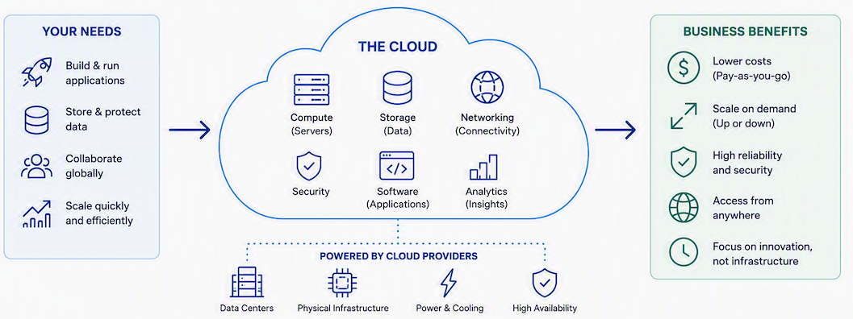
What is Cloud Computing?
Cloud computing: is the delivery of computing services-such as servers, storage, databases, networking, software, and analytics-over the internet.
Anyone can build, run, and scale applications without managing physical infrastructure.
7

Slide 8
AI Shaping Cloud Infrastructure by 2030
By 2030, AI requirements will push customers to move towards multi cloud strategies and address key questions on digital sovereignty
Metric / Horizon
Current State
2030 Projection
Strategic Implication
Industry AI Agents
<10% adoption
→
>80% enterprise deployment
AI shifts to industry-specific autonomous agents
Multi-Cloud Model Operations
Fragmented / Single-cloud focus
→
>60% intensive AI workloads
AI workloads span multiple hyperscalers by default
Data Center Energy Demand
Baseline 2026 consumption
→
More than 3x increase
Re-architect power distribution and cooling
AI Compute Optimization Penalty
Variable efficiency
→
>50% cost penalty
Failure to optimize compute overpays by over half
Digital Sovereignty Strategies
Emerging / Ad hoc
→
>75% enterprise adoption
Sovereignty drives hosting choices
https://www.gartner.com/en/newsroom/press-releases/2025-09-24-ai-enabling-cloud-services-are-the-future-of-cloud
https://www.gartner.com/en/newsroom/press-releases/2026-06-10-gartner-says-data-center-electricity-demand-to-grow-26-percent-in-2026
8

Slide 9
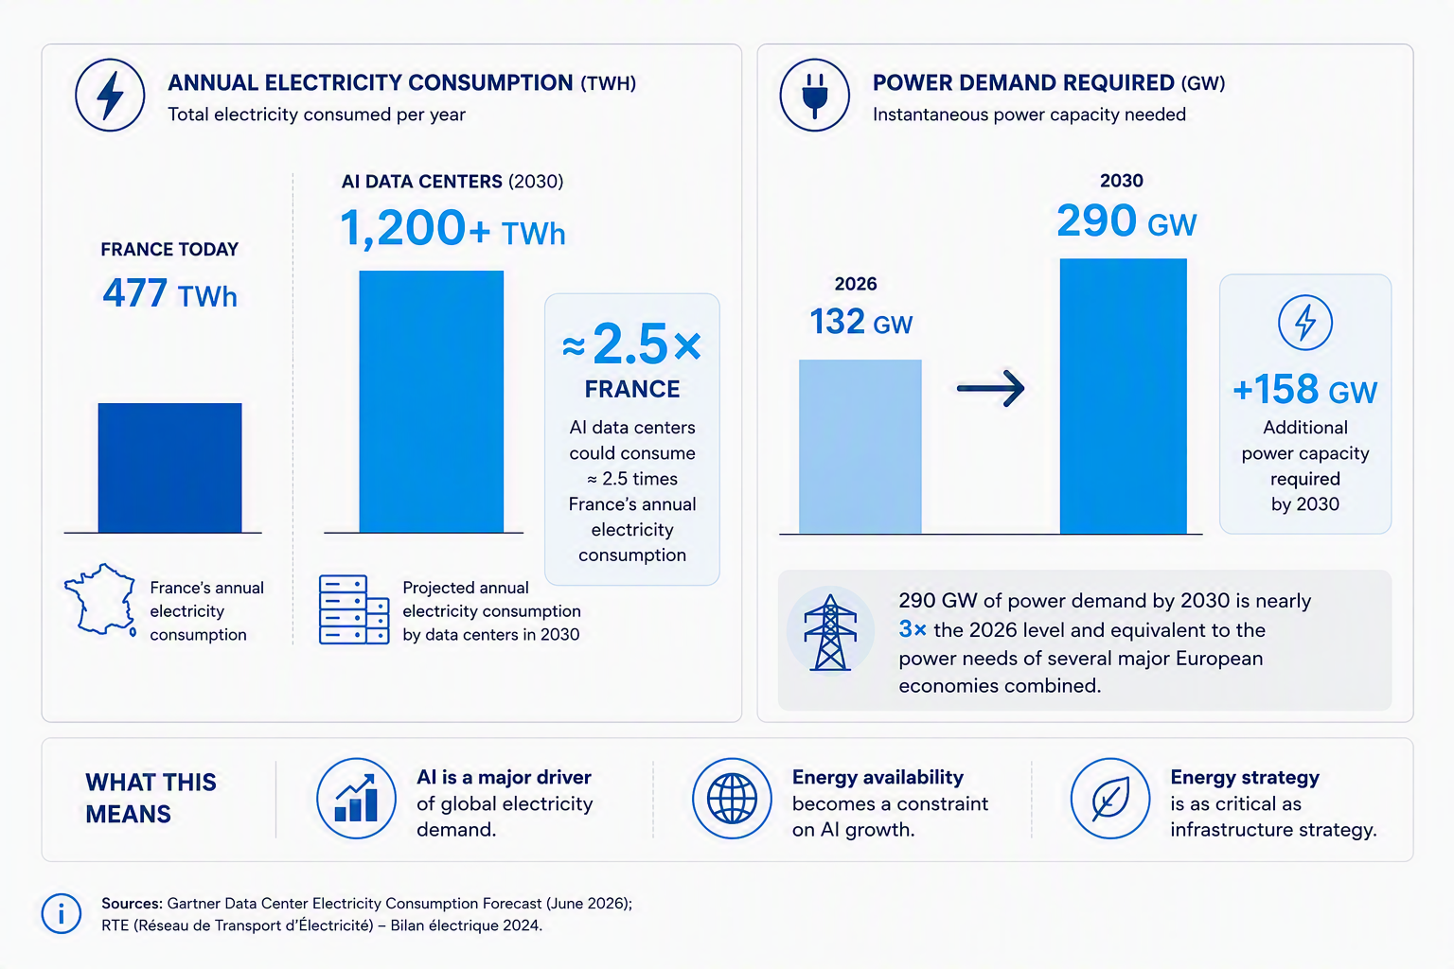
Cloud Market Size (in Electricity Consumption)
9
https://www.gartner.com/en/newsroom/press-releases/2026-06-10-gartner-says-data-center-electricity-demand-to-grow-26-percent-in-2026

Slide 10


Know your Fundamentals
NEW CHALLENGES
10

Slide 11
From Inception to Delivery, Support & Handover
Foundation Pillar for AI Initiatives
Platforms
Key Portfolios
Initiative Streams
2024
2025
2026
2027
2028
Clean & single source of truth
Data Hygiene
Core Data Warehouse
Azure
Integration Platform (AIP)
Glovia Replacement
Azure
Integrate global apps
SOA Migration
Landing Zone (govern, secure, scale)
Design / Build / Operate
Business Apps
Modernize & Migrate
Cloud Center of Excellence - towards multi cloud
AWS
Operate & SaaSify
Landing Zone (govern, secure, scale)
Design / Build / Operate
AI for IT
AI Center of Excellence
Agentic Ops (SRE/Observability)
AI & Automation
Agentic Modernisation Factory
Business driven Technology
AI for Business
Digital Factory
Business Platform data & context

Slide 12
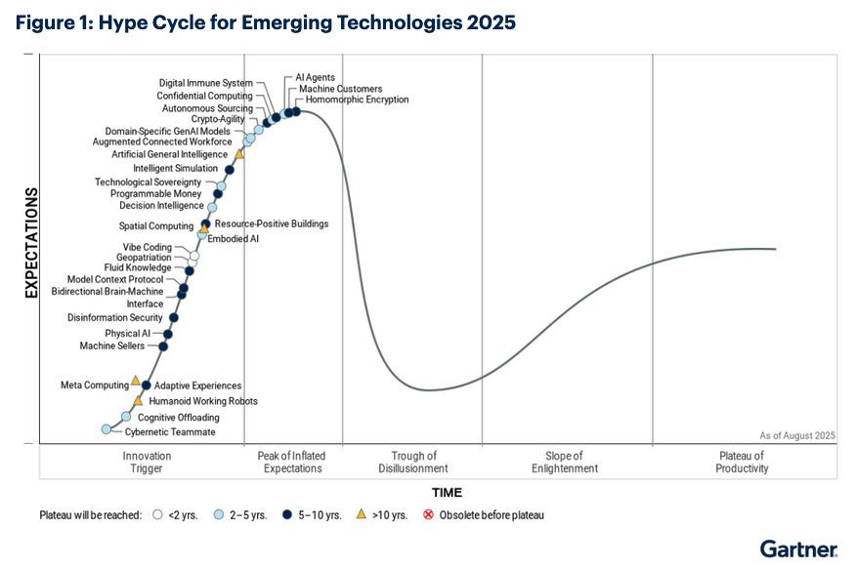
Future Opportunity Landscape
12
https://www.gartner.com/en/newsroom/press-releases/2025-09-10-gartner-unveils-top-emerging-technologies-to-support-autonomous-business

Slide 13
Business Leader vs Digital Transformation
Scenario 1:
Digital transformation happening fast with limited guidance
MX
M3
Reasons:
No guidance with digital leadership team, no team-work or collaboration, business operates in silo
Consequences:
Hasty decisions, no proper planning, proof of concepts becoming production “monsters”, demotivation, burnouts, decrease in work happiness
Transformation Level
(Milestone (M))
M2
M1
T1
T2
T3
TX
Time (T)
Digital Transformation
Business Leader Involvement in IT decisions
13
Notes:
BMI

Slide 14
Business Leader vs Digital Transformation
Scenario 2:
Close to no digital transformation
MX
M3
Reasons:
Little awareness from the business leader(s), no strategy, lack of interest, lack of understanding
Consequences:
Loss of confidence, increase in confusion, loss of momentum, difficulty to hire, operate and remain competitive.
Heavy reliance on COTS applications
Transformation Level
(Milestone (M))
M2
M1
T1
T2
T3
TX
Time (T)
Digital Transformation
Business Leader Involvement in IT decisions
14
Notes:
Advantest

Slide 15
Business Leader vs Digital Transformation
Scenario 3:
Properly balanced digital transformation roadmap
MX
M3
Reasons:
Proper guidance from the business leader, vision within all major aspects of the digital adoption spectrum
Consequences:
Increase in agility, innovation, reactivity to market trends (competition and customers), change management simplified, increase in work happiness
Ready for disruptive changes (genAI, Quantum computing, etc…)
Transformation Level
(Milestone (M))
M2
M1
T1
T2
T3
TX
Time (T)
Digital Transformation
Business Leader Involvement in IT decisions
15
Notes:
KONE

Slide 16
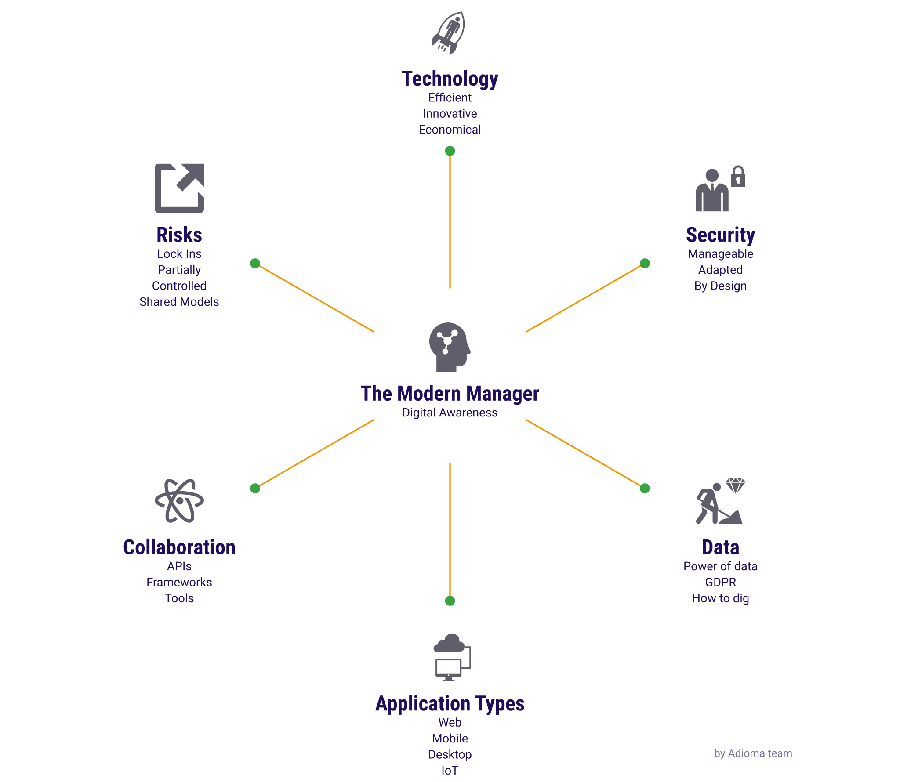
Digital Sovereignty
16

Slide 17

Transition to the Cloud
The traditional approach
High upfront costs
High maintenance
Limited storage & compute capabilities
Challenge to scale
Challenge to backup & recover after a disaster
17

Slide 18
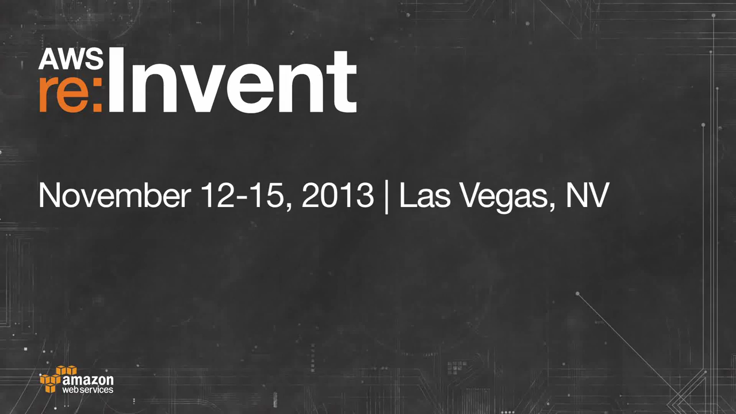
Compute Power & Storage as a Commodity
The Cloud approach
Definition:
In the digital world, it is the exploitation of the best suited machines for a particular job at any scale through an internet connection.
Pay as you go model
No maintenance
Unlimited storage & compute capabilities
Flexible and ease of scaling Up or Down
Real time Backup & Disaster Recovery
Link: https://aws.amazon.com/solutions/case-studies/airbnb-case-study/
18

Slide 19
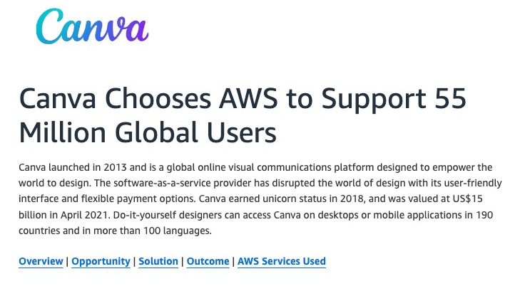
Transition to the Cloud
Cloud – compute power as a commodity
https://aws.amazon.com/solutions/case-studies/canva-2019/
19

Slide 20
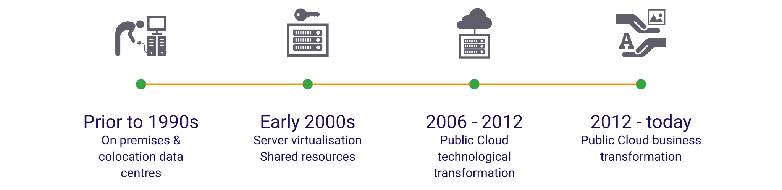
Compute Power & Storage as a Commodity
Today, anyone with an internet connection has access to the same compute power capacity as the biggest companies in the world
Few organisations, large or highly capable
Mainstream, massive adoption & expansion,
from the smallest start-up to the biggest firms internal AI, LLMs, Quantum Computing, …
20
Early adopters: Dropbox, Airbnb, Netflix
Notes:
What is Cloud?
2006 AWS first introduces on- demand virtualised machines and redefines SLAs from machines only to machines + software
2007 Dropbox was founded - Storage as a service is created using AWS S3 buckets

Slide 21
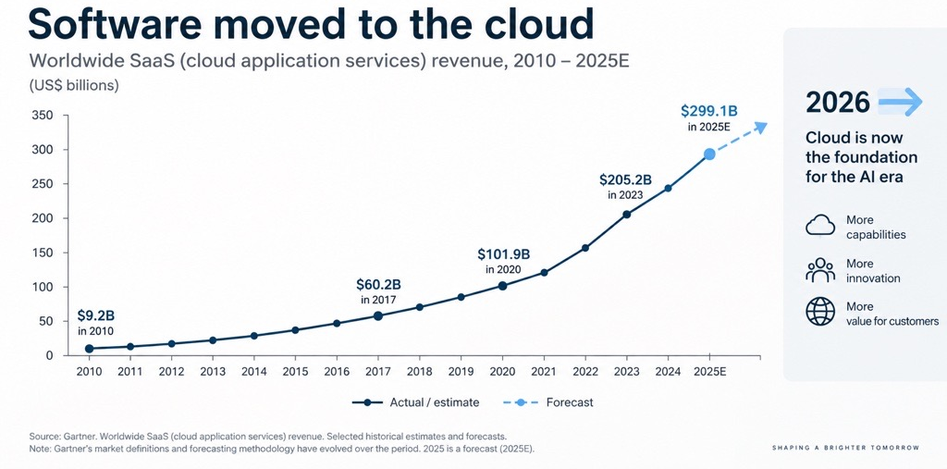
Compute Power & Storage as a Commodity
Early adopters: Dropbox, Airbnb, Netflix
Source: Gartner
21

Slide 22
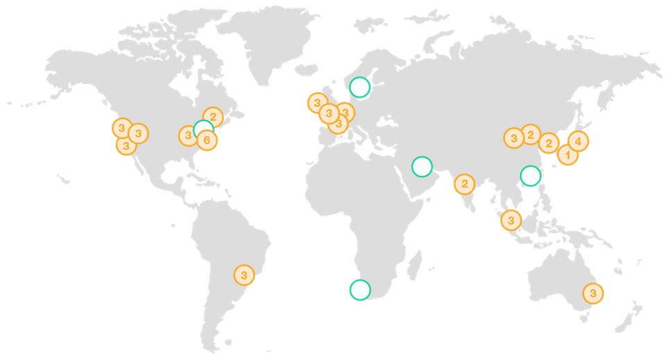
Compute Power & Storage as a Commodity
Global Availability
Source: AWS
22

Slide 23
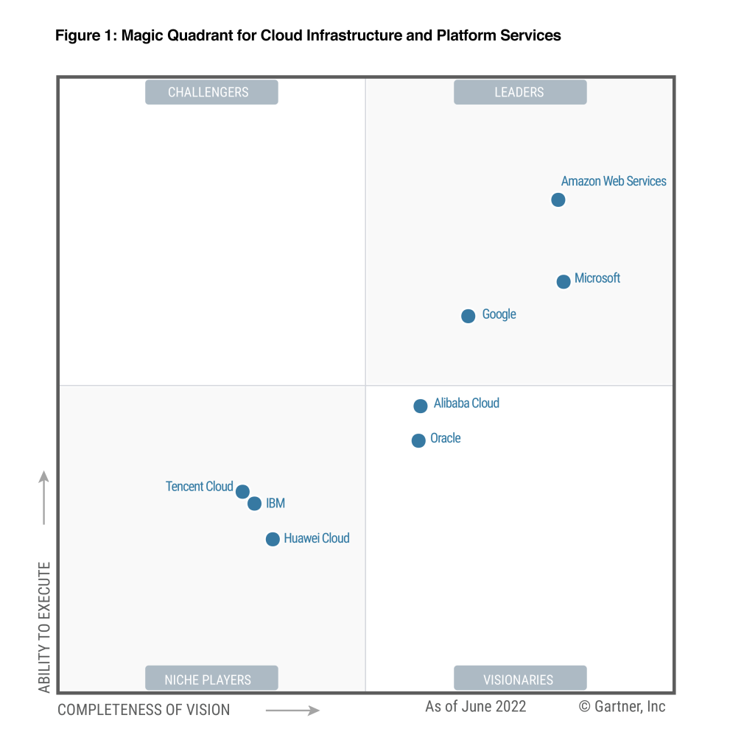
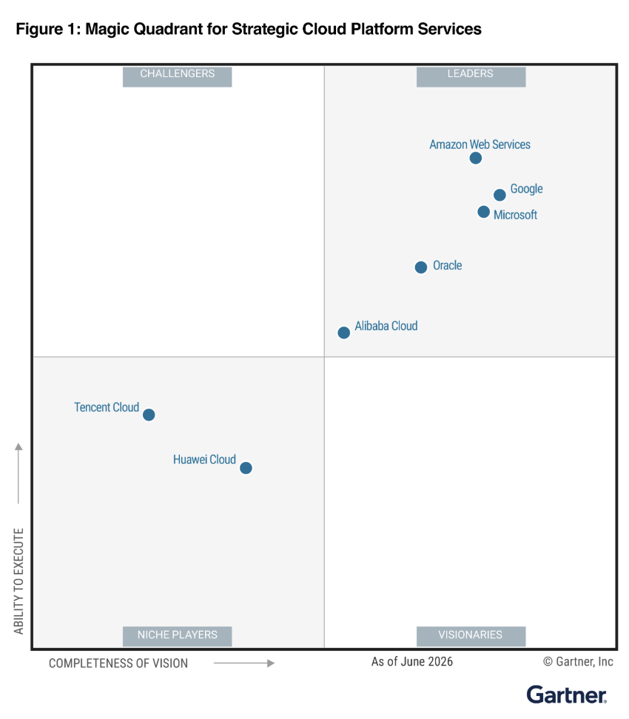
Compute Power & Storage as a Commodity
Today’s Cloud Players
Source: Gartner
23

Slide 24
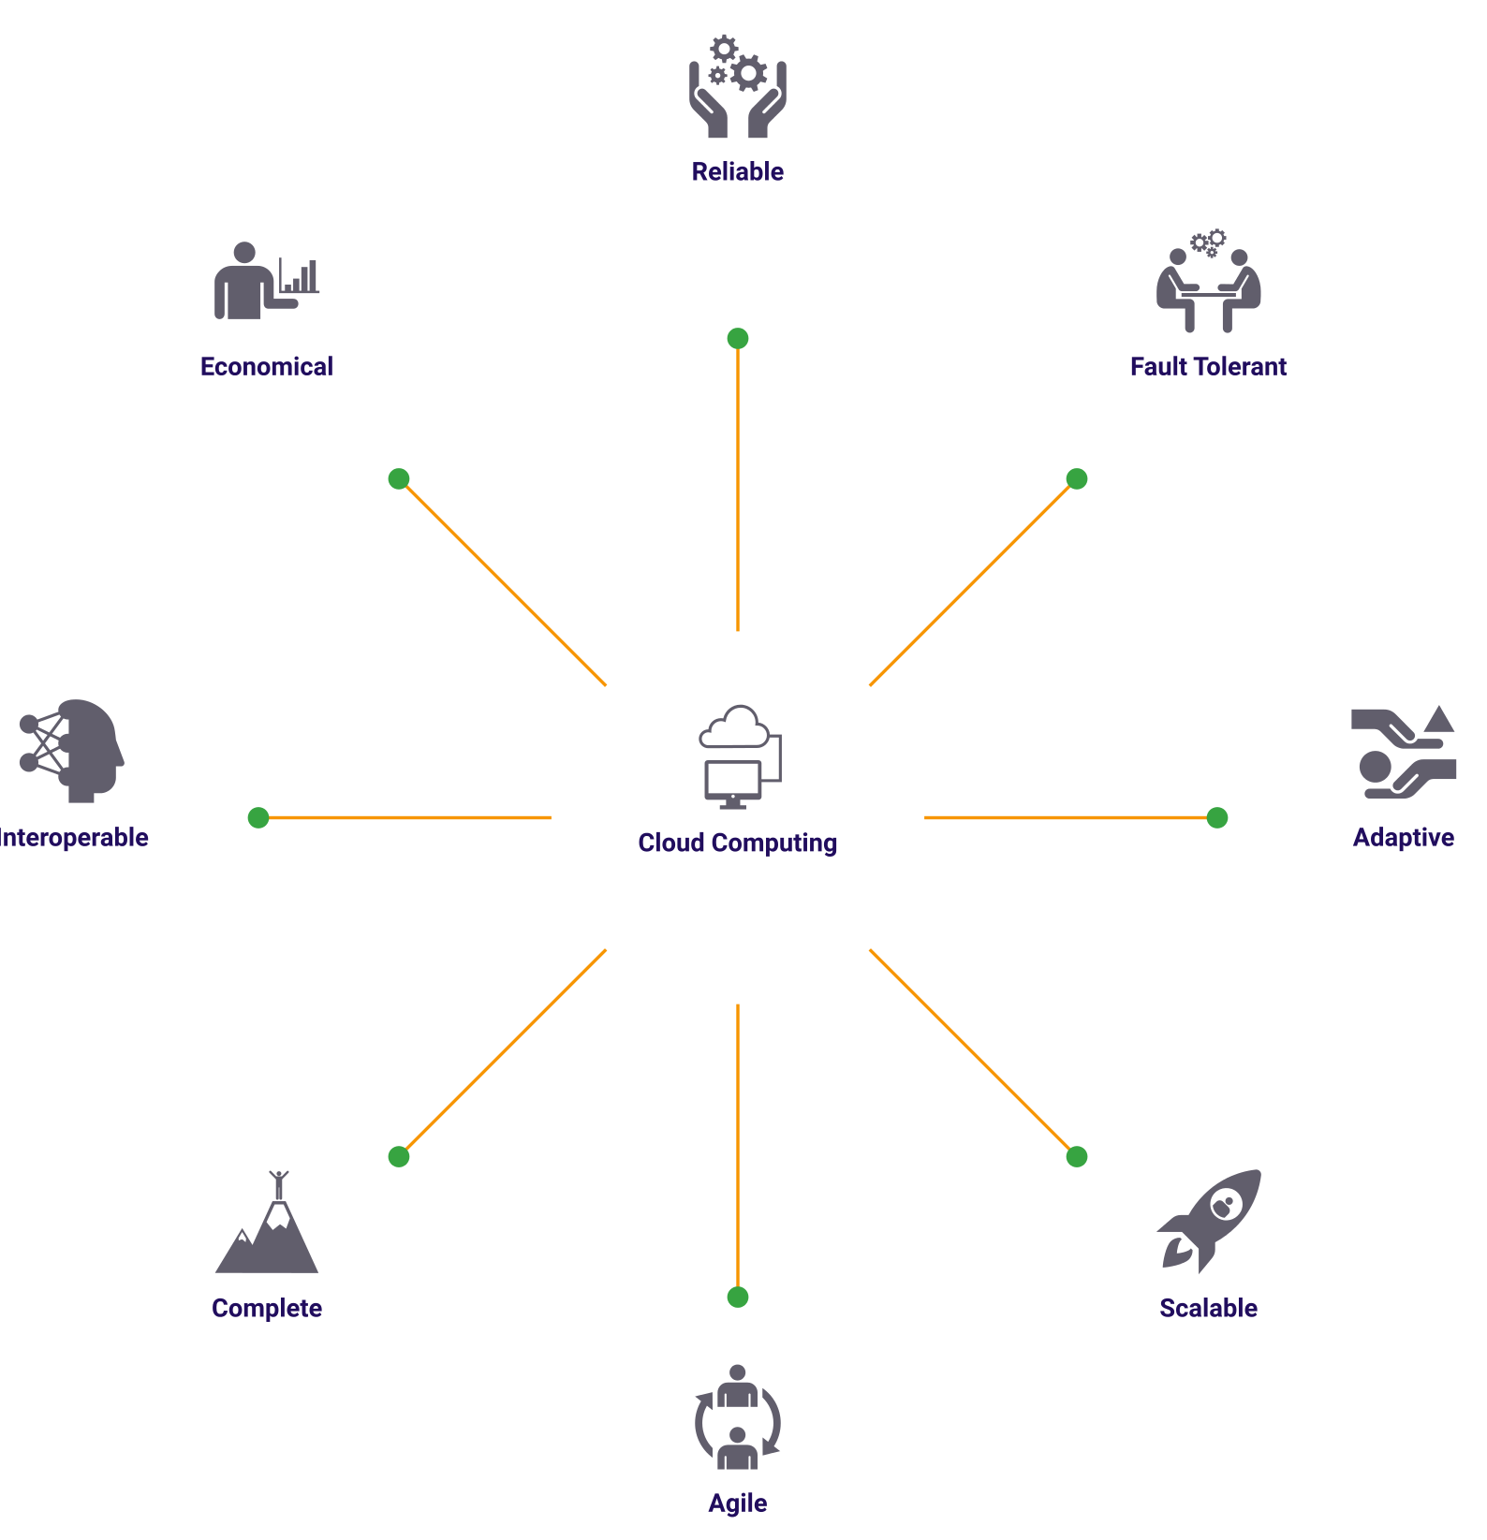
An Efficient Model
24

Slide 25
Hands On
AWS Educate
Zapier

