Slide 1



LLSMS2903 · DIGITAL TRANSFORMATION MANAGEMENT · 2026
LLSMS2903 – Digital Transformation Management · 2026
LLSMF2903 – Digital Business Systems
KEY CONCEPTS IN ENTERPRISE INFORMATION SYSTEMS
Yves Wautelet (yves.wautelet@kuleuven.be)
KEY CONCEPTS IN
ENTERPRISE INFORMATION SYSTEMS
Yves Wautelet · Digital Business Systems
Notes:
2026 light refresh. Original course structure and visual identity retained.

Slide 2

Towards a Digital Transformation
Towards digital transformation
UCLouvain
Louvain School of Management

Slide 3


Digitalization
Digitalization is the use of digital technologies to change a business model and provide new revenue and value- producing opportunities; it is the process of moving to a digital business.
- Gartner

Slide 4
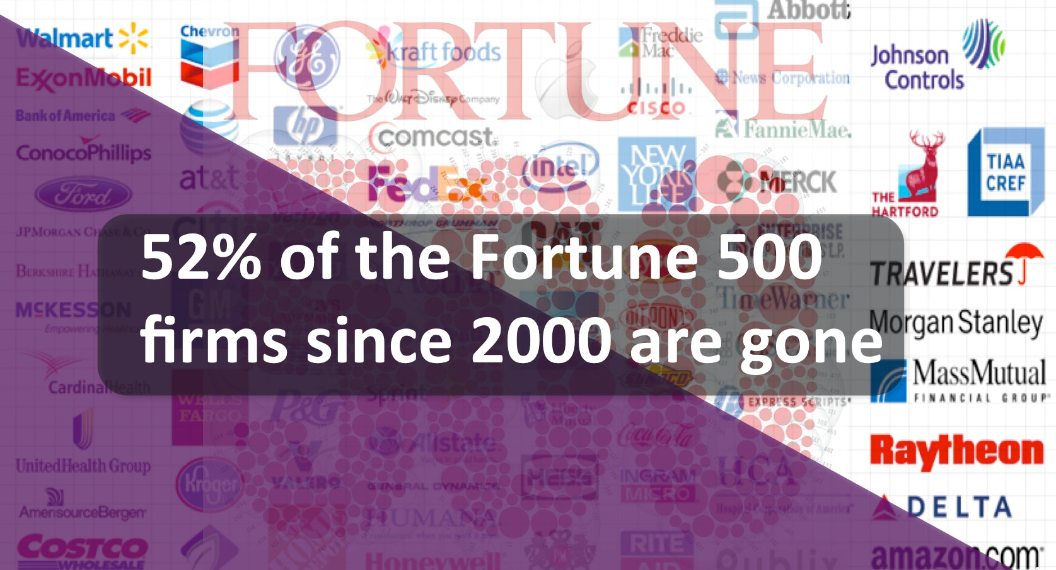

Fortune 500: ranking of the 500 first companies in the US in terms of turnover
How many companies on Fortune 500 in 2000 were still on the list in 2014?
The importance of software and data is increasing every year and will continue to increase (exponentially).
If you don’t use the use the right techniques to develop software and exploit data you will soon be out of business!

Slide 5

Disruption is a new natural phenomenon
Jim Collins (consultant and author of Built to last): Companies last, on average, no more 30, nor 15 but 10 years on the Fortune 500 list. And that time period continues to decrease
Main cause: Companies fail to innovate and to build new core capabilities
Digitalization Is The New Disruptor!

Slide 6
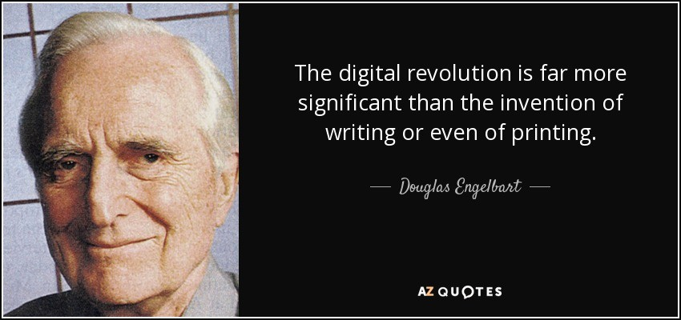
Douglas Engelbart (inventor of the computer mouse)

Slide 7

Three Elements
Digitalization is disrupting industry and society; the same trend should continue and even accelerate
Companies need a new digital business operating system:
  SOFTWARE needs to be developed to sustain all of the business activities in the most rapid and flexible way possible
  DATA allows for Artificial Intelligence (Machine and Deep Learning) solutions and for EMPOWERMENT and autonomy
ECOSYSTEMS around software systems and IT services need to be included in this new digital business operating system

Slide 8
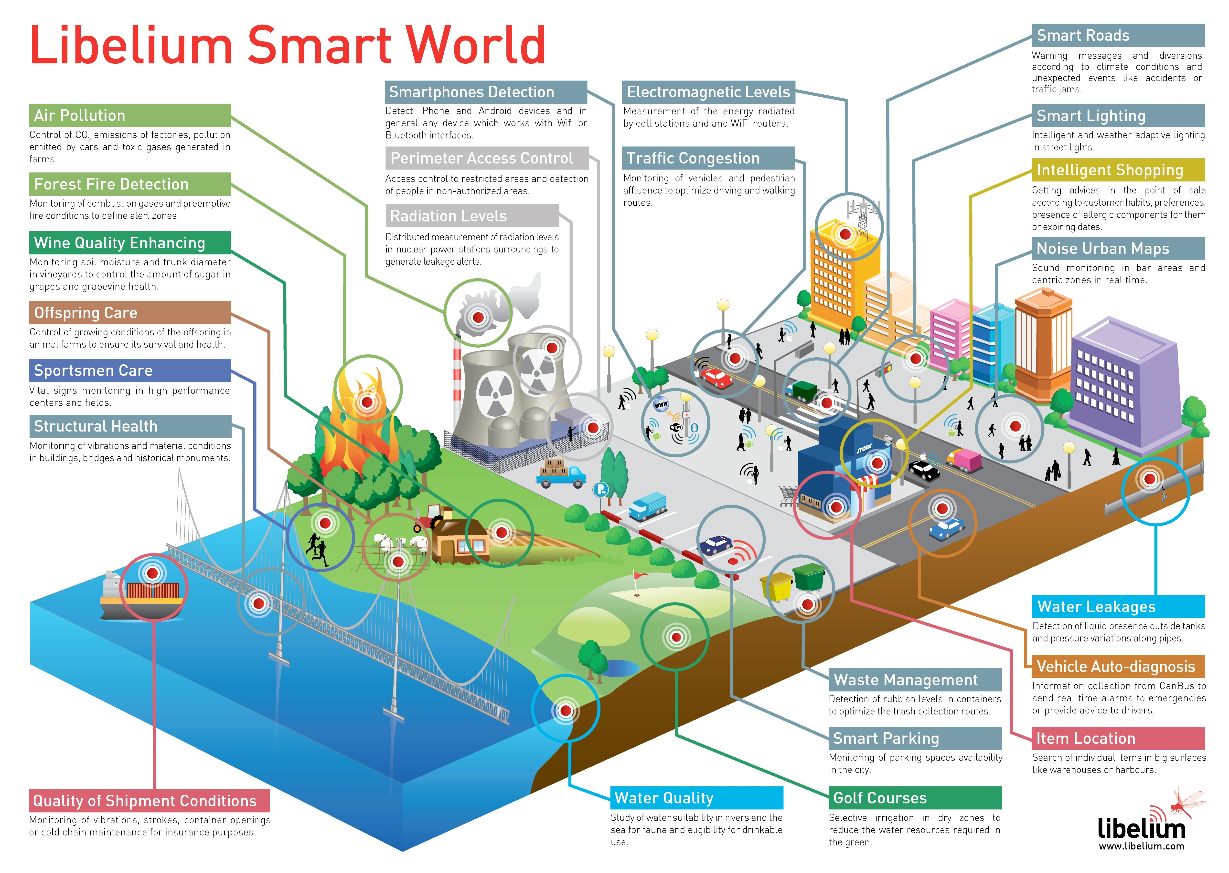
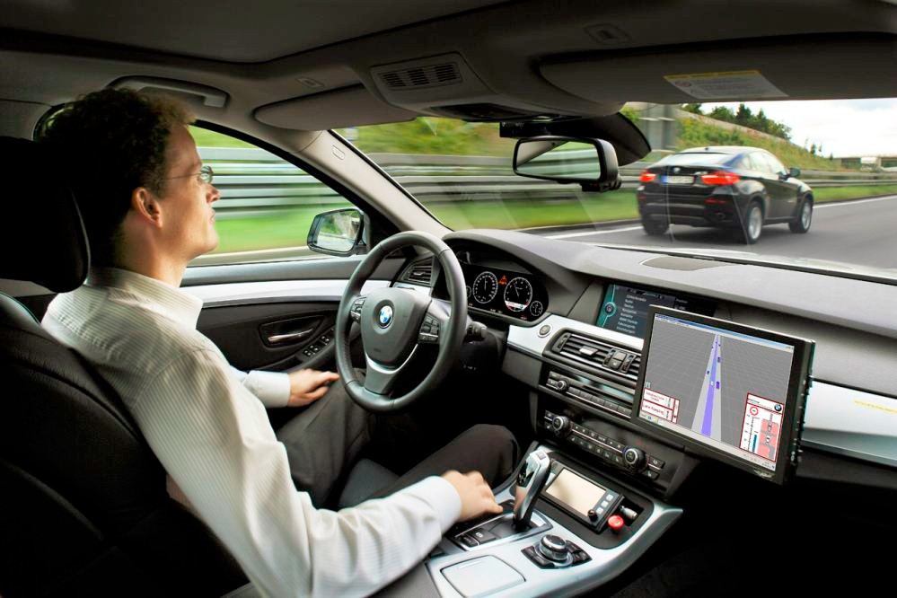
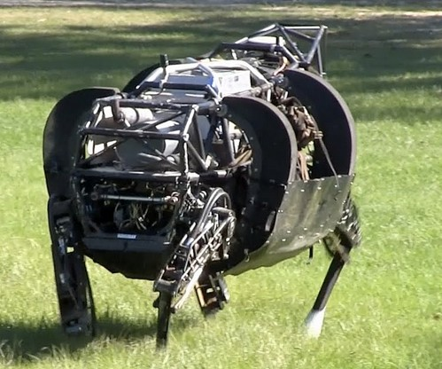
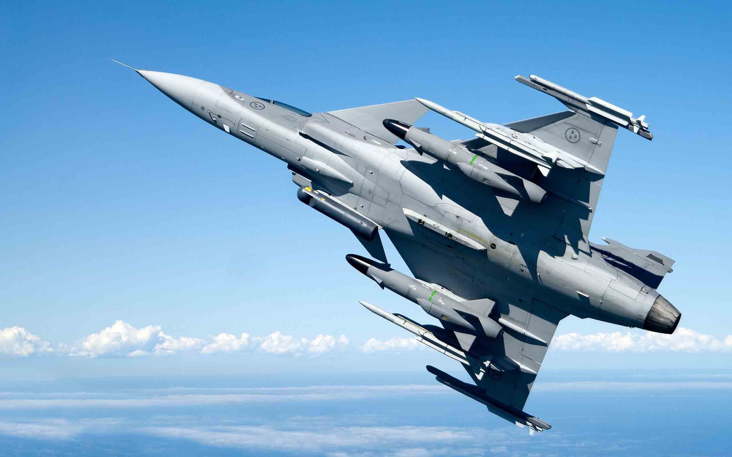
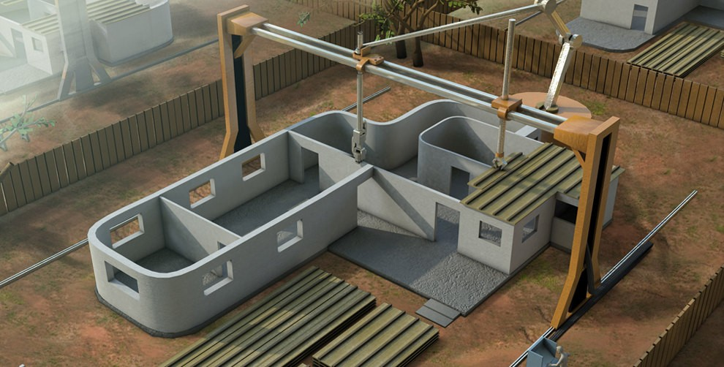
Software Drives Everything
Self-Driving Cars
Robots
Gripen Drone
3D Cement Printing

Slide 9
Digital transformation in 2026
The Digital Age
UCLouvain
Louvain School of Management

Slide 10
What makes a company a digital one?
Using email?
Have a website?
Use social media?
Video conferencing?
Chatbots?
Data-driven decision making
Relentless experimentation (e.g. A/B testing)
Short feedback cycles
Decision making pushed down in organization
Strategic data collection
Unified data warehouse
Pervasive automation
New job descriptions

Slide 11

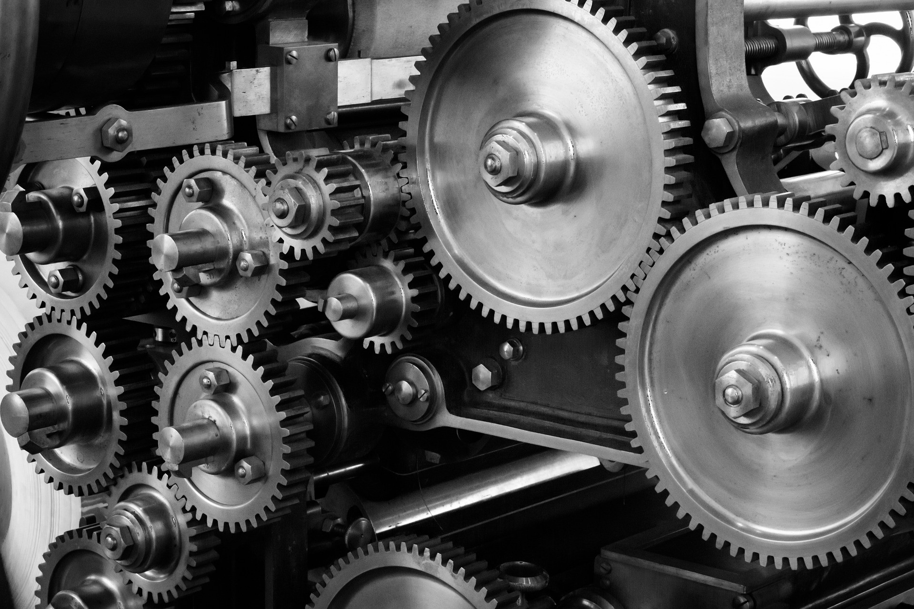
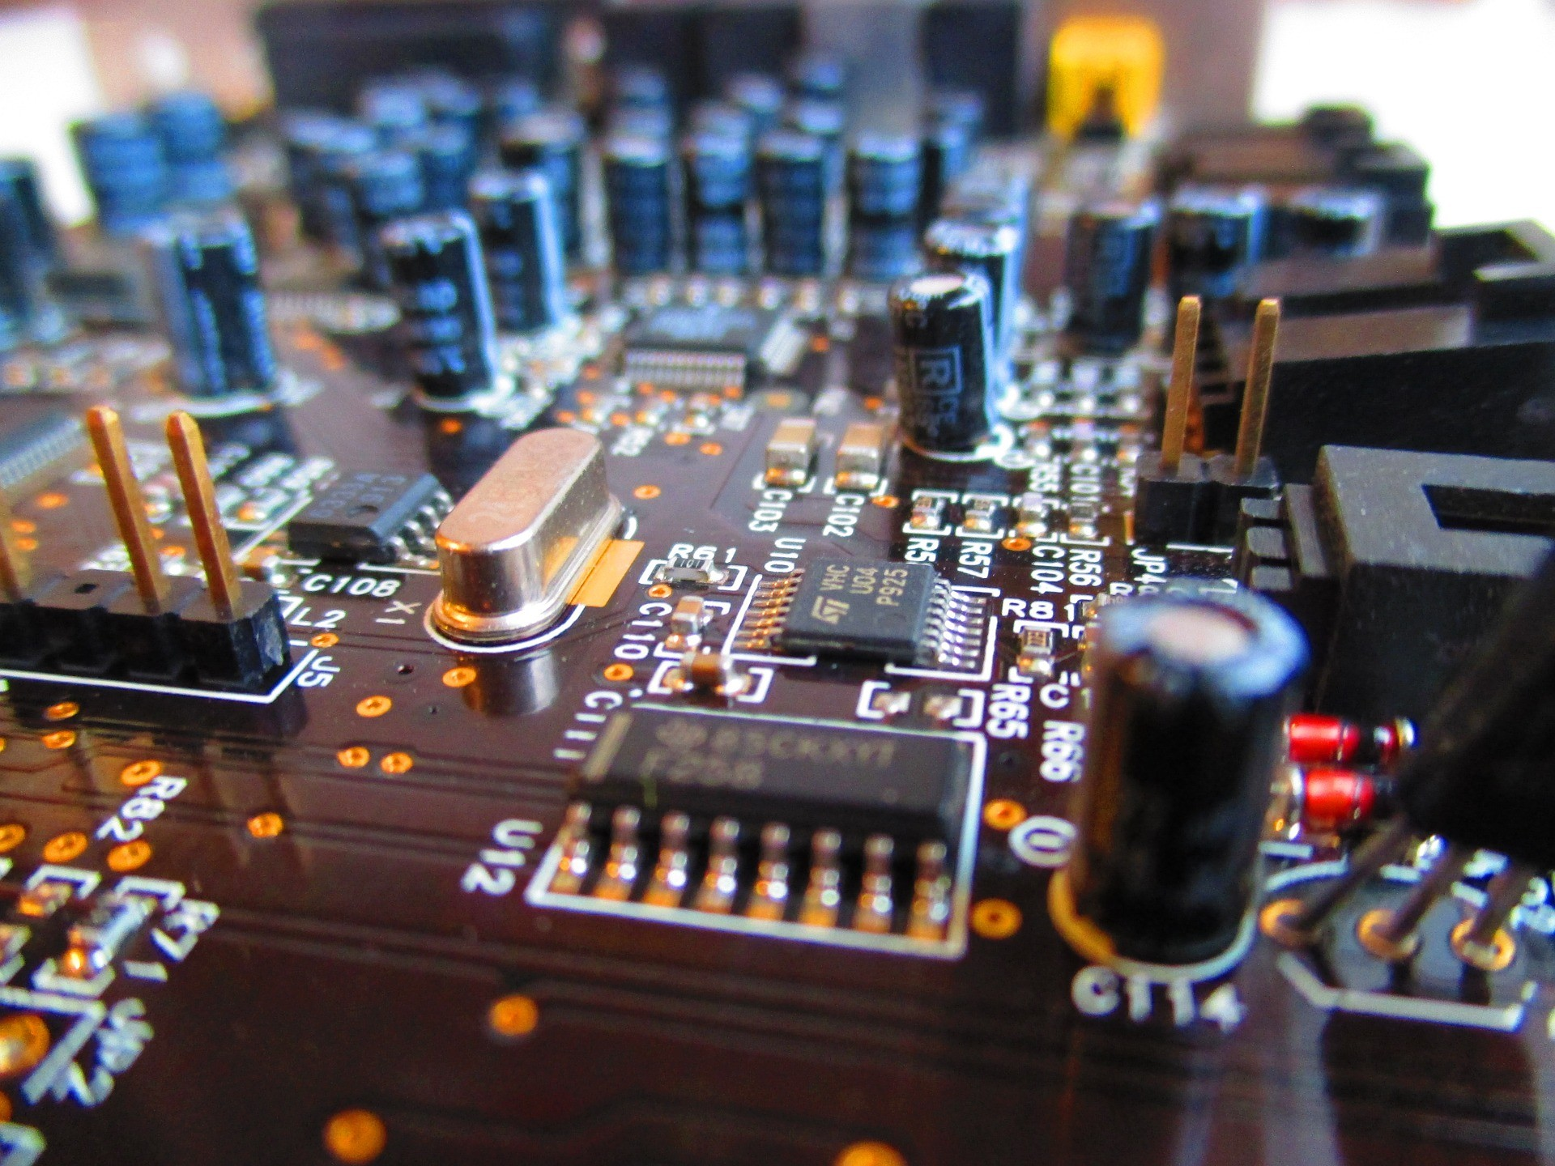


Technology Evolution
mechanics
electronics
software
data
artificial intelligence

Slide 12
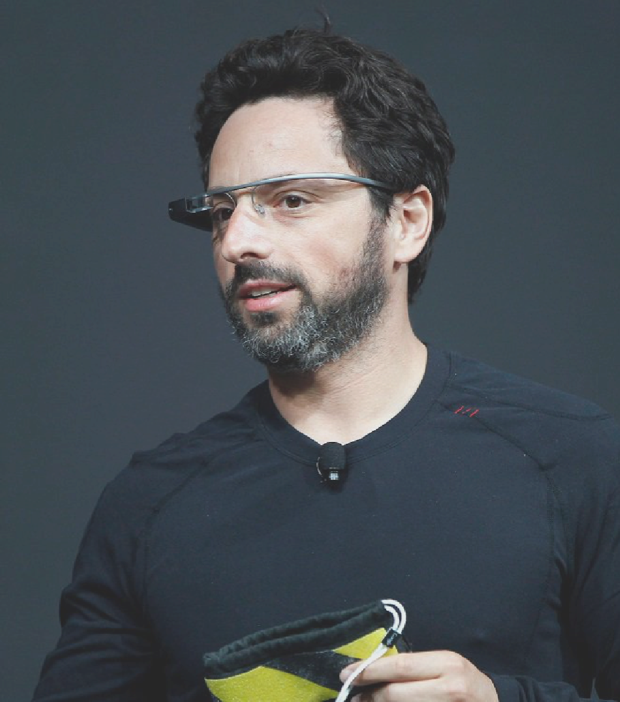
The new spring in artificial intelligence is the most significant development in computing in my lifetime
— Sergey Brin, co-founder of Google and currently president of ALPHABET

Slide 13
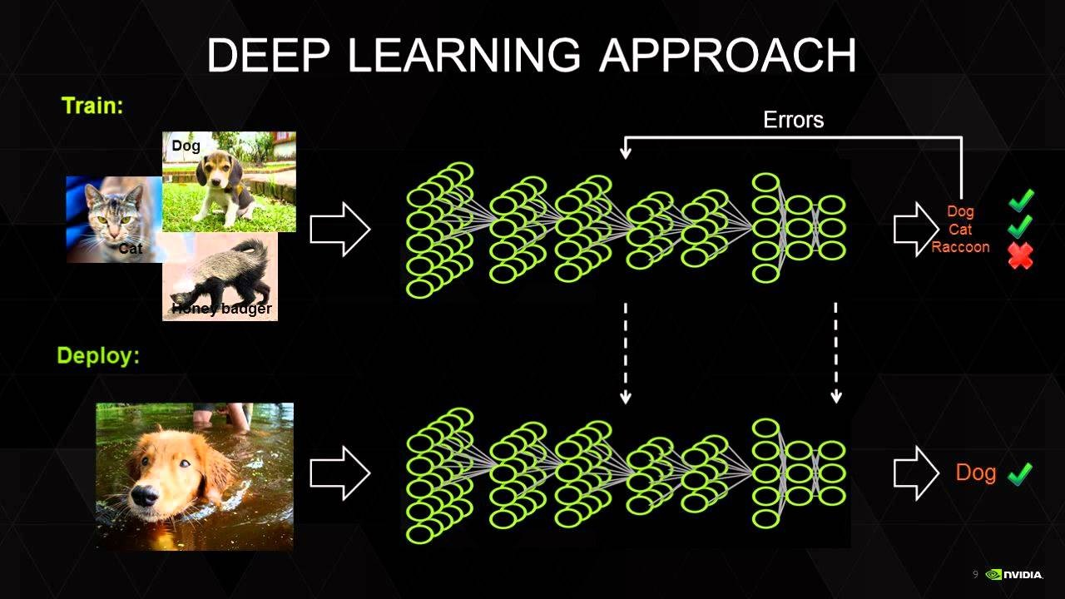
AI Technique: Deep Learning as Methodology

Slide 14

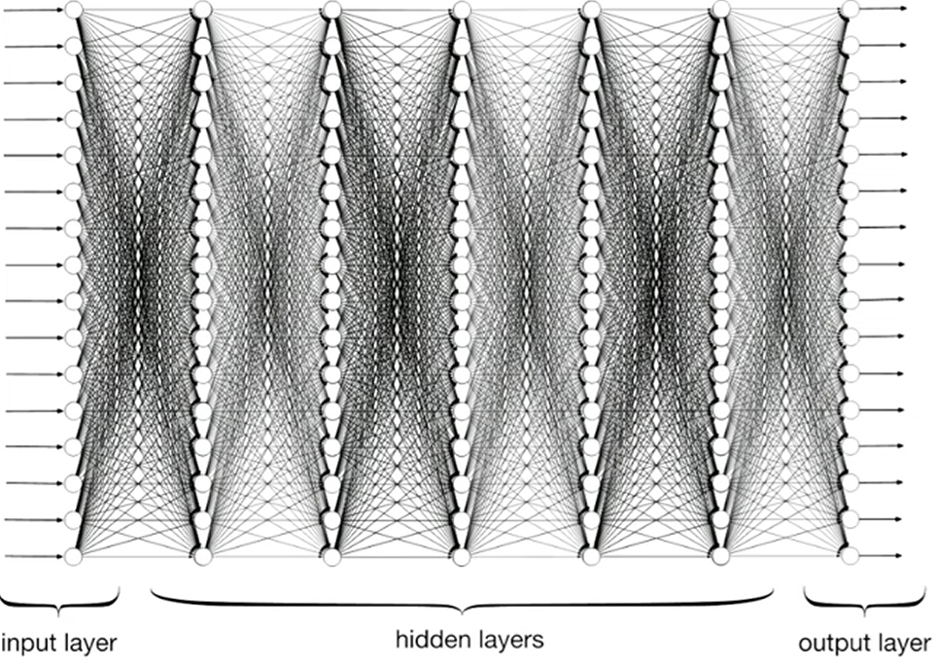
Neural Networks as Building Blocks
Dog
Deep learning is the technique for training neural networks.
Neural networks are made of simple cells that each detect patterns and pass them on.
Their power comes from combining many cells, layer by layer, to capture very complex structures.

Slide 15
Even if it had been known for years it started to work in 2005, why?
For decades, neural networks lacked the fuel they needed.
Around 2005, for the first time in human history, massive digital data became available — from the internet, mobile devices, and social media.
Deep learning could finally train on this scale, turning theory into practice.
First applications:
Computer Vision: image recognition, object detection, facial recognition (ImageNet 2012).
Speech & Audio: voice assistants, automatic speech recognition, speaker identification.
Natural Language Processing: word embeddings, machine translation, chatbots, question answering.
Game & Decision Making: AlphaGo, reinforcement learning for complex strategies.

Slide 16
Next stage: Large Language Models
With neural networks, bigger is better
Big tech companies threw everything at it:
  Enormous neural networks
  Vast amount of training data
  Huge computing power to train data
One technology responded increadibly well: LLMs (ChatGPT, Grok, Gemini, …)
Build the new version 10 times bigger and you will get a competitive advantage

Slide 17
How do LLMs work?
At the core: predict the most probable next word (token) in a sequence.
Repeating this builds sentences, paragraphs, and conversations.
Example:
  “The capital of France is …” → {Paris: 92%, London: 4%, Berlin: 2%} → Paris
It’s just next-word prediction — but trained on massive text corpora, it encodes language, knowledge, and reasoning.
Trained on all internet text, this simple mechanism encodes knowledge and reasoning.

Slide 18
How much data do digital activities generate?
How much data do digital activities generate?
UCLouvain
Louvain School of Management

Slide 19
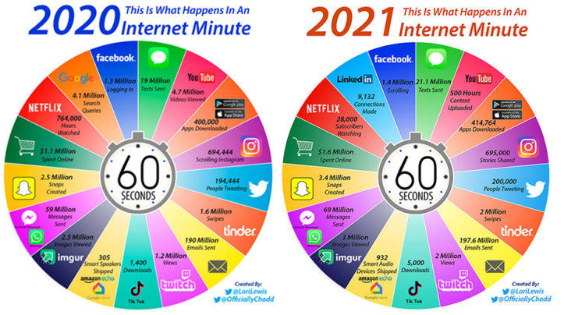
3 important teachings
All of this is driven by software
All of this uses and generates tremendous amounts of data
All of this needs a software ecosystem to properly work

Slide 20
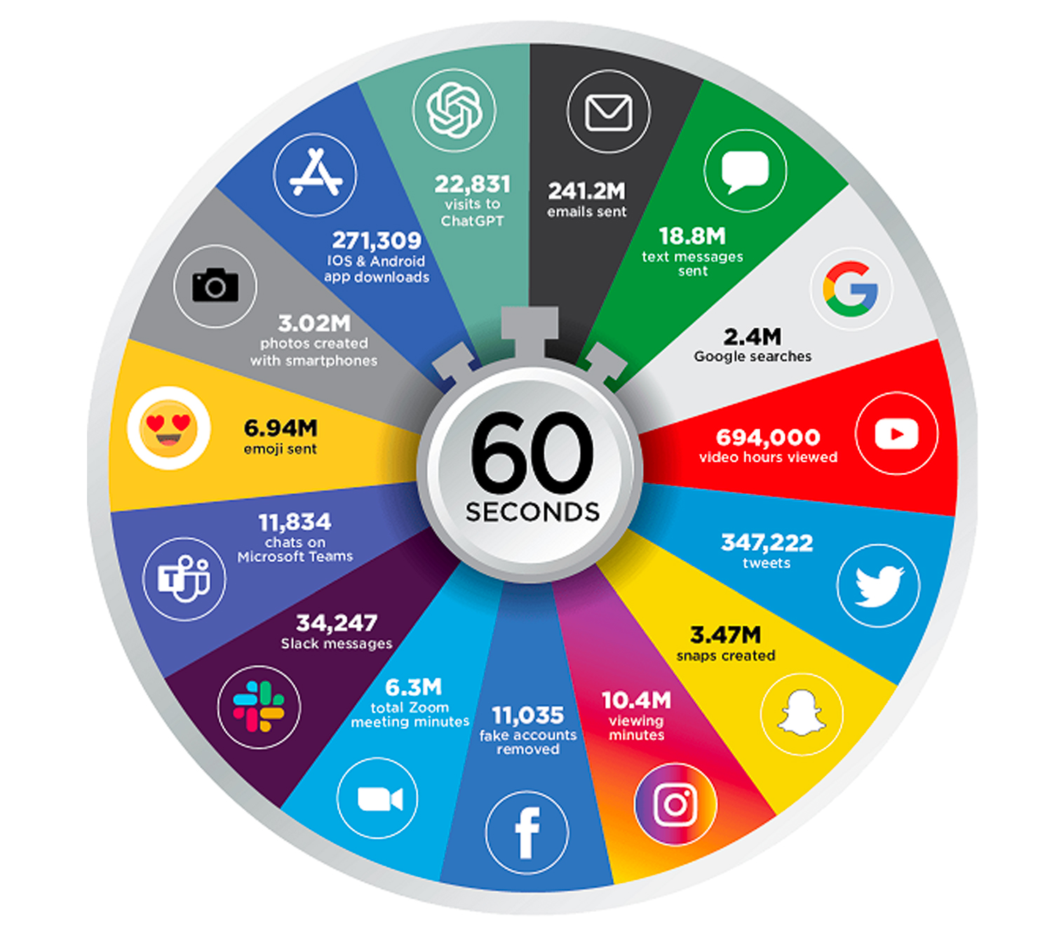
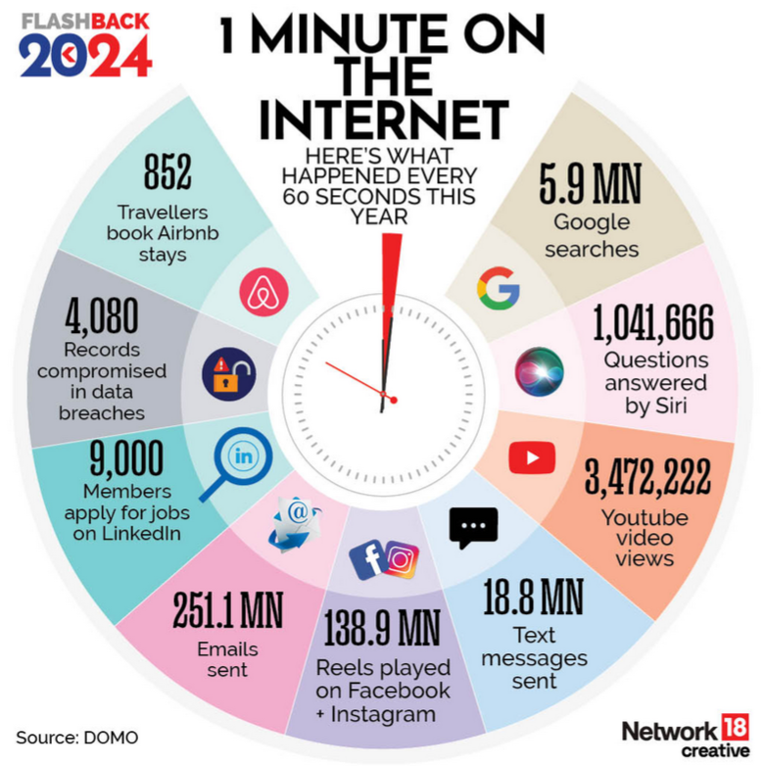
2023

Slide 21
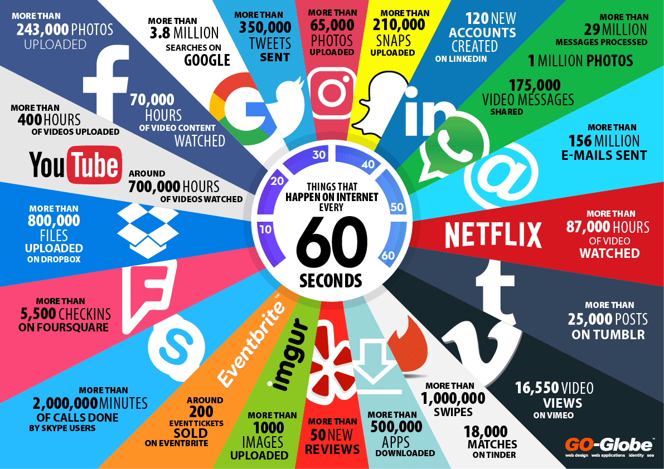
2026

Slide 22








Trend: Need for Speed
Value Creation Shifts
Level of User Contribution
Founded | 1984 | 1995 | 2004 | 2009
1M users | ~6 years | 30 months | 10 months | ?
50M users | N/A | ~80 months | ~44 months | ~ 1 month

Slide 23
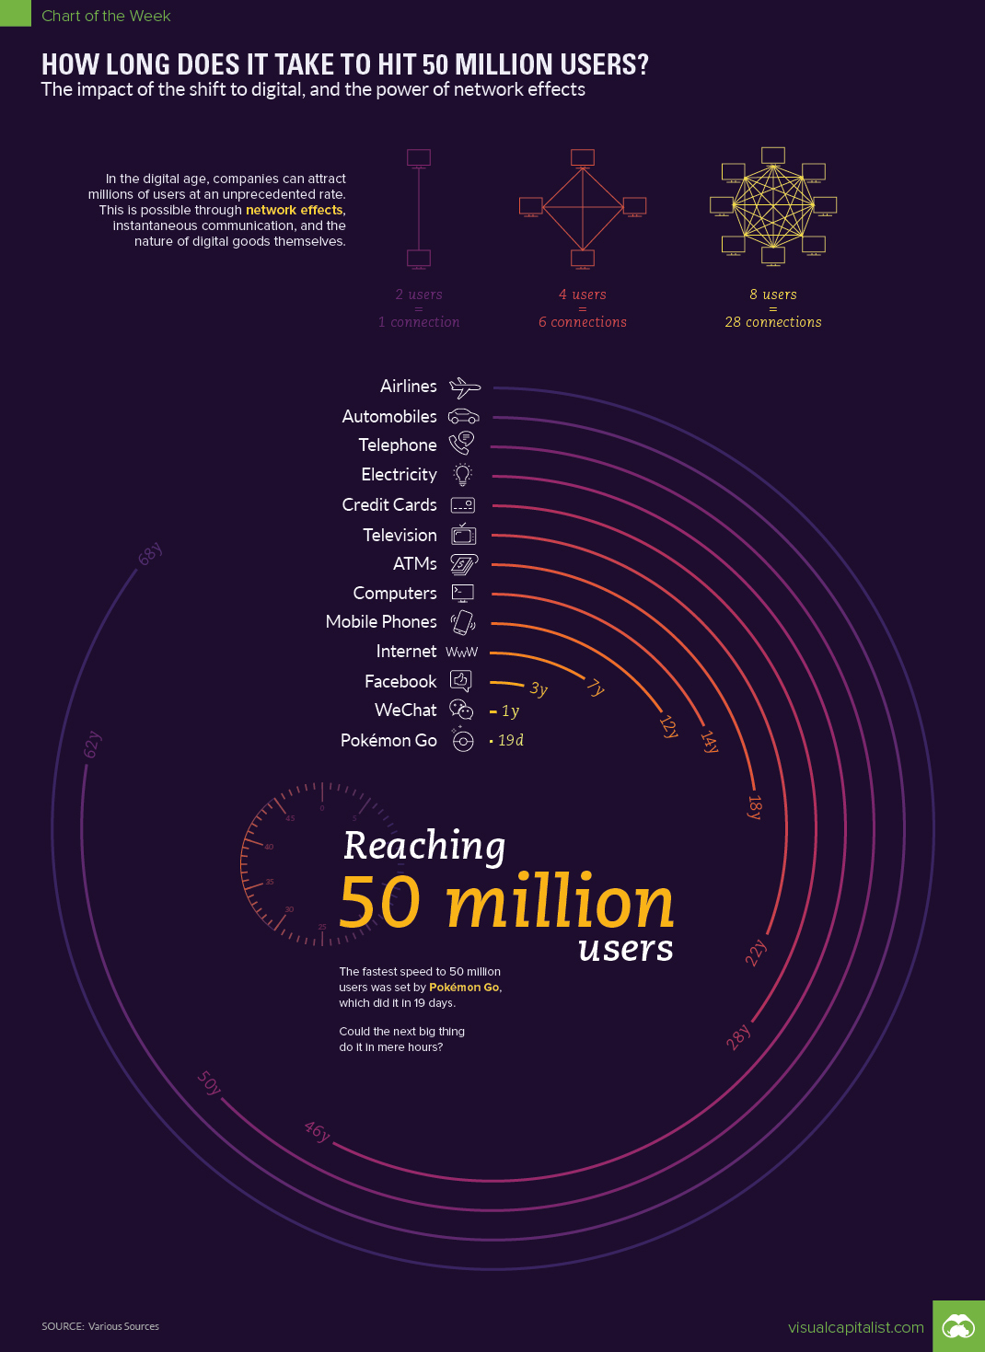
Road to 50 Million

Slide 24
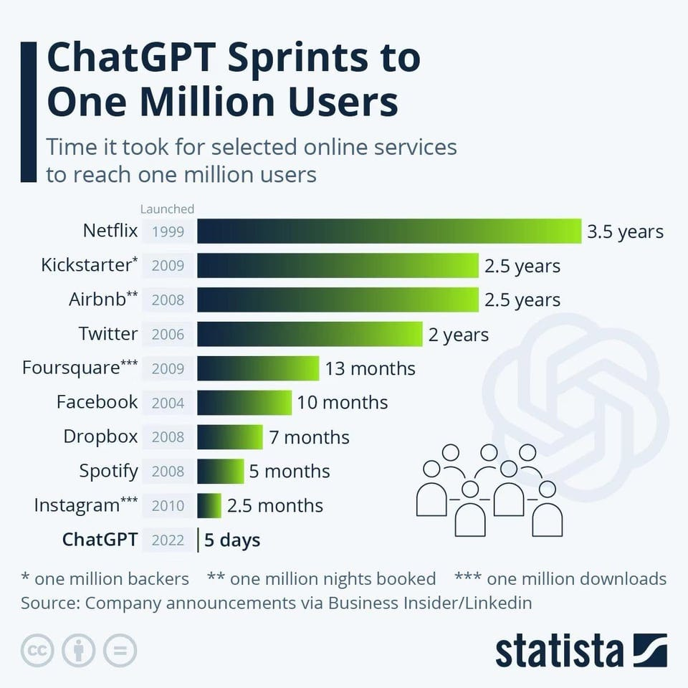
What about ChatGPT?

Slide 25
Operating in a period of continuous innovation
Operating in a period of continuous innovation
Technology changes how companies create value and how they operate
Technological change also requires companies to adapt how they operate.
UCLouvain
Louvain School of Management

Slide 26

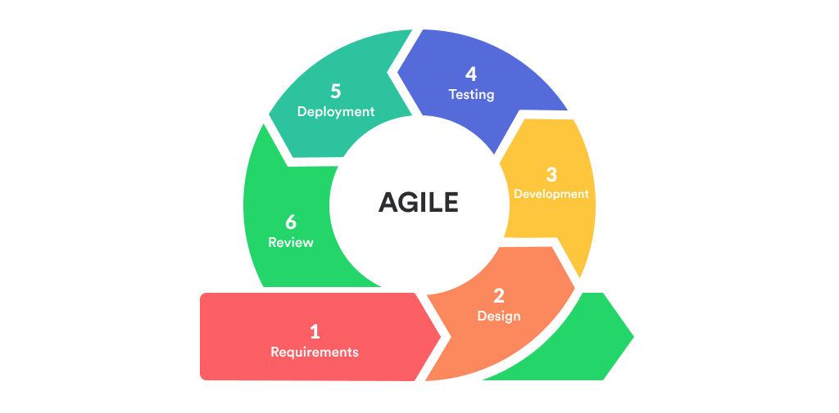
Agile development
Agile manages uncertainty through evidence
Agile as an evidence spiral
Each iteration should reduce uncertainty and improve the next decision
A sprint is useful when it changes what the team knows
Teams develop features through short iterations called sprints. Each sprint should deliver a usable increment.
Teams prioritize features according to the business value they provide.
A learning-oriented sprint
1
Frame a hypothesis
Output versus outcome
State the expected change in behaviour or performance.
Start with a product or process hypothesis.
Build the smallest usable increment that tests it.
Release to an appropriate audience.
Measure behaviour and operational impact.
Adapt the backlog using the evidence.
OUTPUT
Features completed, stories closed, releases shipped.
OUTCOME
Customer behaviour, quality, cost, risk or cycle time improved.
Agile loses its purpose when teams optimize output while nobody owns the outcome.
Increment
2
Build a usable increment
Create the smallest change that can test the hypothesis.
UNCERTAINTY
3
Observe outcomes
Hypothesis
Evidence
Collect evidence from use, quality, cost, risk or cycle time.
4
Adapt the next decision
Change the backlog, the design or the hypothesis.
Adaptation
The spiral expands the evidence base
Short iterations reduce risk only when the organization learns from them.
Notes:
The spiral matters more than the sprint calendar. Iteration creates value when evidence changes the next decision. Output measures activity. Outcome measures change in the system.

Slide 27
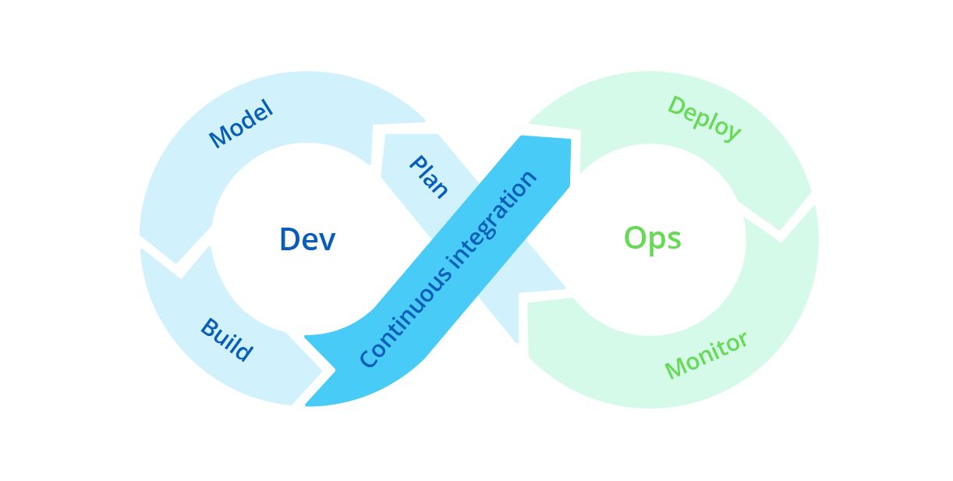
DevOps
The 2026 operating model combines delivery and governance
The operating model for continuous innovation
A learning system connects value, delivery and control
Digital transformation now extends beyond Agile and DevOps
DevOps extends agile practices across development and operations in technology-driven businesses (e.g. Netflix, Amazon, …)
Sprints involve the development team (Dev) and the operations team (Ops) in charge of integrating the produced software (features) into the organization’s software ecosystem. This collaboration supports continuous integration and more frequent, reliable releases.
Integrated delivery capability
Responsible operation
GOVERNANCE
PRODUCT MANAGEMENT
Own the problem and outcome.
DEVOPS AND PLATFORM ENGINEERING
Deliver reliable software repeatedly.
DATA AND ML OPERATIONS
Maintain data, models, evaluation and monitoring.
SECURITY AND PRIVACY
Design controls into the workflow.
AI GOVERNANCE
Define ownership, permitted use, evidence and oversight.
EU CONTEXT
AI transparency requirements apply from August 2026, with other obligations phased in.
ENABLING CAPABILITIES
PRODUCT TEAMS
CUSTOMER AND
BUSINESS OUTCOMES
Platforms, data, AI, security and shared engineering practices
Decision rights, risk appetite, funding and accountability
Feedback moves inward. Accountability extends outward.
The goal is a governed learning system that can improve continuously.

Slide 28
Methods evolved as the dominant constraint changed
Each approach retains useful disciplines from the previous one
PROJECT
MANAGEMENT
AGILE
DEVOPS
PLATFORMS
AI CO-CREATION
Constraint
Constraint
Constraint
Constraint
Constraint
Coordination
Uncertainty
Release friction
Repeated effort
Cognitive throughput
Core response
Core response
Core response
Core response
Core response
Scope, milestones, dependencies
Short cycles and customer evidence
Automation and operational ownership
Reusable services and paved paths
Human direction, machine generation, evaluation
When work is largely predictable
When needs and solutions evolve
When delivery must be frequent and reliable
When many teams need the same capabilities
When exploration and production accelerate
The managerial question: which constraint limits learning and reliable change today?

Slide 29
Vibe coding within a disciplined delivery process
Natural-language generation expands participation, but responsibility remains with the organization
EXPLORE
EVALUATE
ENGINEER
OPERATE
Prompts and rapid prototypes
User value, feasibility and risks
Architecture, tests and maintainability
Security, monitoring and ownership
Low consequence
Easy to reverse
Evidence before commitment
Professional standards
Production accountability
Use vibe coding to explore. Increase evidence and controls as consequences increase.

Slide 30
The AI bottleneck has moved to adoption
Prototypes multiply faster than organizations can integrate and scale them
ADOPTION BOTTLENECK
PROTOTYPING
VALUE AT SCALE
1
Workflow redesign
Fast and increasingly accessible
2
Data and system integration
Reliable use in real work
Prompts, generated code and rapid experiments lower the cost of producing a demonstration.
3
Evaluation and controls
People adopt the changed process and the organization can measure, govern and improve the outcome.
4
Ownership and user behaviour
The management challenge is no longer producing an AI demo. It is changing the system around it.
Notes:
Generative AI makes prototypes abundant. Scaling remains difficult because a useful solution must enter a real workflow, connect to data and systems, meet evaluation and control requirements, have a clear owner, and change how people work. Adoption therefore becomes the binding constraint for AI inclusion.

Slide 31
Human–AI co-creation as a managed learning loop
The division of labour changes across the cycle
1
FRAME
2
GENERATE
Human
Human + AI
Purpose, constraints and acceptable risk
Alternatives, drafts, code and analyses
EVIDENCE
CHANGES THE
NEXT CYCLE
4
INTEGRATE
3
EVALUATE
Human accountable
Human + tools
Decision, deployment and organizational learning
Tests, evidence, critique and comparison
Notes:
AI can contribute strongly to generation and evaluation. Humans remain responsible for purpose, constraints, acceptance criteria and consequential decisions. The loop improves when teams retain evidence and feed it into the next cycle.

Slide 32
Continuous adaptation as an organizational capability
Technology changes. The management logic remains cumulative.
METHODS
OPERATING MODEL
Agile, DevOps, platforms and AI practices
OUTCOMES
Teams, capabilities, governance and incentives
Value and responsible change
Adaptation becomes repeatable when methods, organization and governance reinforce one another.

