Slide 1

LLSMS2903 – Digital Transformation Management
LLSMF2903 – Digital Business Systems
INTRODUCTORY LECTURE

Slide 2
ORGANIZATION

Slide 3
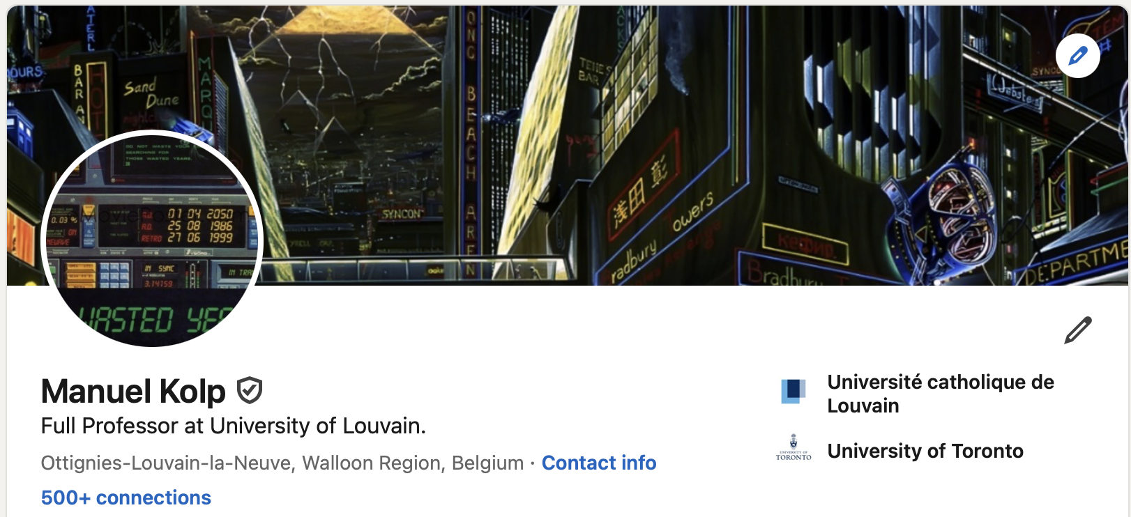


Instructors
3

Slide 4


What is the course about?
Digital transformation
  Process by which companies embed digital technologies across their businesses to drive fundamental change.
  Why?
    Increased efficiency
    Greater business agility
    Unlocking of new value for employees, customers, and shareholders.
  How? Many possible paths
    Cloud computing to enhance customer experience
    Machine learning to improve supply chain
    AI to predict demand
    Etc.
DIGITIZATION
Conversion of information into a digital format
DATAFICATION
Transformation of social action into data
DIGITALIZATION
Use of digital techno-logies to change business processes
4

Slide 5
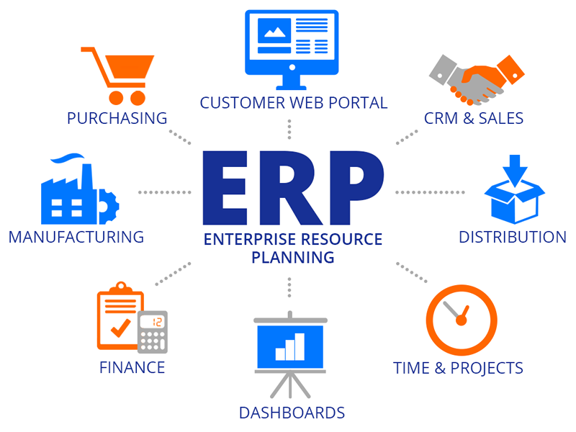
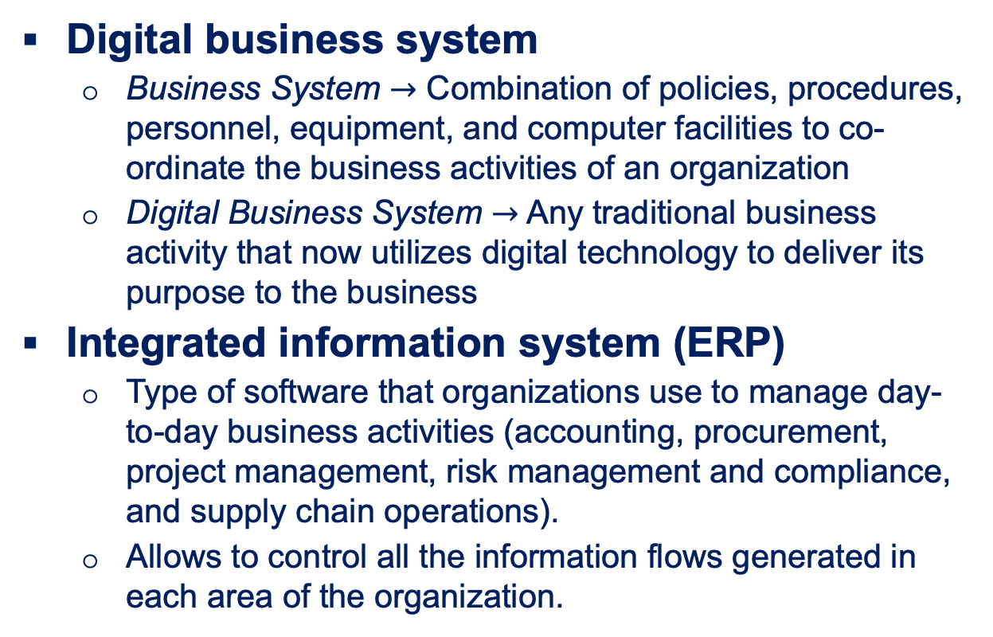
What is the course about? (2)
Digital business system
  Business System $→$ Combination of policies, procedures, personnel, equipment, and computer facilities to co-ordinate the business activities of an organization
  Digital Business System $→$ Any traditional business activity that now utilizes digital technology to deliver its purpose to the business
Integrated information system (ERP)
  Type of software that organizations use to manage day-to-day business activities (accounting, procurement, project management, risk management and compliance, and supply chain operations).
  Allows to control all the information flows generated in each area of the organization.
5

Slide 6

What is the course about? (3)
Strategic planning and coordination of all digital transformation processes aimed at improving the working and performance of an organization
Digital
Transformation MANAGEMENT
Identify and implement digital business processes that improve the customer experience, reduce friction, increase productivity, or enhance performance.
Collect, analyze, and visualize data. Turn it into insights that help an organization base its strategy on actionable information.
Lead a team of developers and data scientists.
Manage the organization’s business intelligence systems.
6

Slide 7





How is the course organized?
LECTURES
23 hours
GROUP WORK
Project-based learning
INDIVIDUAL WORK
Readings, study, quizzes, games
7

Slide 8

Schedule
Lectures
  S1 – Tuesday 15/09 – 13.00-16.00 – MONT 11 MK, YW, JC
  S1 – Thursday 17/09 – 16.15-18.15 – MONT 10 MK
  S2 – Tuesday 22/09 – 16.15-18.15 – STUD 11 MK
  S2 – Thursday 24/09 – 16.15-18.15 – MONT 10 MK
  S3 – Tuesday 29/09 – 16.15-18.15 – STUD 11 YW
  S3 – Thursday 1/10 – 16.15-18.15 – MONT 10 YW
  S4 – Tuesday 6/10 – 16.15-18.15 – STUD 11 YW
  S4 – Thursday 8/10 – 16.15-18.15 – MONT 10 JC
  S5 – Tuesday 13/10 – 16.15-18.15 – STUD 11 JC
  S5 – Thursday 15/10 – 16.15-18.15 – MONT 10 JC
  S6 – Tuesday 20/10 – 16.15-18.15 – STUD 11 TBA
  Group work
  Not supervised
  Time Slots booked on Tuesdays (MBE) and Thursdays (MMA)
  Instructors and teaching assistants are available upon request
  S7 – S8 – Online Presentations + Self and Peer Assessment
8

Slide 9
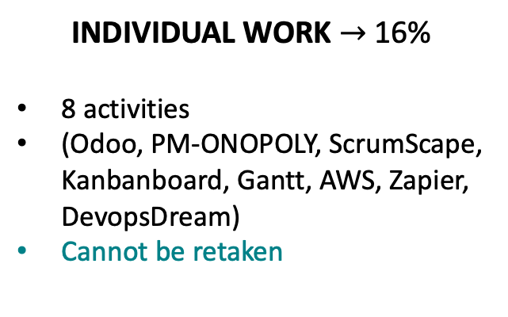
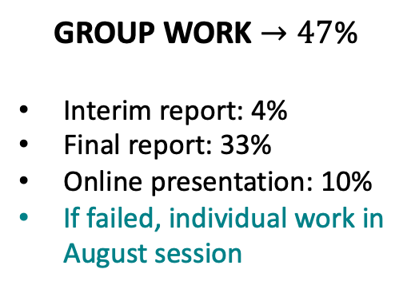
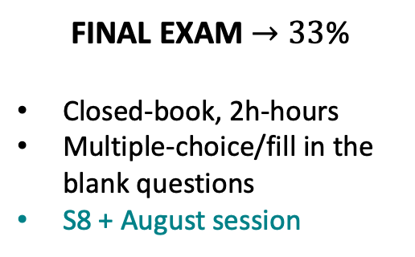
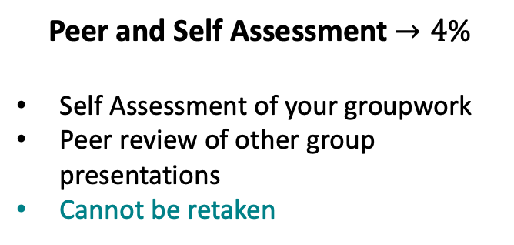
Assessment
FINAL EXAM $→33$%
Closed-book, 2h-hours
Multiple-choice/fill in the blank questions
S8 + August session
GROUP WORK $→47$%
Interim report: 4%
Final report: 33%
Online presentation: 10%
If failed, individual work in August session
INDIVIDUAL WORK $→$16%
8 activities
(Odoo, PM-ONOPOLY, ScrumScape, Kanbanboard, Gantt, AWS, Zapier, DevopsDream)
Cannot be retaken
Peer and Self Assessment $→4$%
Self Assessment of your groupwork
Peer review of other group presentations
Cannot be retaken
9

Slide 10
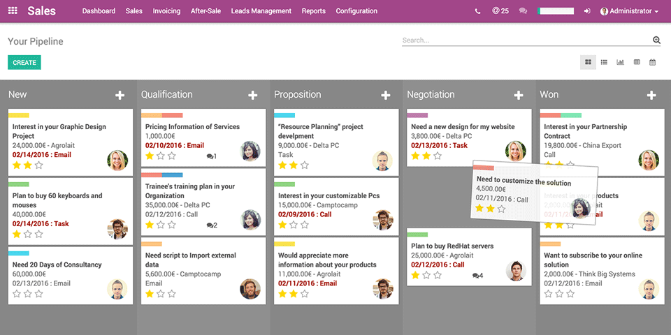
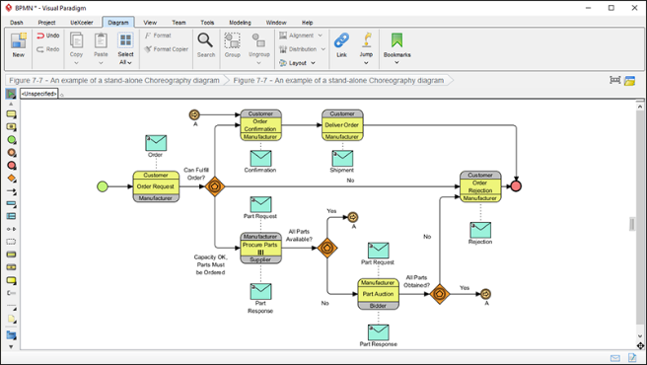
Odoo Project !! You agree to be committed to your group!!
IS/ERP Project with odoo.com - subject at your convenience –
Fictive (but realistic) organization
Group of max 6 students
Could be mix GEST/INGE
YOU compose your group: deadline Sept 27 (end of W2)
If not part of a group by 28/9 -> Individual project for August 2027
Draft Report (3 pages) by Week 3 (1/10)
Final Report (+/- 20 pages + annexes) by Week 8
15 min video presentation by Week 7
+ Peer Review with Comproved (2 pairs of presentations to review per student)
+ Self evaluation of your group work with Dynamo (commitment)
10

