Slide 1
Odoo

Slide 2
Outline
Creating an Odoo account
Odoo documentation
E-learning Platform
Odoo Scale Up Game: 1st individual assignment

Slide 3
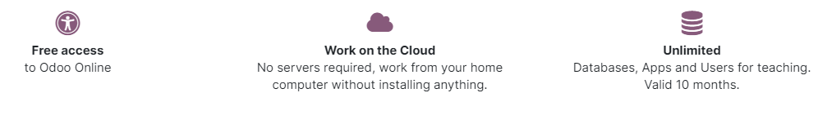
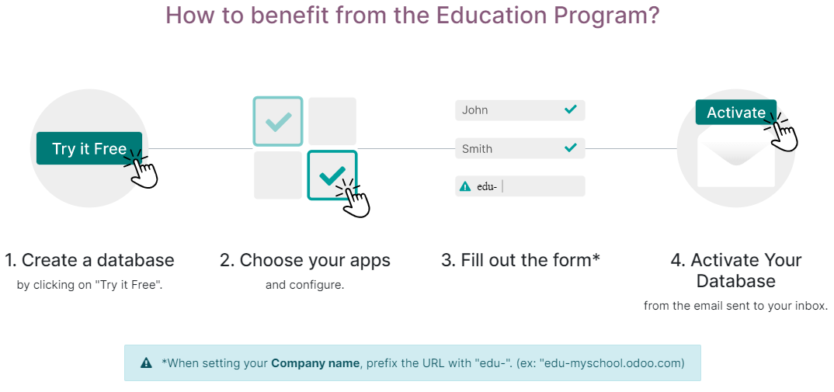
Odoo Education Program

Slide 4
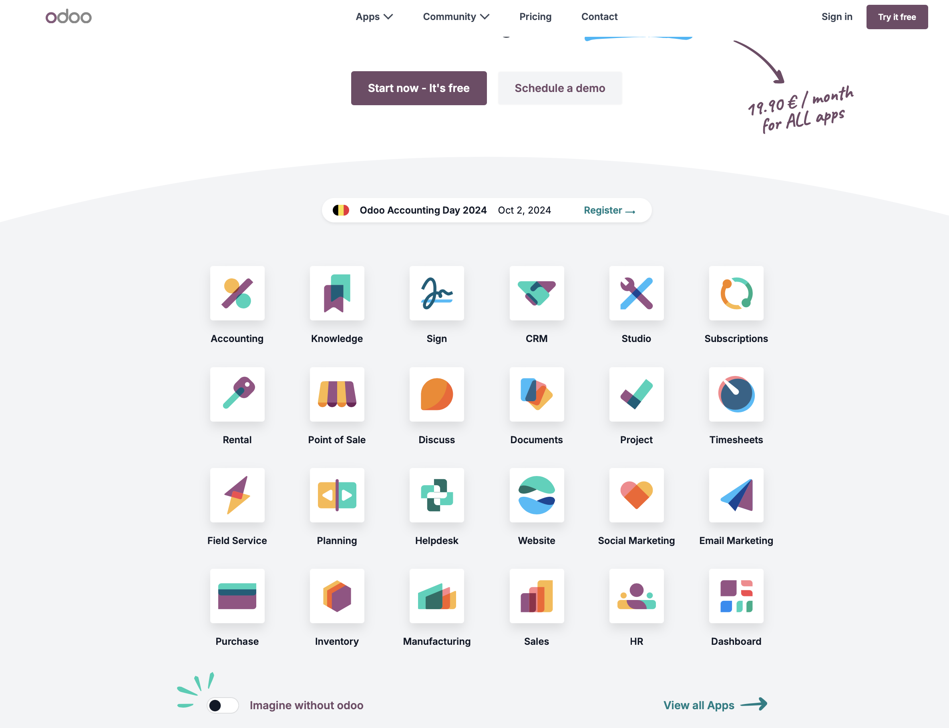
Creating an odoo account
Go to odoo.com
Click on SIGN IN.

Slide 5
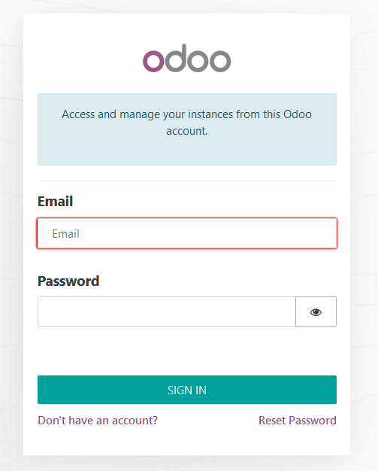
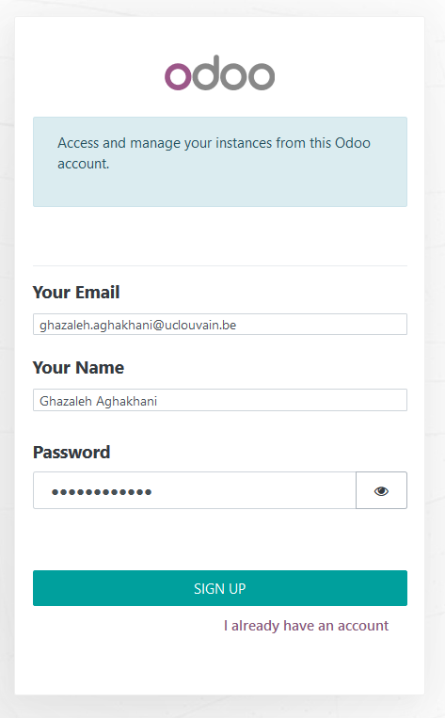
Creating an odoo account
Select Don't have an account? – Then fill in your information

Slide 6
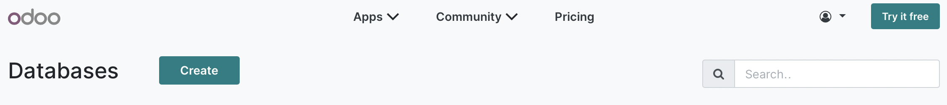
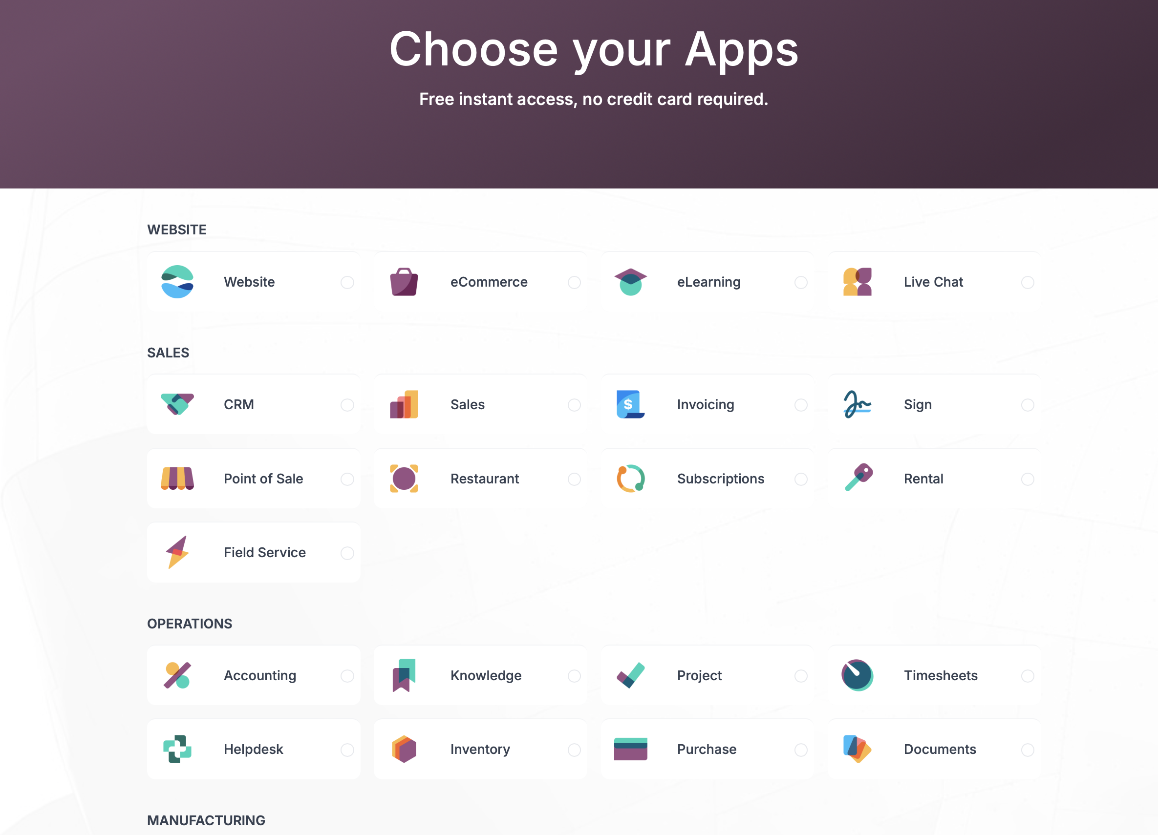
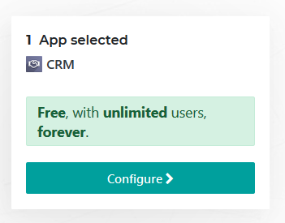
Creating an odoo account
To start, Choose any app and then select “Configure”.
1
2
3

Slide 7
Creating an odoo account
Get unlimited database for students. Be aware that an education database is valid for 24 months.
How to Start?
When you choose to start a free trial, just make sure that the url (under the Company name) starts with the prefix "edu-" (ex: "edu-myschool.odoo.com").
Your database will last 24 months, as long as you:
  Start the database name with "edu-"
  Activate your database from the email sent to your inbox.

Slide 8
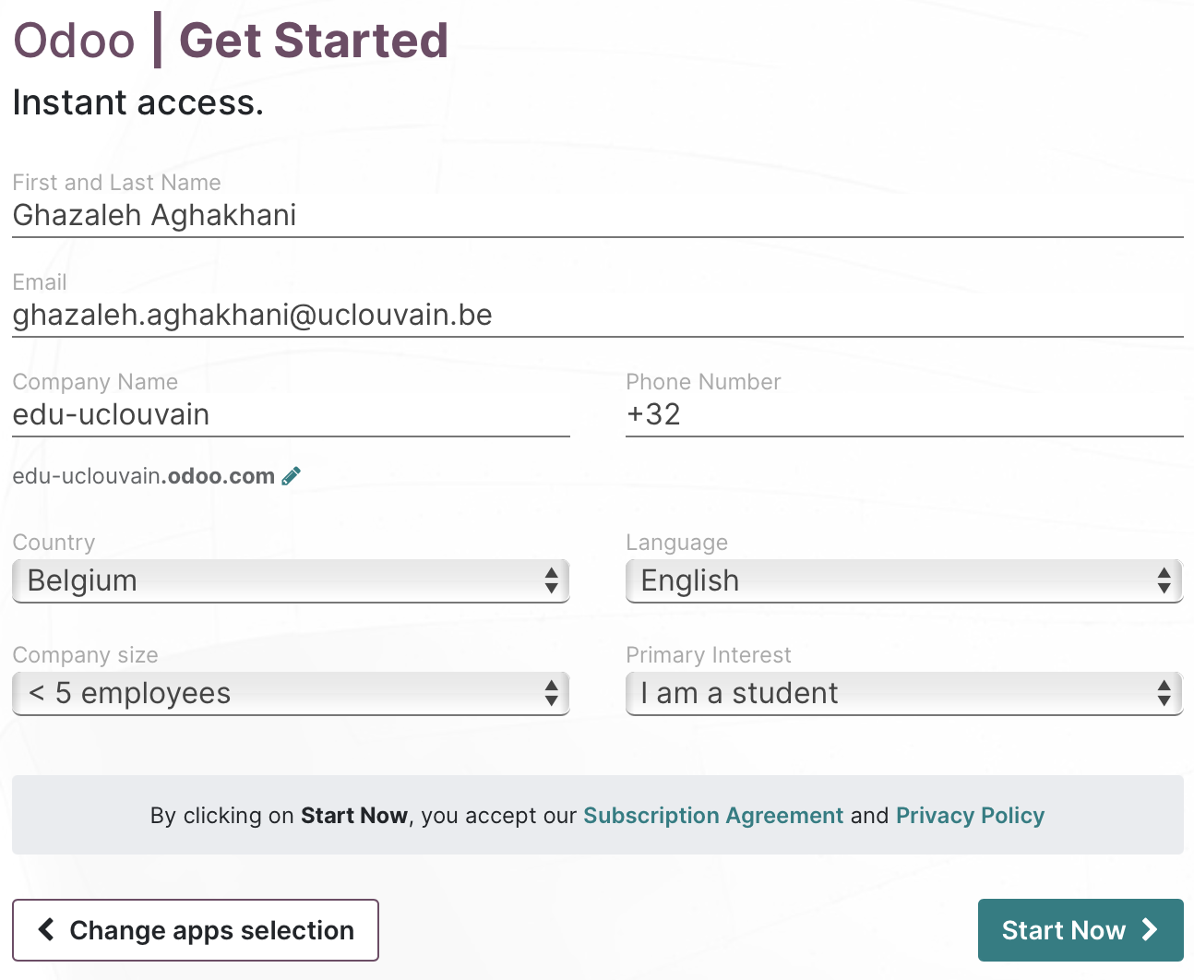
Creating an odoo account
Get access: fill in the information and activate

Slide 9
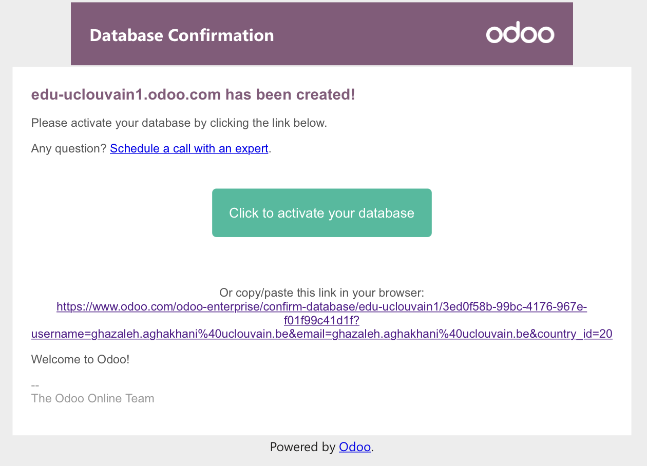
Creating an odoo account
Do not forget to activate your database via your email

Slide 10
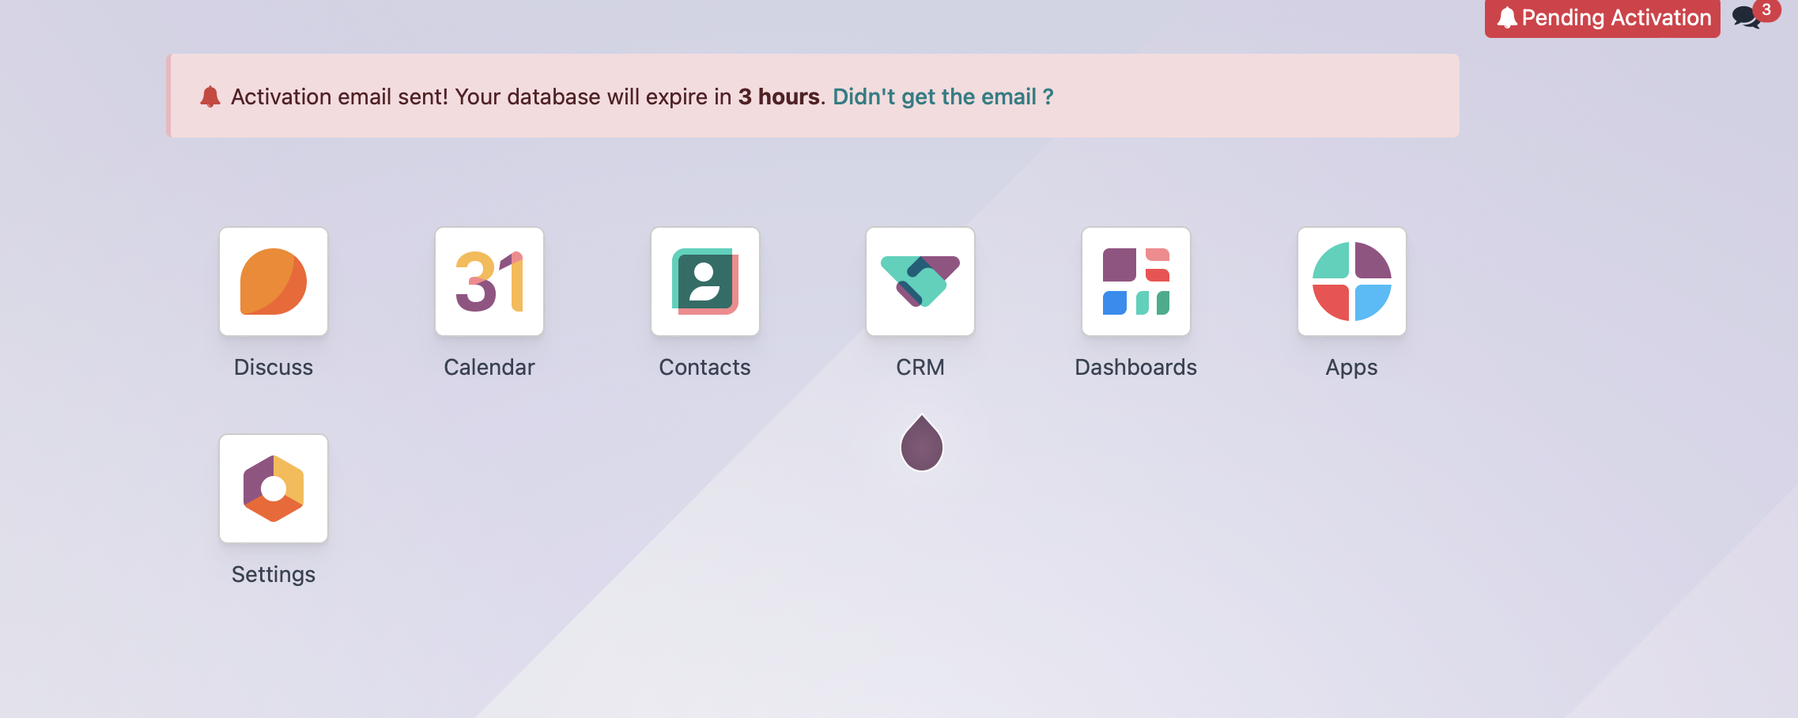
Creating an odoo account
You can start setting up your company database

Slide 11
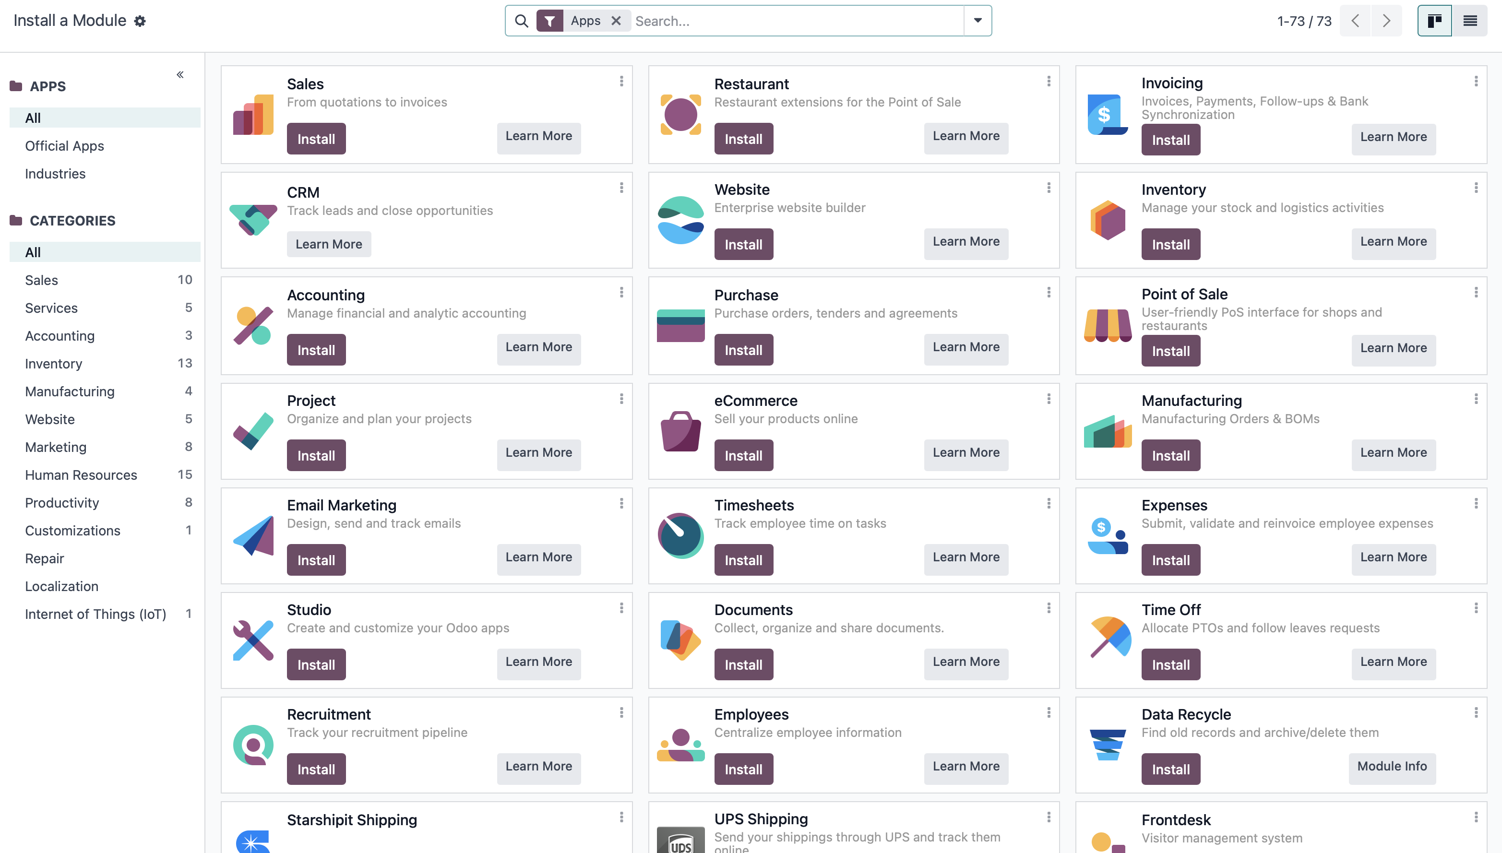
Creating an odoo account
You can install all the apps that you need for your company!!

Slide 12
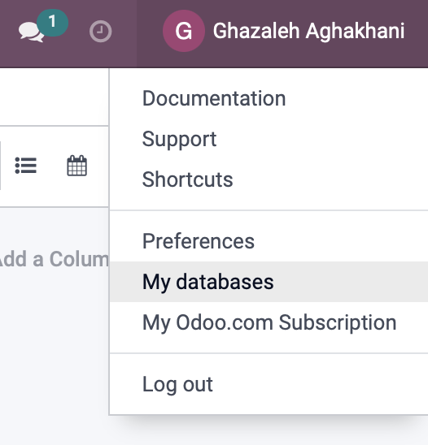
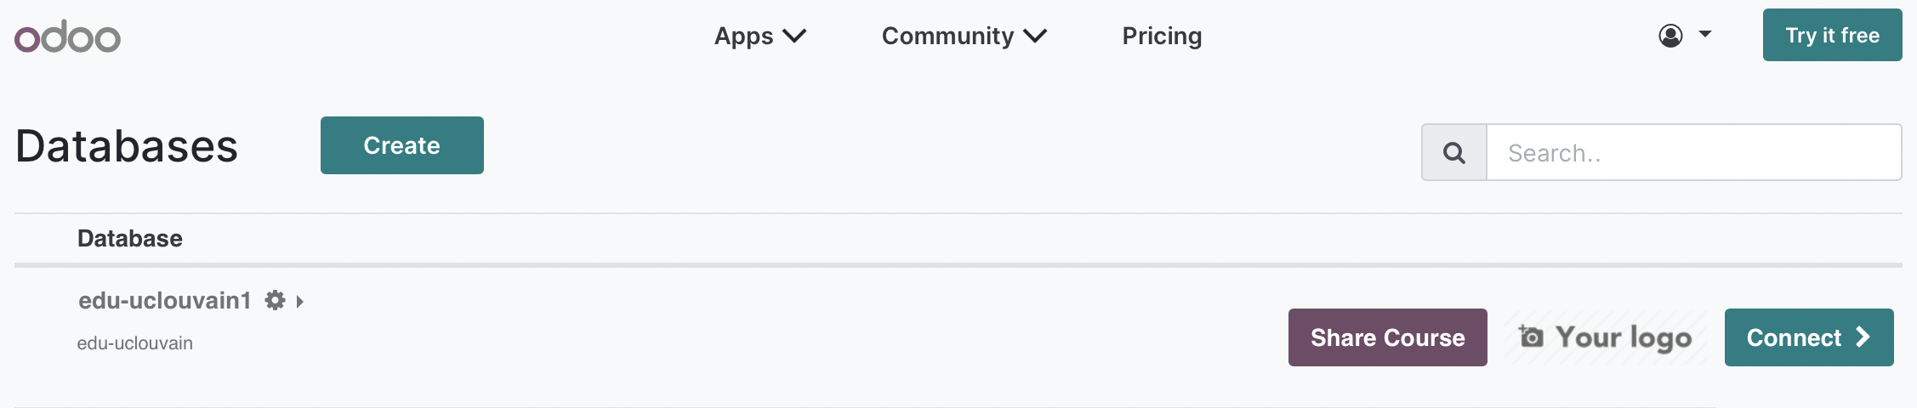
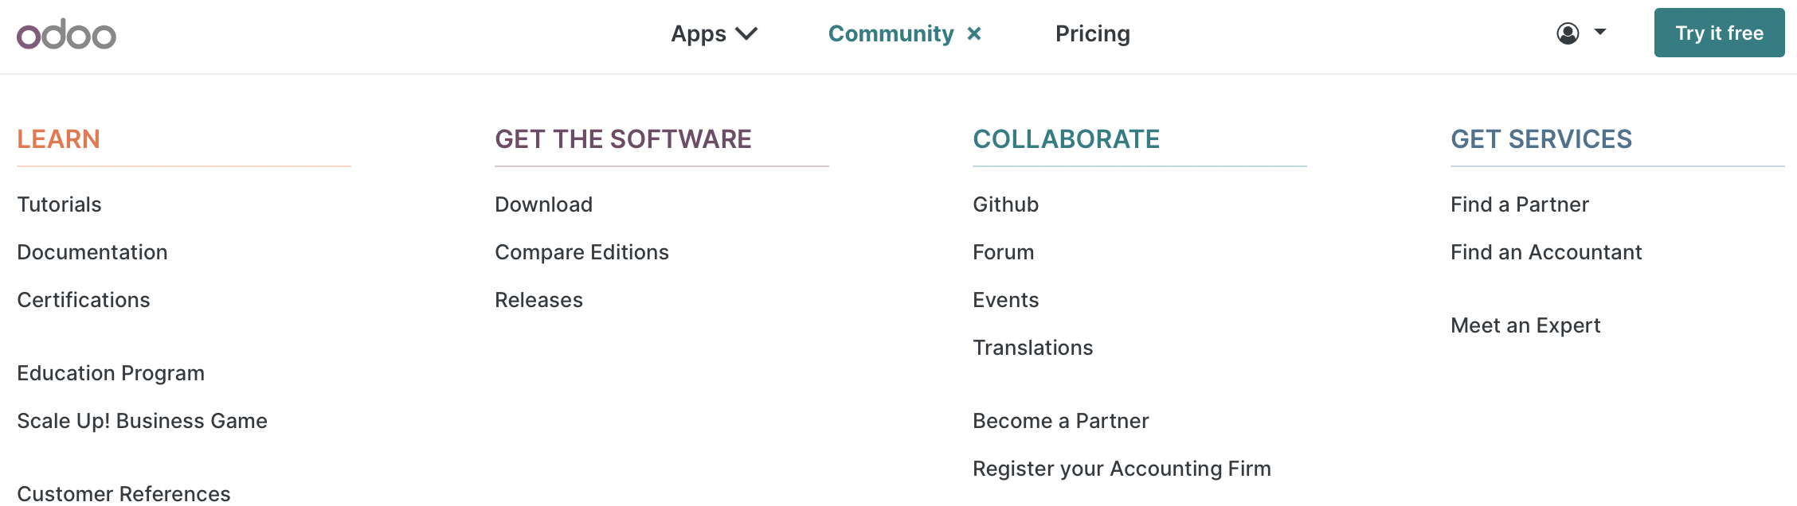
Tutorial and documentation

Slide 13
Odoo documentation
Useful Links: https://www.odoo.com/page/education-program
Read the Education Guidelines to make sure you're not missing any important information!
  Read the Odoo documentation to get started with Odoo quickly.
  Watch training videos on the E-learning platform! Watch videos, play quiz, win Karma points and develop your Odoo Superpower!
  Play & learn with our business game Scale-Up!
  It's free for teachers! How? Fill in the prepared email that pops-out when clicking on the "get it for free" link.

Slide 14
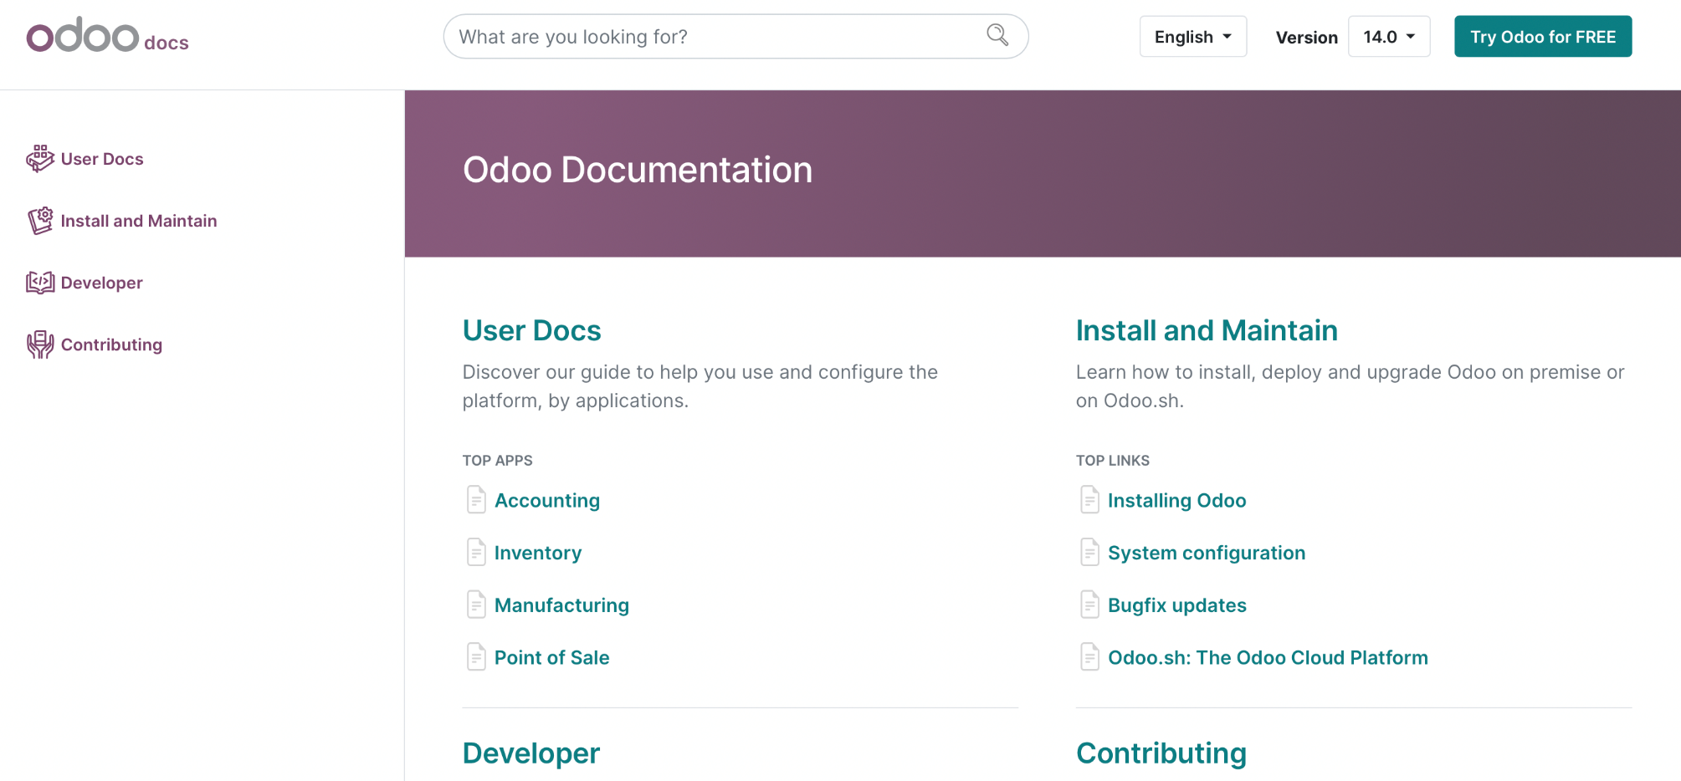
Odoo User Docs
https://www.odoo.com/documentation/

Slide 15
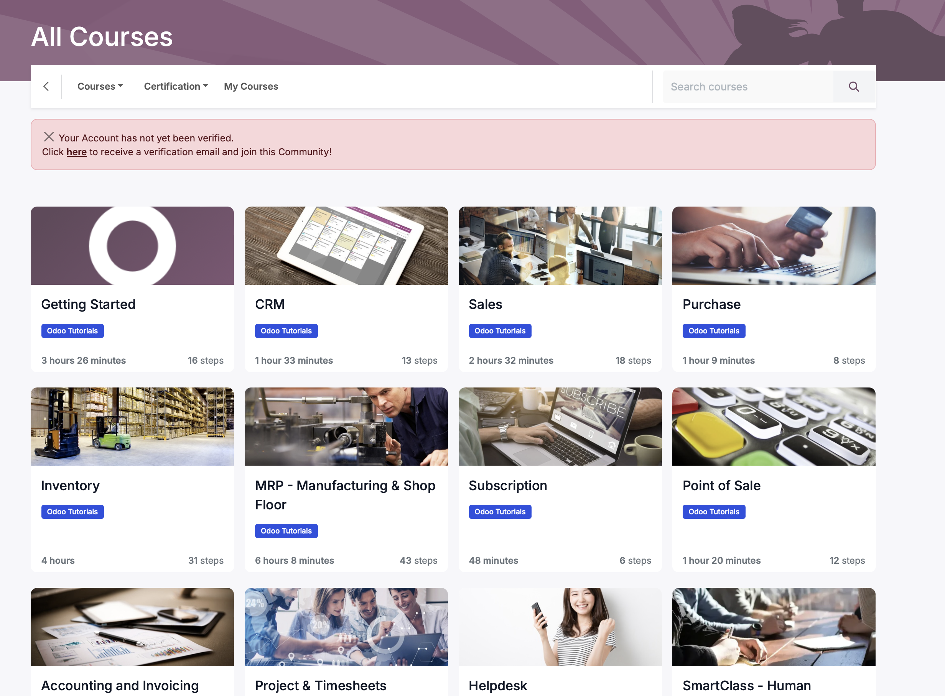
Tutorials
https://www.odoo.com/slides/all

Slide 16
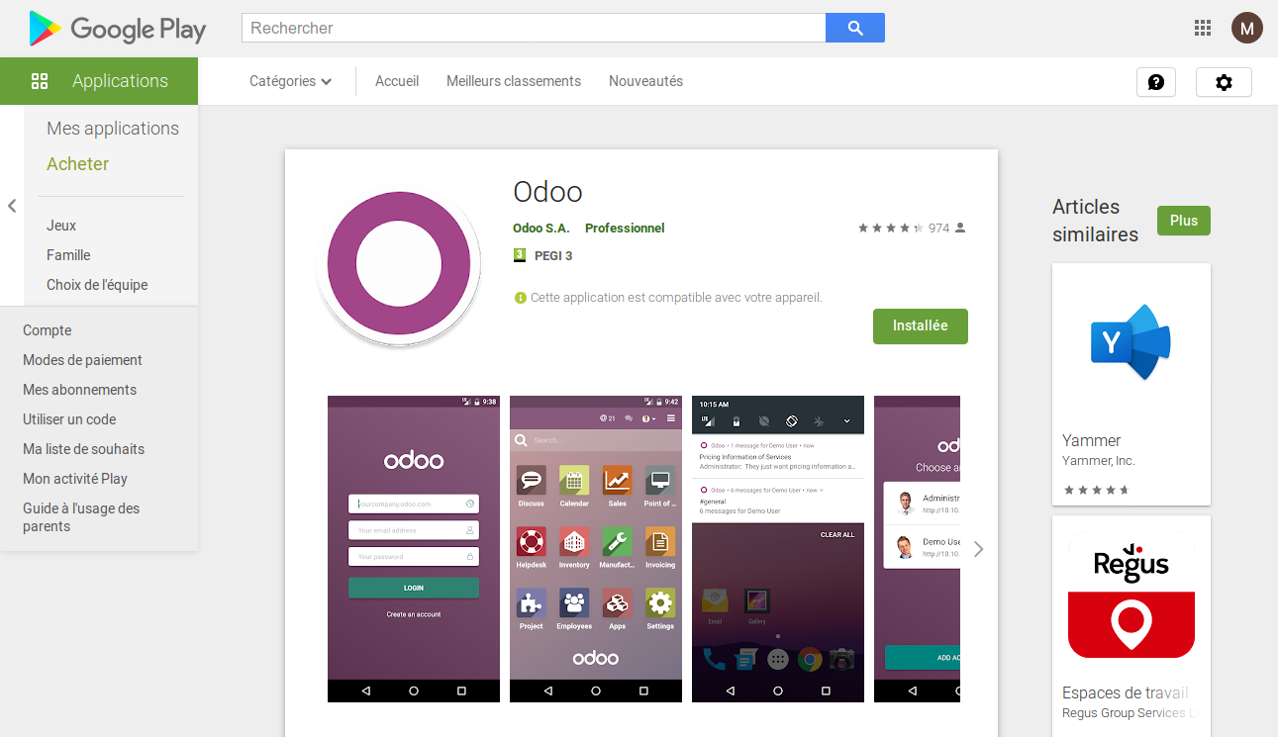
Ex.: Odoo mobile App
You can download the mobile app for Odoo from Google Play or App Store

Slide 17
Odoo Scale Up Game
First Individual Online Assignment
Individual Proof-of-work due on Moodle by 22/9
Scenarios: Blue Cards "Buy and Sell pp 3-22; Grey Cards "Run a Store" pp. 23-40; Green Cards "Manufacture" pp. 75-92
Submit as proof-of-work a doc including 3-4 screenshots for each exercice (Blue, Grey, Green)

