Slide 1
Numbers
Ordinal
Numbers
How do you say « 0 » in English?
Dates
Cardinal
Numbers
1, 2, 3, 4, 5, 6, 7, 8, 9, 10, …
1st, 2nd, 3rd, 4th, 5th, 6th, 7th, 8th, 9th, 10th, …
oh, nought, zero, nil, nothing, love
6 November 2012
November 6, 2012

Slide 2
Numbers
Cardinal numbers
1, 2, 3, 4, 5, 6, 7, 8, 9, 10, …

Slide 3
CARDINAL
NUMBERS
1 | one | 11 | eleven | 21 | twenty-one | 40 | forty
2 | two | 12 | twelve | 22 | twenty-two | 50 | fifty
3 | three | 13 | thirteen | 23 | twenty-three | 60 | sixty
4 | four | 14 | fourteen | 24 | twenty-four | 70 | seventy
5 | five | 15 | fifteen | 25 | twenty-five | 80 | eighty
6 | six | 16 | sixteen | 26 | twenty-six | 90 | ninety
7 | seven | 17 | seventeen | 27 | twenty-seven | 100 | a/one hundred
8 | eight | 18 | eighteen | 28 | twenty-eight | 1,000 | a/one thousand
9 | nine | 19 | nineteen | 29 | twenty-nine |  | a/one million
10 | ten | 20 | twenty | 30 | thirty |  | a/one billion
from 1 to a billion

Slide 4
CARDINAL
NUMBERS
Hundreds and tens are usually separated by 'and'
(in American English 'and' is not necessary).
Separation between hundreds and tens
110
one hundred and ten
1,250
one thousand, two hundred and fifty
2,001
two thousand and one

Slide 5
CARDINAL
NUMBERS
Tens and units are separated by ‘-'
(= a hyphen)
Separation between tens and units
21
twenty - one
42
forty - two
53
fifty - three

Slide 6
CARDINAL
NUMBERS
Use 'a' or 'one'
'a' can only stand at the beginning of a number
Hundreds
Thousands
Millions
100
a hundred / one hundred
2,100
two thousand one hundred
Use commas as separators
57,458,302

Slide 7
CARDINAL
NUMBERS
Numbers are usually written in the singular
Singular or Plural?
two hundred euros
several thousand light years

Slide 8
CARDINAL
NUMBERS
The plural is only used with dozen, hundred, thousand,
million, billion, when they are used in a indefinite sense (then also with ‘of’)
Singular or Plural?
hundreds of Euros
thousands of light years

Slide 9
Numbers
Ordinal Numbers
1st, 2nd, 3rd, 4th, 5th,
6th, 7th, 8th, 9th, 10th, …

Slide 10
ORDINAL
NUMBERS
1st | first | 11th | eleventh | 21st | twenty-first | 40th | fortieth
2nd | second | 12th | twelfth | 22nd | twenty-second | 50th | fiftieth
3rd | third | 13th | thirteenth | 23rd | twenty-third | 60th | sixtieth
4th | fourth | 14th | fourteenth | 24th | twenty-fourth | 70th | seventieth
5th | fifth | 15th | fifteenth | 25th | twenty-fifth | 80th | eightieth
6th | sixth | 16th | sixteenth | 26th | twenty-sixth | 90th | ninetieth
7th | seventh | 17th | seventeenth | 27th | twenty-seventh | 100th | hundredth
8th | eighth | 18th | eighteenth | 28th | twenty-eighth | 1,000th | thousandth
9th | ninth | 19th | nineteenth | 29th | twenty-ninth |  | millionth
10th | tenth | 20th | twentieth | 30th | thirtieth |  | billionth
first
to
billionth

Slide 11
ORDINAL
NUMBERS
Just add th to the cardinal number
Form
four
4th
fourth
Exceptions
one
1st
first
two
2nd
second
three
3rd
third

Slide 12
ORDINAL
NUMBERS
Just add th to the cardinal number
Form
four
4th
fourth
Change in spelling
five
5th
fifth
eight
8th
eighth
nine
9th
ninth
twelve
12th
twelfth

Slide 13
ORDINAL
NUMBERS
In names of kings and queens, ordinal numbers are written in Roman numerals.
In spoken English, the definite article ‘the’ is used before the ordinal number.
Titles
Edward I
Edward the First
Henry VIII
Henry the Eighth

Slide 14
Numbers
oh, nought, zero,
nil, nothing, love
How do you say 0 in English?

Slide 15
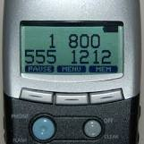
O
phone numbers
account numbers
room numbers
bus numbers
Each figure is said separately.
oh

Slide 16
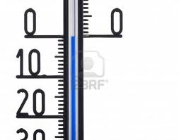
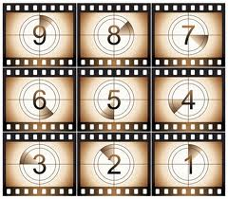
O
zero degrees
Zero
when measuring temperatures
in countdowns
9,8,7,6,5,4,3,2,1 … zero

Slide 17
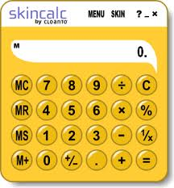
O
Decimal point
0.05 %
nought point nought/oh
five
zero point zero/oh five
nought
oh only AFTER the decimal
point
nought
zero
oh

Slide 18
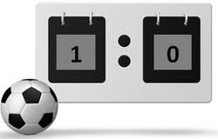
O
zero
nil
for scores in team sports,
e.g. football
1 - zero
1 - nil

Slide 19
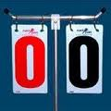
O
For scores in tennis
love
love

Slide 20
O
What is the origin of
'love‘ in tennis scoring?
debatable
Some say it’s French, "l’oeuf", meaning "egg", which looks like a zero.
Others say it’s an English term, along the lines of "playing for love" (as in, if you’re scoring zero, you must be playing because you love it, because you’re not good at it.)
love

Slide 21
Numbers
Dates
6th November 2012
November 6, 2012

Slide 22
DATES
If the last two figures = 00 → 09
Say :
the first two figures are a number
oh
the last figure is a number.
or
Say :
the first two figures are a number
hundred and
the last two figures are a number.
1806
Years
eighteen
oh
six
eighteen
hundred and
six

Slide 23
DATES
If the last two figures = 10 → 99
Say :
the first two figures are a number
the last two figures are a number.
or
Say :
the first two figures are a number
hundred and
the last two figures are a number.
1999
Years
nineteen
ninety-nine
nineteen
hundred and
ninety-nine

Slide 24
DATES
Years
1900
nineteen hundred
849
eight forty-nine
2001
two thousand and one
2012
two thousand and twelve OR twenty twelve

Slide 25
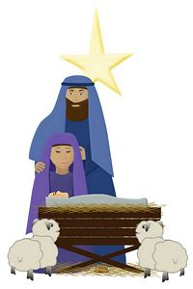
DATES
Years
BC
AD
= before Christ
(English)
Birth of Christ
= Anno Domini (Latin)
= after Christ
(English)

Slide 26
Written English
DATES
Dates
British English
American English
6th November 2012
November 6, 2012
Spoken English
British English
American English
the sixth of November
two thousand and twelve
November the sixth
two thousand and twelve

Slide 27
Numbers
Time
It’s half past two.
It’s two thirty.

Slide 28
Time

Slide 29
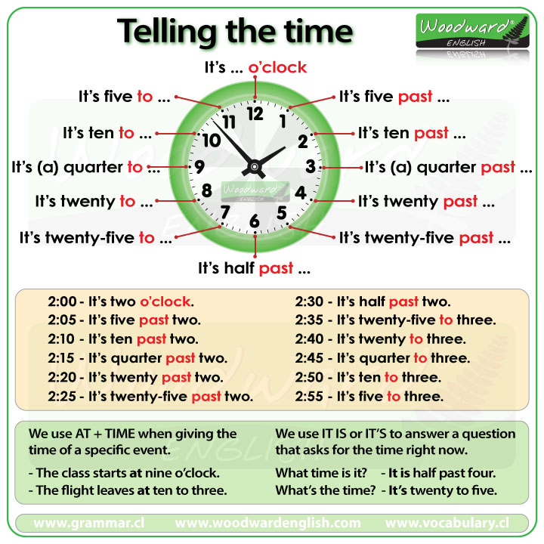
Time

