Slide 1
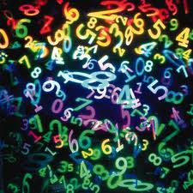
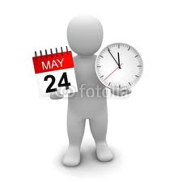
Numbers and dates
Key to the exercises

Slide 2
Numbers
Phonetics

Slide 3
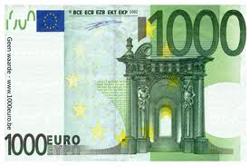
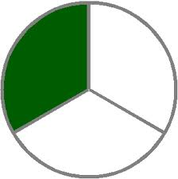
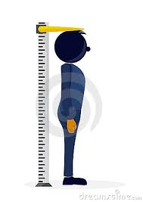
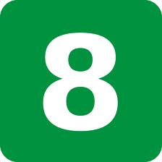
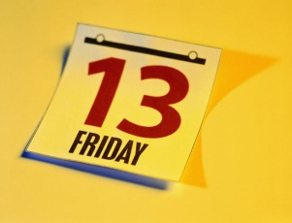
1. Identify the following numbers :
[ wʌn ]
[ ə ˈθaʊzn̩d ]
[ ˈθɜːd ]
[ eɪt ]
>< [ haɪt ]
e) [ ˌθɜːˈtiːnθ ]
one
a thousand
third
eight
>< height
e) thirteenth

Slide 4
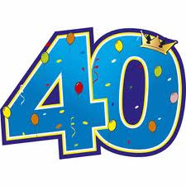
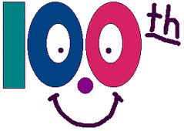
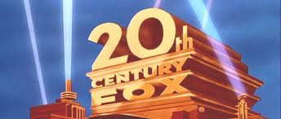
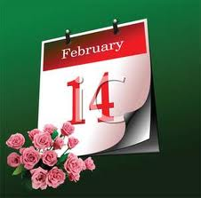
1. Identify the following numbers :
[ ˈfɔːti ]
[ ˈhʌndrədθ ]
[ ˈtwentɪəθ ]
[ ˌfɔːˈtiːnθ ]
[ ˈsekənd ]
forty
hundredth
twentieth
fourteenth
second

Slide 5
Numbers and dates
How do you say them ?

Slide 6
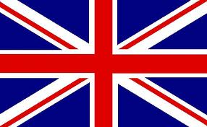
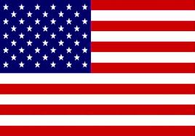
How do you say the following numbers and dates ?
462
1/2
2,345
33
e) 0.7
four hundred and sixty-two
a/one half [ə hɑːf ]
two thousand three hundred and forty-five
thirty-three
nought point seven
zero point seven

Slide 7
How do you say the following numbers and dates ?
1/3
1,250,000
2,000,000
¾
52%
a/one third
a / one million two hundred and fifty thousand
two million
three quarters
fifty-two percent [pəˈsent ]

Slide 8
How do you say the following numbers and dates ?
602 8477 (phone number)
Elizabeth I
September, 10th
22 July
in 1903
in 1876
six oh two eight four double seven
Elizabeth the First
the tenth of September
the twenty-second of July
in nineteen oh three
in eighteen (hundred and) seventy-six

Slide 9
Important facts about British History
Do you know any of the missing dates ?

Slide 10
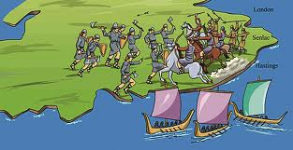
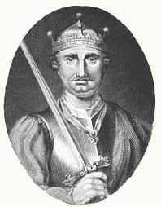
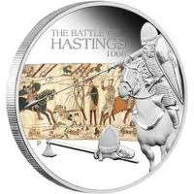
a. England hasn’t been successfully invaded since …
William
the Conqueror
1066

Slide 11
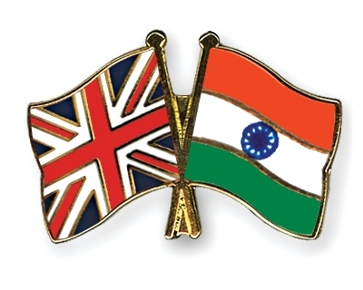
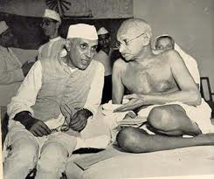
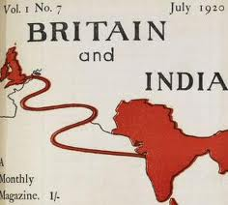
b. Britain hasn’t governed India since …
1947

Slide 12
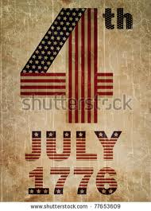
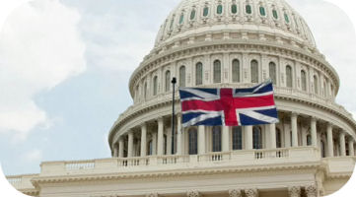
c. Britain hasn’t governed the United States since
1776

Slide 13
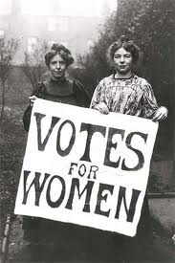
d. Women in Britain have had the vote since …
1918
for women over the age of 30
1928
suffrage rights for women = same as those for men

Slide 14
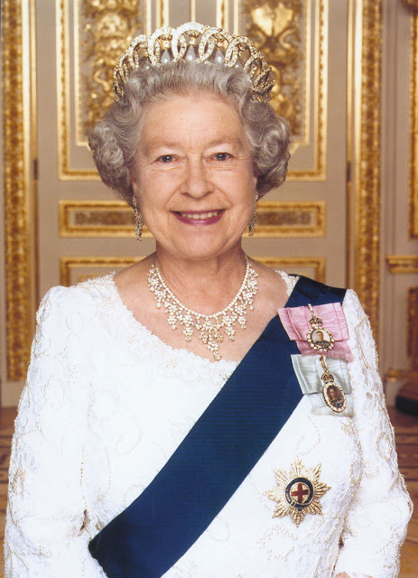
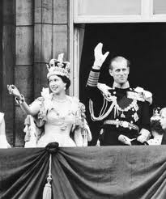
e. Queen Elisabeth II has been Queen since …
1952

Slide 15
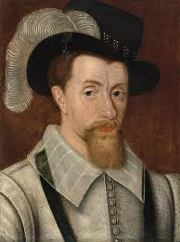
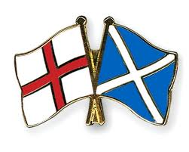
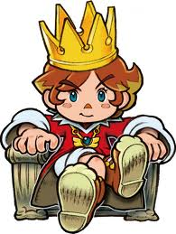
f. England and Scotland have had the same king since …
King James I
1603

Slide 16
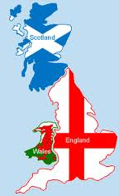
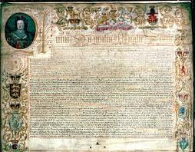
g. The kingdoms of England, Wales and Scotland became the new states of Britain in …
1707

Slide 17
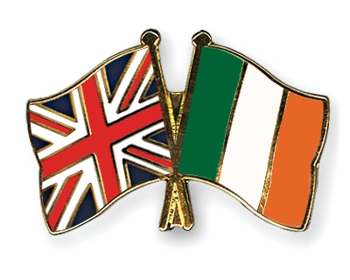
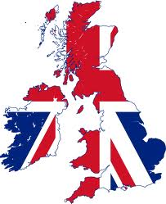
h. Great-Britain and Ireland merged to form the United Kingdom of Great-Britain and Ireland in …
1801

Slide 18
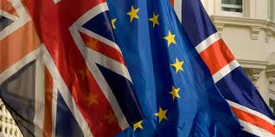
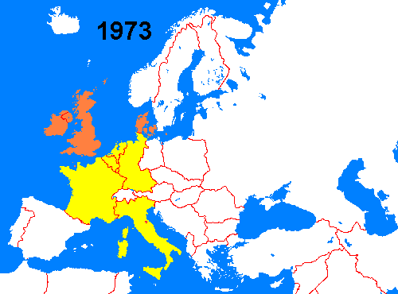
i. Britain has been a member of the European Community since …
1973

Slide 19
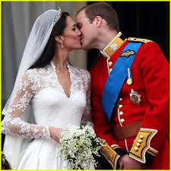
j. Prince William got married to Kate Middleton in …
2011

