Slide 1
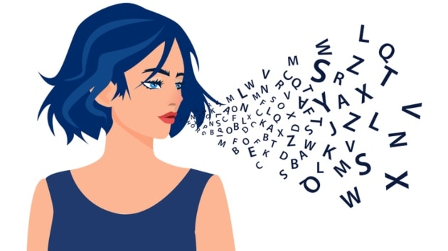
Pronunciation – week 5

Slide 2
Reading Aloud
Pronunciation ED – ENDINGS P40
“The patient waited in the waiting room, visited the clinic for his session, washed his hands, booked the next appointment, and played a balance game with the physio.”
/ðə ˈpeɪʃnt ˈweɪtɪd ɪn ðə ˈweɪtɪŋ ruːm, ˈvɪzɪtɪd ðə ˈklɪnɪk fə hɪz ˈseʃn̩, ˈwɒʃt hɪz hændz, bʊkt ðə nekst əˈpɔɪntmənt, ənd ˈpleɪd ə ˈbæl(ə)ns ɡeɪm wɪð ðə ˈfɪziəʊ/

Slide 3


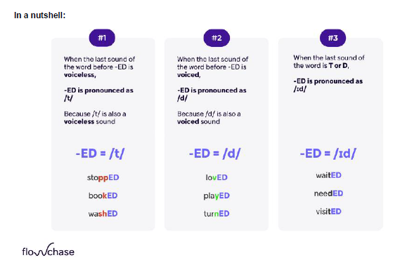
/t/
P → helped
K → looked
SH → washed
CH → watched
GH → laughed
TH → breathed
SS → kissed
C → danced
X → fixed
= voiceless
ED Endings
/ d/
L → called
N → cleaned
R → offered
G → damaged
V → loved
S → used
W → followed
Y → enjoyed
Z → amazed
= voiced
/ id/
T → wanted
D → needed

Slide 4
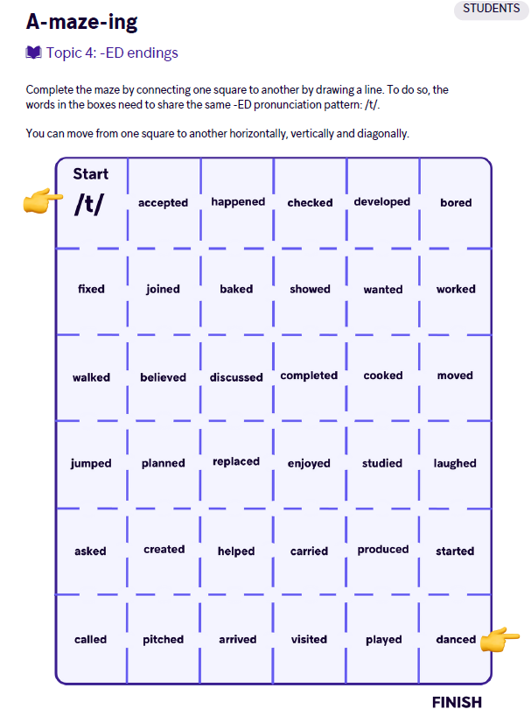
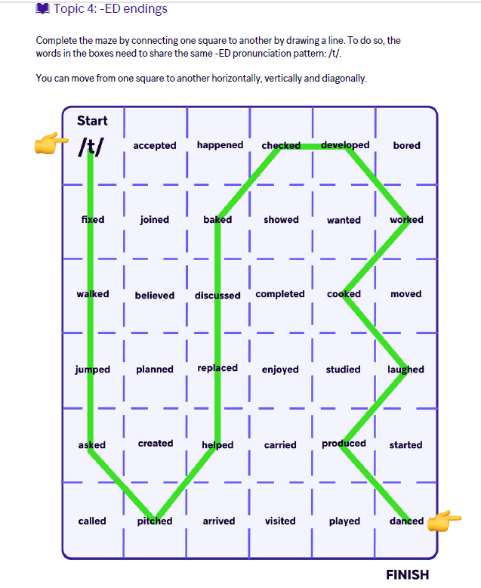
ED Endings

Slide 5
Reading Aloud (Final – S)
The physiotherapist watches the patient closely, catches the ball, sings a tune, and washes the equipment after the session.
She mixes the oils, bags the tools, and updates the progress graphs at the end of each appointment.
/ðə ˌfɪziəʊˈθerəpɪst ˈwɒtʃɪz ðə ˈpeɪʃnt ˈkləʊsli, ˈkætʃɪz ðə bɔːl, sɪŋz ə tjuːn, ənd ˈwɒʃɪz ði ɪˈkwɪpmənt ˈɑːftə ðə ˈseʃn̩/
/ʃi ˈmɪksɪz ði ɔɪlz, bæɡz ðə tuːlz, ənd ˈʌpdeɪts ðə ˈprəʊɡres ɡrɑːfs æt ði end əv iːtʃ əˈpɔɪntmənt/

Slide 6

FINAL S
/ Z/
B → crabs
D → words
G → bags
L → deals
M → dreams
N → fans
NG → sings
R → wears
V → gloves
Y → plays
= voiced
/S/
P → sleeps
K → books
T → hats
F → cliffs
PH → graphs
TH → myths
= voiceless
/ iZ/
C → wanted
S → buses
X → boxes
Z → prizes
SS → kisses
CH → watches
SH → dishes
GE → changes
= sibilant

Slide 7
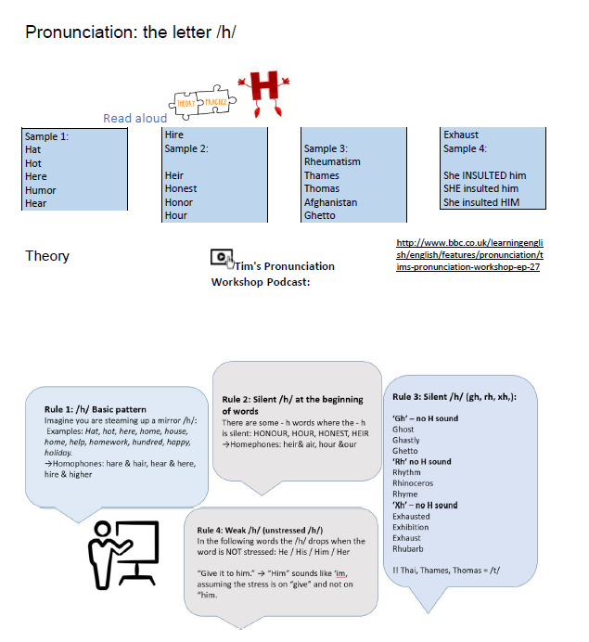
The letter /h/

Slide 8
Word stress : Reading Aloud
2nd syllable
PhoTOgraphy
SoCIety
3rd syllable
photoGRAphic
volunTEER
information
1st syllable
PHOtograph
PENcil
“The patient showed hesitation but gave a scientific analysis of the gym’s climate to develop better recovery graphs.”
/ðə ˈpeɪʃnt ʃəʊd ˌhezɪˈteɪʃən bʌt ɡeɪv ə ˌsaɪənˈtɪfɪk əˈnæləsɪs əv ðə dʒɪmz ˈklaɪmət tə dɪˈveləp ˈbɛtə rɪˈkʌvəri ɡrɑːfs/
Word stress summary:
hesitation — /ˌhezɪˈteɪʃən/ (3rd syllable)
scientific — /ˌsaɪənˈtɪfɪk/ (3rd syllable)
analysis — /əˈnæləsɪs/ (2nd syllable)
climate — /ˈklaɪmət/ (1st syllable)
develop — /dɪˈveləp/ (2nd syllable)
recovery — /rɪˈkʌvəri/ (2nd syllable)

Slide 9
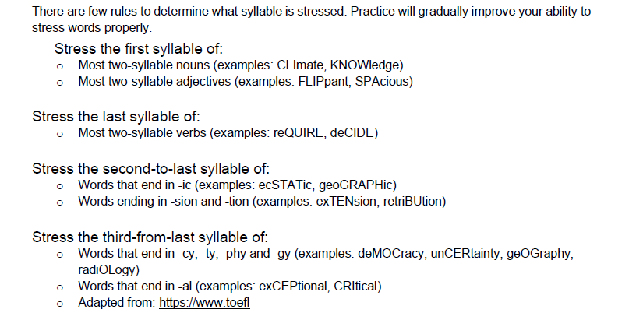

Slide 10
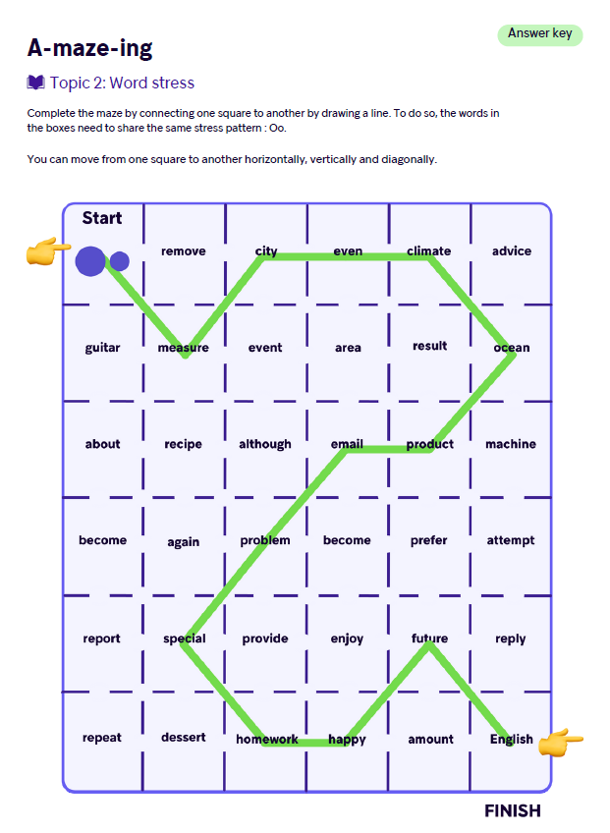
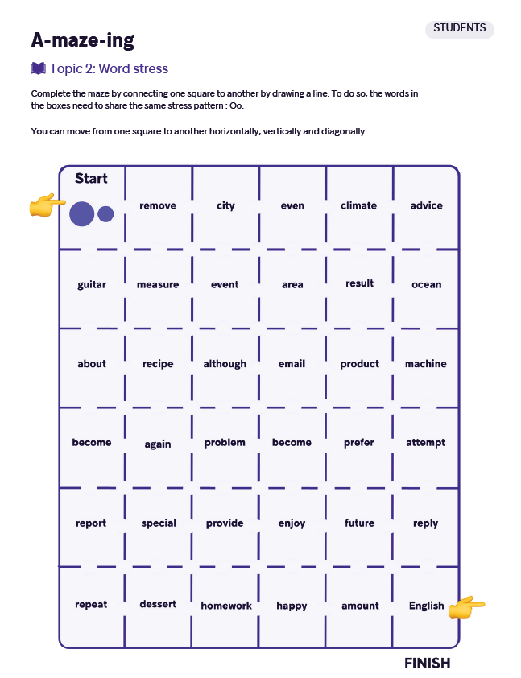
Word Stress

Slide 11
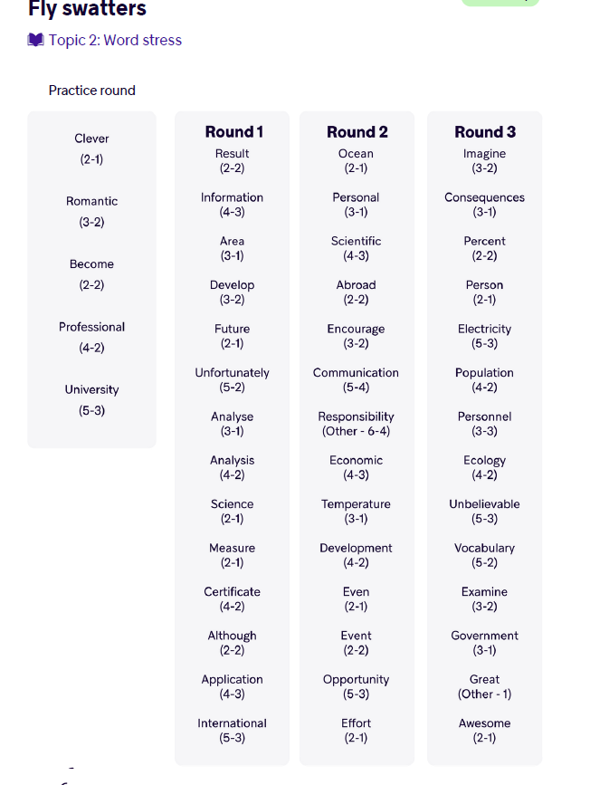
Word Stress
! PopuLAtion

Slide 12
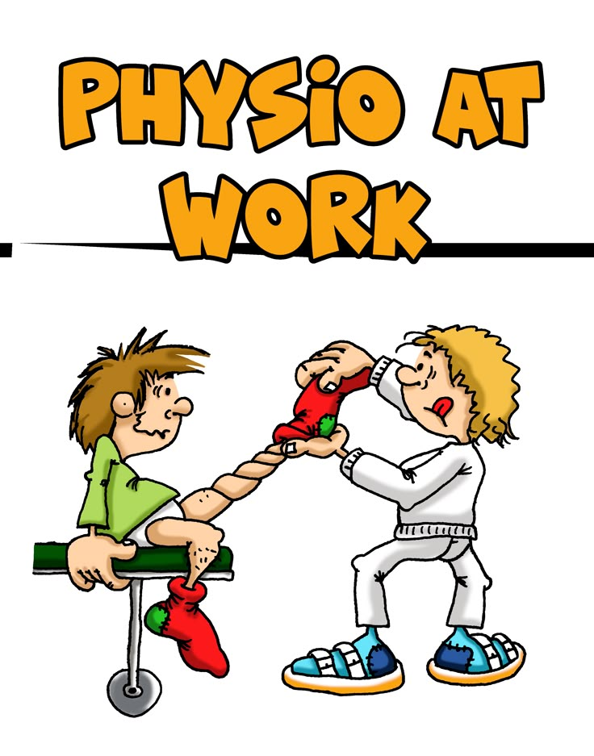
Sentence Stress – Reading Aloud
Physio 1: “No, last one! If you don’t stretch now, the patient won’t recover!”
Physio 2: “Alright, alright, I’ll stretch — but only after I check the graphs one more time!”

Slide 13

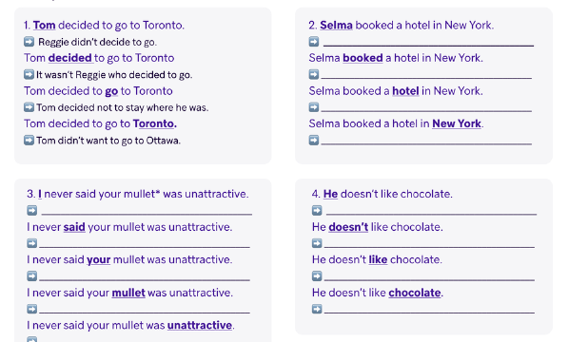

Sentence Stress
Most non – stressed words are FUNCTION WORDS, such as:
Determiners: the, a, some
Prepositions: before, next to, opposite
Pronouns: they, she, us
Auxiliary verbs: am, can, were
Conjunctions: while, as
Most stressed words are CONTENT WORDS, such as:
Nouns: kitchen, Peter
Adjectives: beautiful, interesting
Lexical verbs: visit, construct
Adverbs: often, carefully
Emphatic stress: function words can be stressed too.
A sentence can have many meanings based on the word you stress.

