Slide 1
ENGLISH +

Slide 2
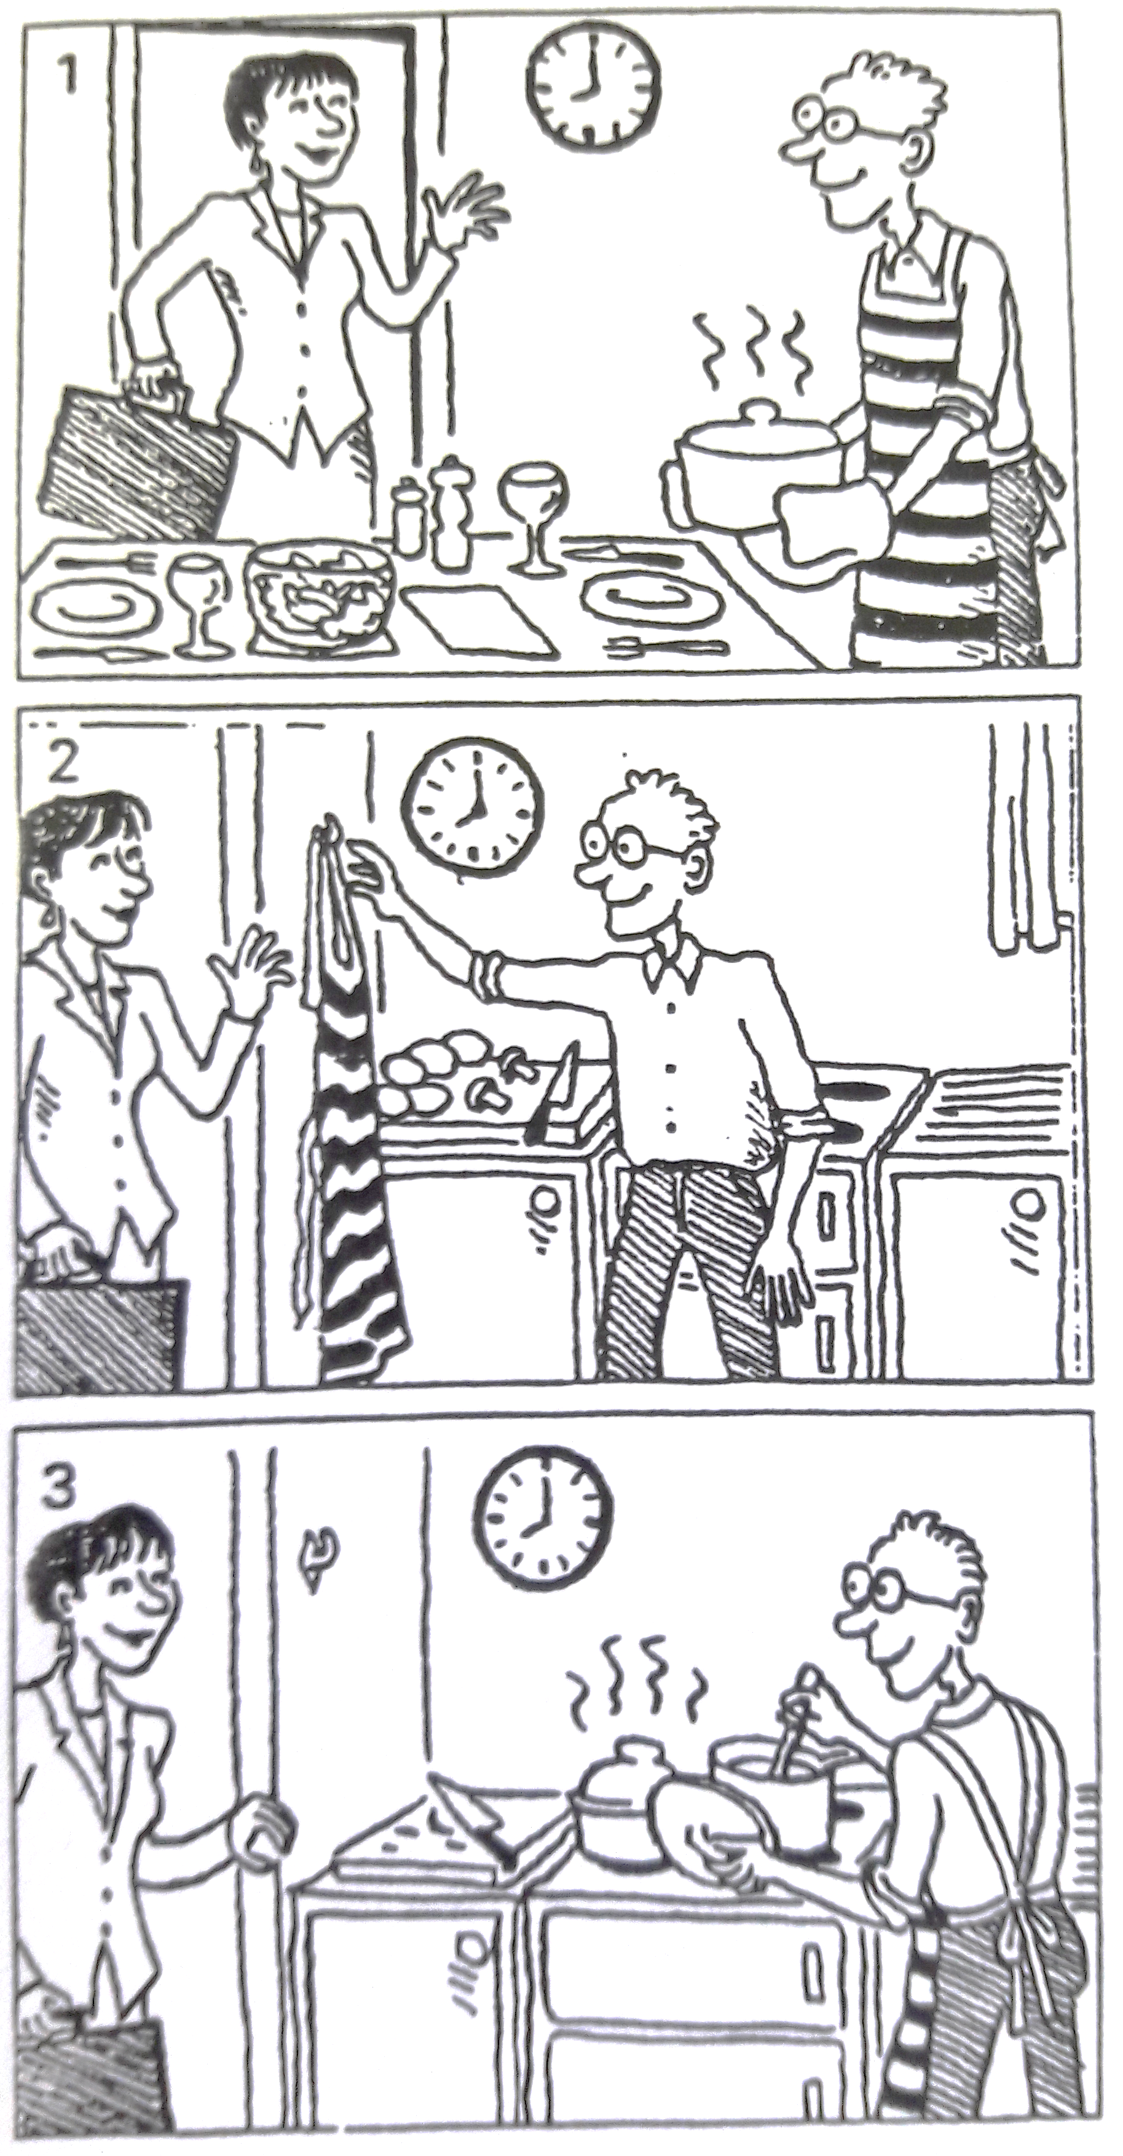
Past tenses
Match each picture with one of these sentences:
When Sylvia arrived at 8.00 pm, Tim cooked the dinner.
When Sylvia arrived at 8.00 pm, Tim was cooking the dinner.
When Sylvia arrived at 8.00 pm, Tim had cooked the dinner.

Slide 3
Past tenses
When Judy called Bree was watching TV and Tom had finished his homework.

Slide 4
Past tenses
When Judy called Bree was watching TV and Tom had finished his homework.

Slide 5
Past tenses
When Judy called Bree was watching TV and Tom had finished his homework.
Present

Slide 6
Past tenses
When Judy called Bree was watching TV and Tom had finished his homework.
Present

Slide 7
Past tenses
When Judy called Bree was watching TV and Tom had finished his homework.
Present

Slide 8
Past tenses
When Judy called Bree was watching TV and Tom had finished his homework.
Present

Slide 9
Past tenses – underline the correct tense
It was ten o'clock in the evening. Peter (a) sat/had sat down on his sofa and thought about the day. What a busy day it (b) was!/had been! This was his first night in his own flat. He (c) lived / had lived his entire life in the family home, and now for the first time, he (d) was / had been on his own. He sat surrounded by boxes that they (e) didn't manage / hadn't managed to unpack during the day. It (f) took / had taken months to get all his things together. His mother (g)was / had been very generous, buying him things like towels and mugs. He (h) went/had gone into the kitchen and (1) got/had got a beer from the fridge. He suddenly u) felt / had felt very tired and yawned. No wonder he (k) was /had been tired! He (I) was / had been up since six o'clock in the morning. He (m) decided /had decided to finish his beer and go to bed.

Slide 10
Past tenses – Choose the correct answer
……………………………….. when you left the house?
Did it rain
Was it raining
Had rained
Joanne……………………………….. Luis for years but she recognized him immediately.
didn’t saw
wasn’t seeing
hadn’t seen
Sarah's parents ……………………………….. for her when she got home.
were waiting
wasn’t waiting
waited

Slide 11
Past tenses – Choose the correct answer
The music ……………………………….. when the curtains opened.
was already starting
had already started
did already start
When I (arrive) ……………………………….. at the party, everybody (dance) ………………………………..
arrived – was dancing
arrived – danced
was arriving – danced

Slide 12
Past tenses – Fill in the blanks
got
My brother ……………………………………. (get) married last year.
We……………………………………. (have) dinner when Sally called.
John got to the cinema late and the film …………………………………….(start) when he arrived.
I was driving home when the accident ……………………………………. (happen).
…………………………………….(you / watch) TV when I phoned?
I knew the answer but I ……………………………………. (not know) how to phrase it.
were having
had started
happened
Were you watching
didn‘t know

